Slide 1
World War II
EQ: Why was the US drawn into WWII despite efforts to remain neutral? How did the US emerge from WWII as a superpower?

Slide 2
Europe on the Brink of War
Issues in Europe in the 1930’s:
Worldwide economic depression.
Germany suffered harsh punishments from WWI & The Treaty of Versailles

Slide 3
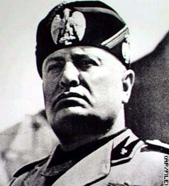
The Rise of Dictators in Europe and Asia
Italy – Benito Mussolini

Slide 4
The Rise of Dictators in Europe and Asia
Germany – Adolf Hitler

Slide 5
The Rise of Dictators in Europe and Asia
Soviet Union – Joseph Stalin

Slide 6
The Rise of Dictators in Europe and Asia
Spain – Francisco Franco

Slide 7
The Rise of Dictators in Europe and Asia
Japan – military takes over control
of the country from Emperor Hirohito.
General Hideki Tojo is in charge.

Slide 8
Hitler’s Plans
Became Prime Minister 1933.
Became President in 1934 “The Fuhrer”
Expand “Lebensraum” German territory.
Unite all Germans ”the master race”
Rebuild the German army
Rid Germany of the Communist
Conquer Eastern Europeans “the Slavs”.
Eliminate the Jews *Holocaust

Slide 9
Hitler’s Alliances
Rome-Berlin Axis 1936 makes Germany and Italy allies
Anti-Comintern Pact brings Japan in with Germany
Tripartite Pact-Germany, Italy, Japan “the Evil Axis Powers”

Slide 10
The U.S.A. Plans
President Roosevelt (FDR)= Remain Neutral / Isolation
The Neutrality Act of 1935,1936 – illegal to sell weapons to countries at war.
*in response to Italy invading Ethiopia & The Spanish Civil War
Neutrality Act 1937 & 1939 “Cash & Carry”- any sales of U.S. goods/weapons to foreign nations at war had to be picked up and paid in cash. *in response to Japan invasion of China

Slide 11
Events that led to World War II
Appease (Appeasement) Hitler:
Appease/appeasement- to give in to somebodies demands
Let him occupy the Rhineland, 1936
Give him Austria - The Austrian Anschluss, 1938
Give him part of Czechoslovakia – the German speaking Sudetenland, 1938 – Munich Pact
Hitler wants Poland – Britain and France say they will fight if that happens

Slide 12
Events that led to World War II
Nazi – Soviet Nonaggression Pact
USSR and Germany would not attack each other
They would conquer Poland and divide between them

Slide 13
Events that led to World War II
Germany invades Poland Sept. 1st, 1939
Uses Blitzkrieg war
This event begins WWII
Britain and France declare war on Germany Sept. 3rd 1939
WORLD WAR II HAS BEGUN!

Slide 14
World War II 1939 - 1945
U.S. reaction to the beginning of WW II
FDR declares U.S. will be neutral
Isolationists created the America First Committee – Americans against the war
FDR traded ships to Great Britain for military bases in the Caribbean, Newfoundland and Bermuda
U.S. begins the draft

Slide 15
The Presidential Election of 1940
FDR announces he will run for a record 3rd term. “Vote for FDR, he will keep us out of war”.
Wendell Willkie – Republican candidate also promised to stay out of war
FDR wins in a landslide.*1st President to win a 3rd term

Slide 16
The Phony war in the West Ends
Hitler defeats Denmark and Norway – April 1940
Stalin defeats Finland
June 1940 – Germany has defeated Belgium, Netherlands and Luxembourg. Then France falls
Many British and French soldiers escape France through the port of Dunkirk. “Miracle of Dunkirk”
The Battle of Britain – the German air force bombs Britain day and night. Radar helps the British be prepared
Germany invades the Soviet Union, June 1941 *Violates Nazi-Soviet Pact

Slide 17
America Enters WWII
German U-boats (Wolf Packs) have sunk American ships
Japan plans to attack the U.S. because:
We embargo oil & steel sales
We freeze assets and $ in banks
We are viewed as a threat to them in Asia
The Japanese surprise attack on Navy base at Pearl Harbor, Hawaii
Dec. 7th, 1941
Over 300 Japanese planes attack
21 U.S. ships anchored at “battleship Row”, and 188 planes destroyed
^{2,400 Americans killed}
^{FDR & America declares war}
Japanese Americans were sent to internment camps in the U.S.

Slide 18
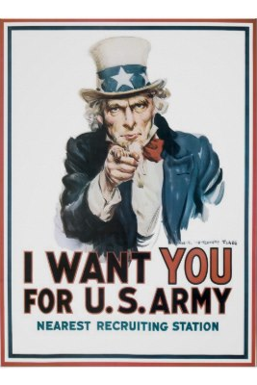
America’s Involvement in WWII
Swift mobilization for war on “The Home Front”
Businesses and the economy in the U.S. switch to making war related items
The war helped pull the U.S. out of the Great Depression
War Production Board told US businesses to make war goods
Office of Price Administration est. to control inflation caused by shortage of goods
A Draft ( Selective Service ) was used to increase the number of soldiers

Slide 19
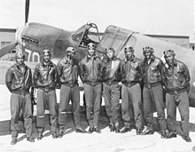
America’s Involvement in WWII
African Americans served in WW II. *Tuskegee Airmen

Slide 20
America’s Involvement in WWII
Many women went to work in the factories to replace men that went to war
“Rosie the Riveter”

Slide 21
America’s Involvement in WWII
Rationing was instituted
Sell U.S. savings bonds to help pay for the war
America will have to fight a war on two fronts:
Fight the Japanese in the Pacific
Fight the Germany and Italy in Europe
The Manhattan Project – U.S. builds atomic bomb

Slide 22
The War in the Pacific
U.S. fights Japan in the Pacific
Japan takes the U.S. Philippines – May 1942
The U.S attacks and bombs Tokyo, Japan by air – April 1942
“Island Hopping” U.S. strategy of fighting the Japanese in the Pacific
General MacArthur “returns” & defeats the Japanese in the Philippines, March 1945

Slide 23
The War in Europe
Churchill, Stalin, & Roosevelt plan how to defeat Hitler
U.S. and Britain will invade France, then Germany
The USSR will attack Germany from the East
Operation Overlord
U.S. General Dwight Eisenhower was in charge
U.S. & Britiish forces would cross the English Channel and land in German controlled Northern France.
The invasion was known as “D-Day” – June 6th, 1944
It took place on the beaches of Normandy, France

Slide 24
The War in Europe
Nearly 10,000 Allied soldiers die at D-Day by Operation Overlord is a success
Aug. 25, 1944 Paris is liberated and the Germans are pushed out of France

Slide 25
The Invasion of Germany
The Battle of the Bulge – Jan. 1945
Allied forces led by General Patton defeat the Germans in Belgium and move into Germany.
USSR troops reach Berlin (Germany’s capital) April 1945 about the same time Allied forces arrive from the West
Hitler commits suicide April 30, 1945
May 7, 1945 Germany surrenders
V-E Day (Victory in Europe) is May 8, 1945 (Japan fights on)

Slide 26
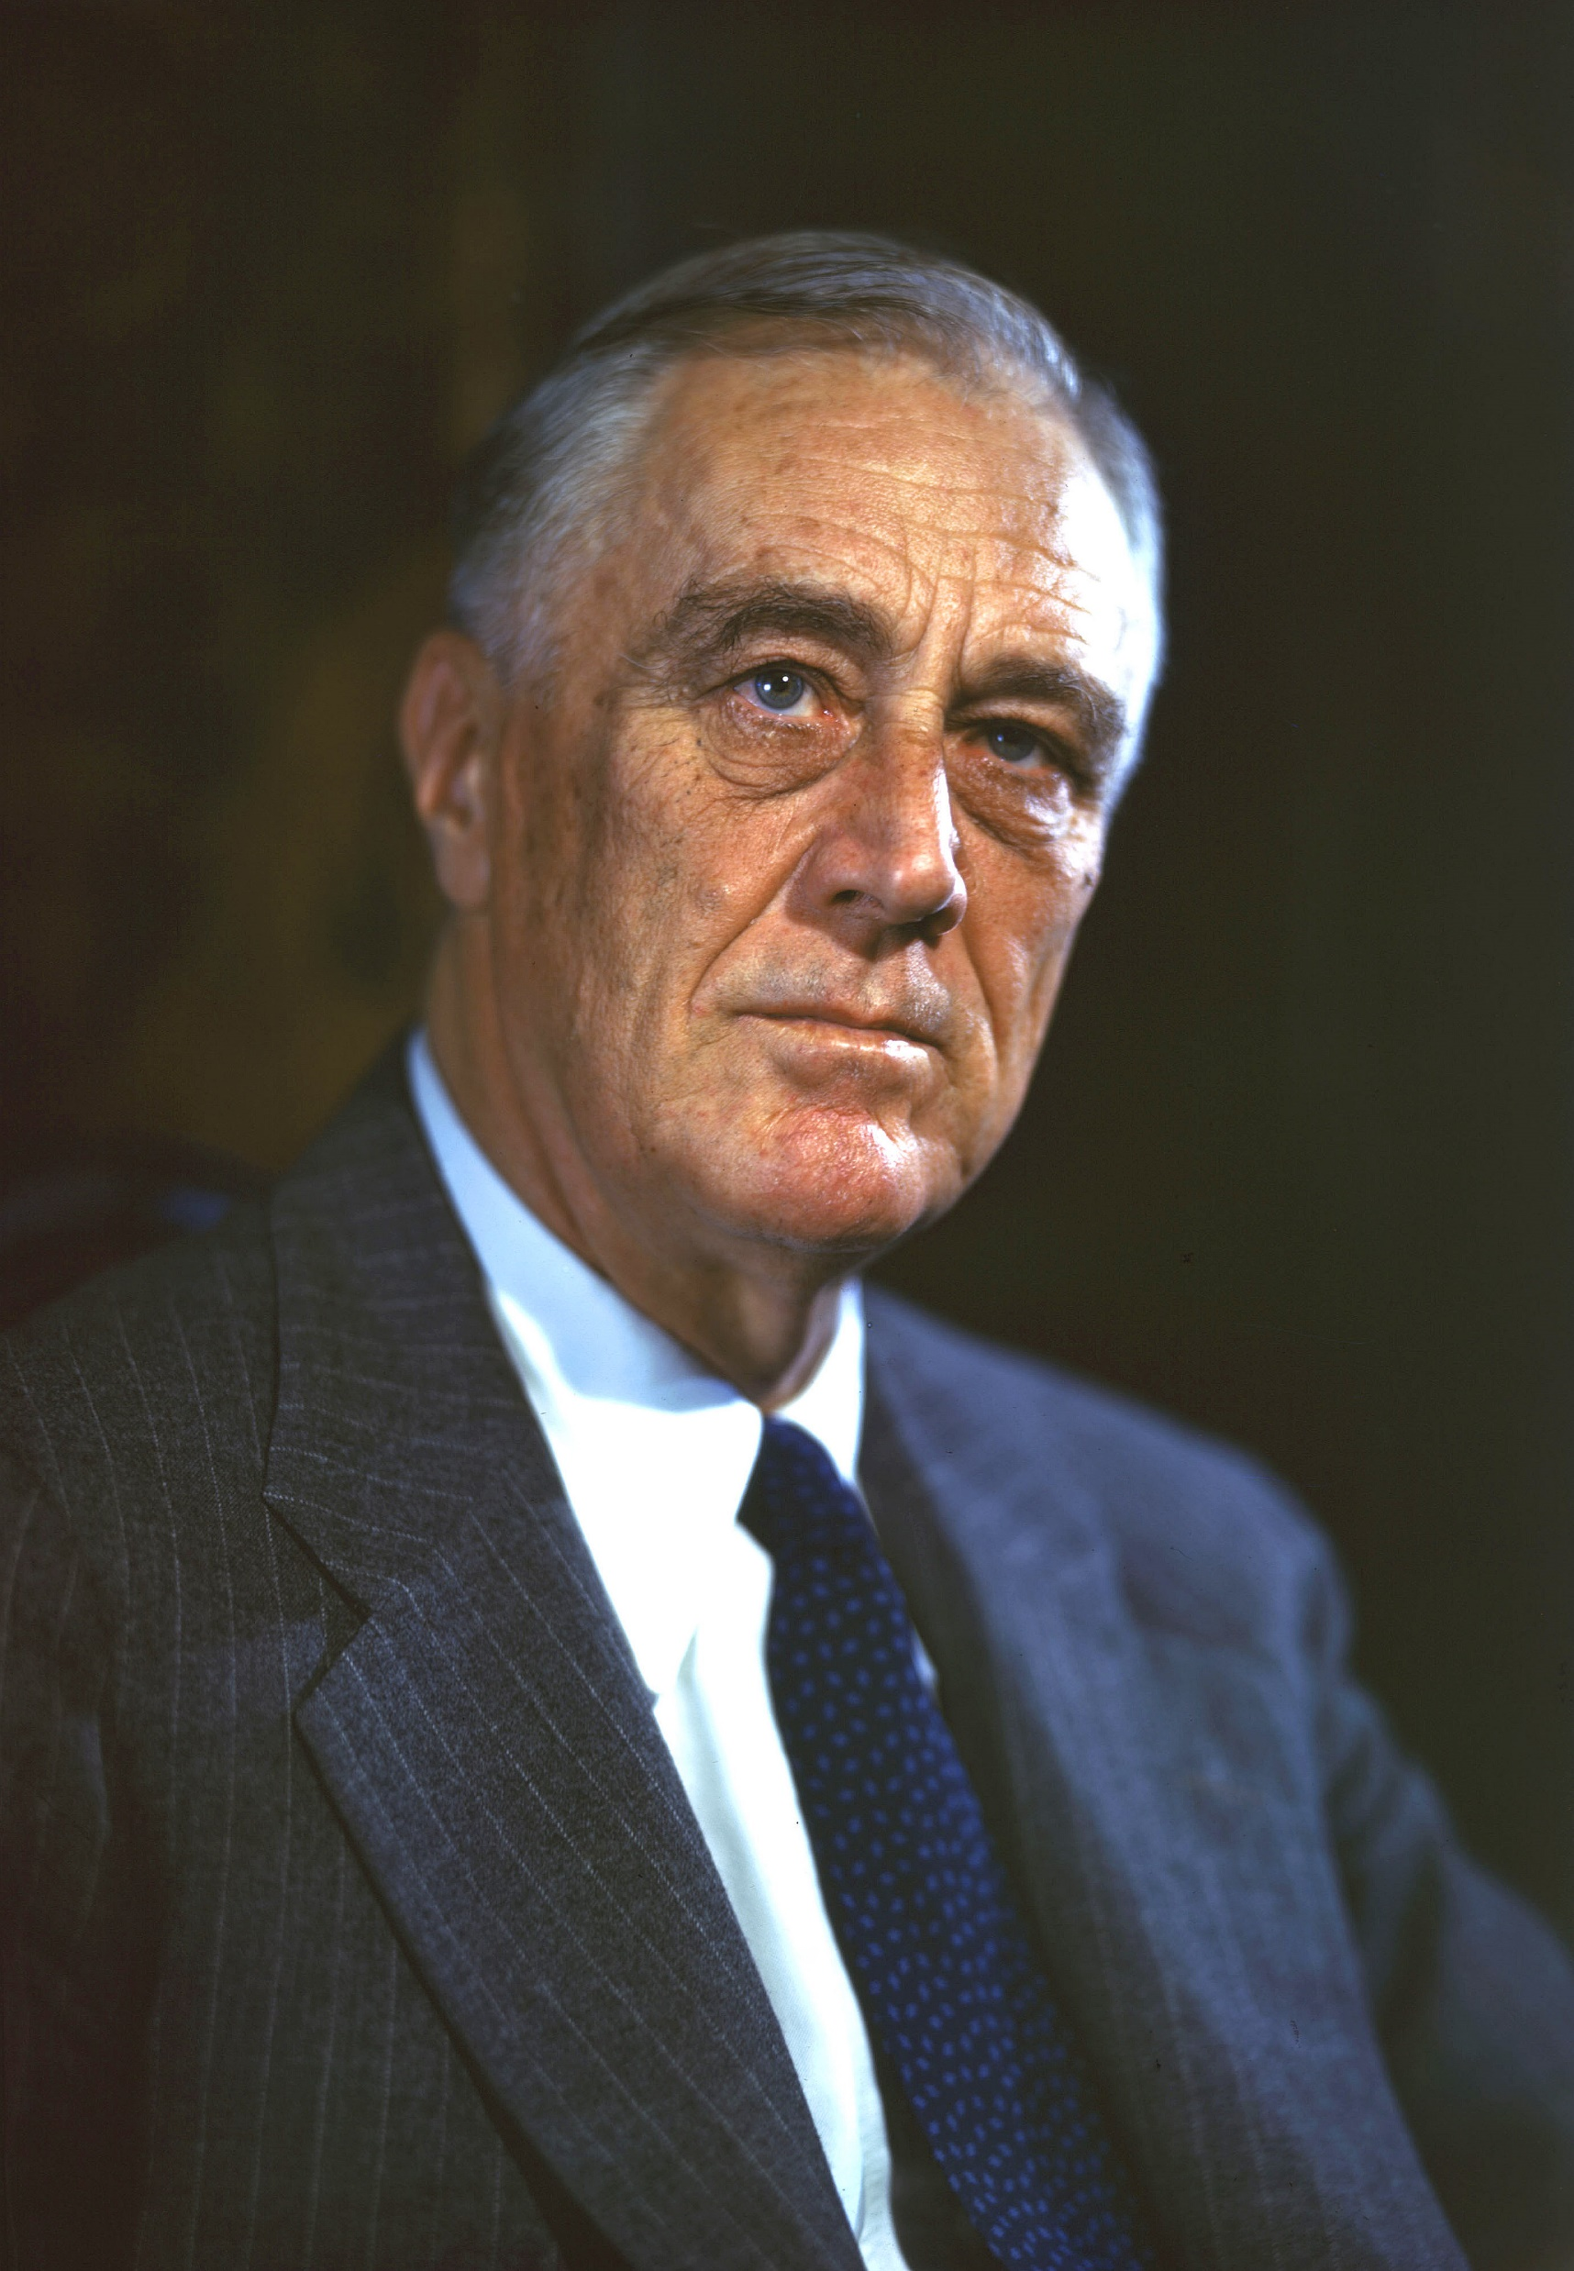
FDR and the End of the War
He wins a record 4th term in 1944 but dies April 12, 1945
Vice President Harry Truman takes over as President

Slide 27
The Defeat of Japan
U.S. Marines capture the island of Iwo Jima very close to Japan
B-29 bomber planes firebomb Japanese cities
Japanese are defeated at the island of Okiinawa only 350 miles from Japan
Truman orders the Atomic Bomb to be used on Japan
The bomb “Little Boy” is dropped by bomber plane named Enola Gay on city of Hiroshipa, Japan on Aug. 6th 1945
A 2nd atomic bomb is dropped on the city of Nagasaki on Aug. 9th, 1945
V-J (victory over Japan) Aug. 15th 1945 – the Japanese surrender finally
WWII is finally over!!!!

Slide 28
Post WWII
The United Nations:
A world peace keeping organization to replace the League of Nations
Would be located in New York, USA.
War crime trials called the Nuremburg Trials took place in Germany and Japan
Germany was divided into East and West

