Slide 1
The Vietnam War
EQ: Why did the U.S. decide to enter the Vietnam war and why did so many American citizens oppose it?

Slide 2
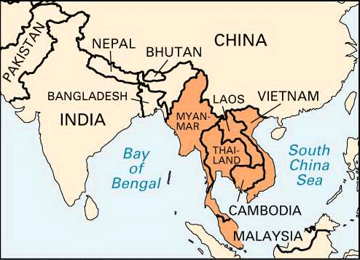
Colonial Indochina
Indochina – large peninsula located directly south of China
Heavy forests/jungles, mountains, and valleys. Hot and wet
Modern day Vietnam, Laos, and Cambodia
Ruled by the French in the 19th century
Briefly taken over and controlled by Japan during WWII

Slide 3
Vietnam declares independence
Japan surrenders WWII and withdraws from Vietnam in 1945
Vietnam declared independence however France refused to recognize their independence
Conflict ensues between Vietnamese and French forces 1946
The Vietnamese were able to control the North under leader Ho Chi Minh
The French maintained control of the South
The U.S. viewed Ho Chi Minh as a Communist and so gave the French assistance
Communist China and the Soviet Union supported Ho Chi Minh in the North

Slide 4
U.S. outside involvement
France would continue to fight for control of Vietnam until 1954
Geneva Accords – 1954 – negotiate a peace settlement
Laos and Cambodia became independent neutral states
Vietnam divided into North (Ho Chi Minh and Communists) and South (Vietnamese Emperor)
Division was to be temporary until 1956 free elections to re-unite Vietnam
U.S. replaced France as chief supporter of S. Vietnam
Fear of Communism and the Domino Theory
Faith in Democracy – use Vietnam as a model or other Asian countries
Example to allies and duty as member of SEATO
Underestimation of the Enemy

Slide 5
Diem government in s. Vietnam
Ngo Dinh Diem, Catholic nationalist, appointed prime minister 1954-1963
He refused to hold elections in 1956 and ousted the Emperor
Thousands of North Vietnamese Catholics fled to the South with horror stories of Communist atrocities
Diem established his own oppressive regime
Executed political opponents
Created a secret police headed by his brother
Took land back from peasants and returned it to the landlords
Discriminated against Buddhists and other non-Catholics

Slide 6
The Vietcong revolt
A revolutionary army o South Vietnamese Communists formed when Diem refused to hold elections
Known as the Vietcong – fought using guerilla warfare
Guerilla warfare – a form of irregular fighting
Small groups of forces
Quick attacks followed by a quick retreat
Kennedy sent military aid to help Diem fight the Vietcong
He also sent several thousand military advisers – “counter-insurgency”
Diem’s policies made him increasingly unpopular – murdered in 1963 by his own generals

Slide 7
President Johnson takes office
President Kennedy assassinated in 1963
Lyndon Johnson becomes president and escalates the war in Vietnam
U.S. became even more involved in defense of South Vietnam
“Gulf of Tonkin Resolution” – N. Vietnamese attacked U.S. ships in the Gulf of Tonkin – congress voted to give Johnson powers to stop N. Vietnamese aggression by any means necessary
In 1965, Johnson sends 184,000 American troops to Vietnam and ordered bombing missions over N. Vietnam
Bombings had little success and strengthened resistance

Slide 8
America’s strategy in Vietnam
Johnson assumed we could defeat the Vietcong with our superior technology
Jet bombers
Helicopters
Agent Orange (herbicide that destroyed jungle cover)
Napalm (mixture of gasoline and sticky gel)
Many obstacles stifled the U.S. military
Hot climate
Thick jungles and forests provided enemy cover
Boobytraps
Inability to identify the enemy from civilians

Slide 9
Nixon continues the War
In 1968 North Vietnam agreed to begin peace talks in Paris
Johnson halted bombing missions and decided not to run again for office
Richard M. Nixon wins the Presidential election of 1968
He promised an early end to the war – “peace with honor”
However, the war continued on for 4 more years – he did not want to be the first U.S. President to lose a war
Took a policy of “Vietnamization” – S. Vietnamese assumed brunt off the fighting, gradual withdraw of U.S. troops, ended the “draft”

Slide 10
Cease-fire and end of the war
Secret negotiations continued in Paris
1973 – Paris Peace Accords – cease-fire agreement between U.S. and N. Vietnam – U.S. agreed to complete withdraw of troops
U.S. continued to supply military and economic aid to South
Fighting continued between the North and South until 1975 when communist forces defeated the South
Vietnam united under Vietnamese Communist leadership

Slide 11
U.S. home front during the war
“Doves” – those who wanted U.S. to withdraw from the war
“Hawks” – those who believed the war was an important consequence of stopping the spread of Communism
Vietnam was the first televised war – created a “credibility gap” between what the government and news reported
Baby Boomers – now in the early 20’s
Most were middle class and attended college
Challenged the norm and believed in free speech
Most were anti-war and rallies were common

Slide 12
Counter culture emerges
Challenged the social rules and norms of their elders
Questioned capitalism and materialism of American society
Formed student organizations such as the Students for Democratic Society (SDS)
These young people were especially affected by rock music, greater sexual freedom, and recreational drugs such as marijuana and LSD
Adopted new fashions – men grew long hair, bell bottom pants, beads, colorfully designed materials
Some dropped out of conventional society all together and became “hippies”

Slide 13
Home Front - Resisting conscription
Military conscription or the “draft” was used to recruit soldiers
One could avoid war for religious reasons (conscientious objectors) but not on political grounds
“Draft Dodgers” protested the war by burning their draft cards
Some defected to Canada to avoid the draft
President Trump’s family paid a doctor to declare him “medially unfit” due to bone spurs in his feet to avoid going to war
Anti-war protests and demonstrations in the capital, on college campuses, and in major cities
Kent State University – National Guard killed 4 and wounded several student protesters

Slide 14
Consequences of the Vietnam War
Roughly 1.3 million Vietnamese killed, thousands more left homeless
58,000 American troops killed, thousands more suffered from wounds and exposure to chemicals like Agent Orange (herbicide used in war)
Communism took complete hold in Vietnam and Cambodia and used harsh and repressive policies on the people (2 to 4 million Cambodians killed 1975-1976)
Cost of war led to a reduction of social welfare programs(Great Society)
Failure of the American government led to a widespread lack of confidence in the government
Congress passed the War Powers Act which limited President’s power to commit troops overseas

Slide 15
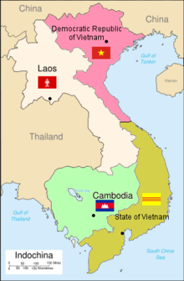
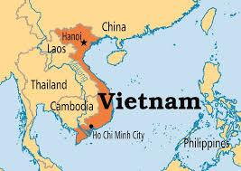
Vietnam Before and after

