Slide 1
Unit 5: Changing America – the 1920’s
EQ: What was the American experience culturally, socially, politically, and economically after wwi?

Slide 2
THE ROARING 20’S / The Jazz Age

Slide 3
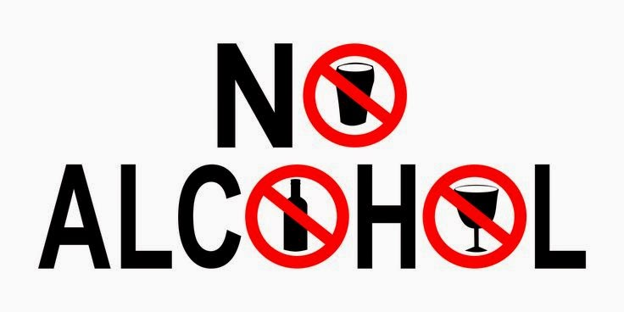

Slide 4
Post WWI
Return to a Foreign Policy of Isolation and high tariffs
Washington Navel Conference
Secretary of State -Charles Evans Hughes & *The Big 5 = decrease navy
Demilitirization
Kellogg-Briand Pact 1928= renounce war
Isolationism- stay out of foreign affairs and the League of Nations
“Dawes Plan” =U.S. loans Germany money to pay WWI reparations
Fordney-McCumber Act = a new high tariff

Slide 5
Anti-immigrant feelings were very high
Nativism returns
Emergency Quota Act of 1921
National Origins Act of 1924
Sacco and Vanzetti trial
Red scare-communism from immigrants *Palmer Raids (FBI)
The KKK returns, expands target groups
Rosewood, Florida massacre 1923
https://www.youtube.com/watch?v=MhTg98WzH5U

Slide 6
Politics in the 1920’s
The Presidential election of 1920
Republican Warren G. Harding wins
Calvin Coolidge as VP
Platform:
Raise tariffs, promote business at home
Isolationism & stay out of the League of Nations
“Return to Normalcy”

Slide 7
Scandals in the Harding Administration
The “Ohio Gang” – old friends of Harding that he gave jobs - spoils system
Forbes scandal – director of the VA, bribes, & selling govt. property
Daugherty scandal- Attorney General Daugherty received bribes
Teapot Dome Scandal- Secretary of the Interior Albert Fall leased govt. oil land in exchange for large bribe

Slide 8
President Calvin Coolidge (R)
President Harding dies in office
Calvin “Silent Cal” Coolidge takes over
Wins reelection in 1924 “Keep Cool with Coolidge”
Get rid of corruption in government
Favors business. * Stock Market booms

Slide 9
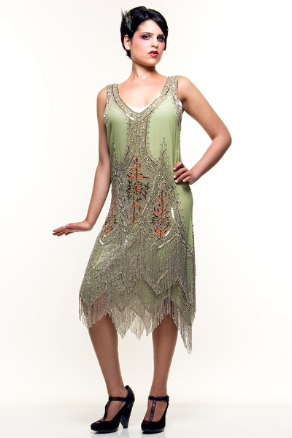
Life in the Roaring 20’s / The Jazz Age
The New Morality- a movement by women and youth to gain new freedom and experience life
Flapper = the “women of the 20’s” independent, stylish, daring
Women’s Suffrage - 19th Amendment
Suffrage = Right to Vote

Slide 10
Prohibition
WTCU & Anti Saloon League work to ban alcohol
18th Amendment outlawed alcohol in 1919. *Volstead Act
Govt. didn’t enforce very well
Alcohol could be found at “speakeasies” and from “Bootleggers” and the “Homebrew”
Crime increased

Slide 11
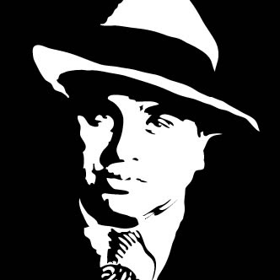
Crime in the 1920’s
Gangsters & gang wars selling alcohol, robbing banks, murder
Chicago & ”Scarface” Al Capone-Public Enemy #1, was the most infamous gangster of the 20’s
Bootleggers/Rum Runners
Prostitution, and gambling

Slide 12
Education
The “Scopes Monkey Trial” outlawed the teaching of evolution. * Fundamentalist movement
William Jennings Bryan vs. Clarence Darrow who represented John Scopes
Biology teacher Scopes found guilty.

Slide 13
New ideas, sports, culture and entertainment of the 1920’s
Arts and Literature – the Bohemian writers like Earnest Hemingway
Entertainment – Hollywood movies and radio are introduced
Music- Big Band, Jazz, Swing and Ragtime
Baseball – Babe Ruth

Slide 14
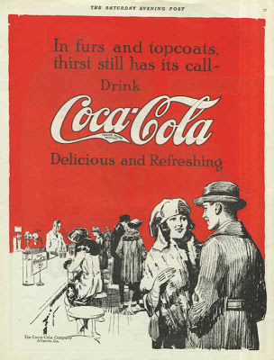
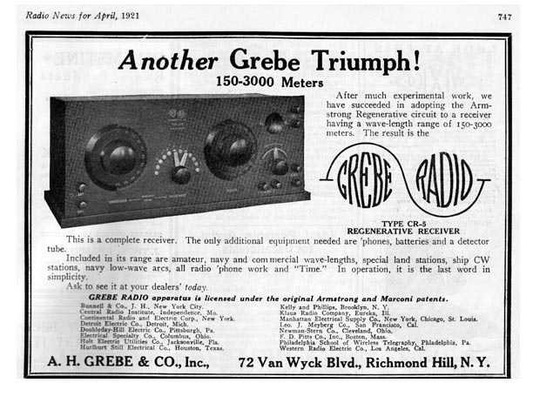
Business, Consumerism & the Stock Market
New appliances, products & cars
Buying on credit/installment loans - cars, homes, home appliances
Advertising
Business and the stock market(*Bull Market) makes $$$$ *the economy booms!

Slide 15
The Harlem Renaissance
African American accomplishments are noticed
The Great Migration- Southern blacks moved North. Many to Harlem, NY
African Americans excel in the arts, music, and literature
Writers = Langston Hughes, Zora Neale Hurston
Singer-Bessie Smith
Jazz- Duke Ellington & Louis Armstrong

Slide 16
African Americans & politics
The black vote increases
NAACP is formed - W.E.B. DuBois
Booker T. Washington-Tuskegee Institute
Marcus Garvey and black pride, “Back to Africa”

Slide 17
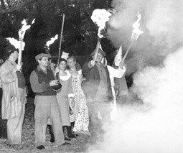
Florida in the 1920’s
Florida land buying boom
The Great Miami Hurricane
Zora Neale Hurston is from Florida
Rosewood, FL massacre

