Slide 1
The Causes of the Civil War
Chapter 1
Section 4
EQ: What factors contributed to the South leaving the Union and the breakout of the civil war?

Slide 2
Civil war Facts
Bloodiest massacre on home soil. Ever.
Families fought against families.
Not necessarily all about slavery, but obviously the biggest part.
Current era, how does it relate?

Slide 3
The Causes of the Civil War
Southern Agriculture
Political Problems

Slide 4
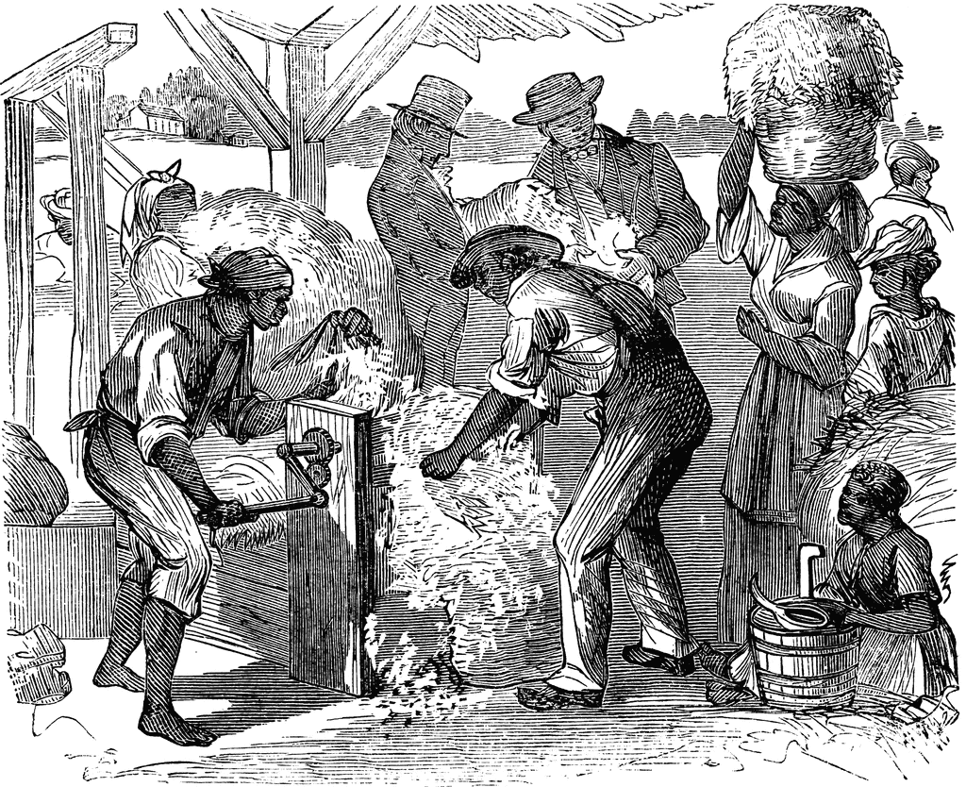
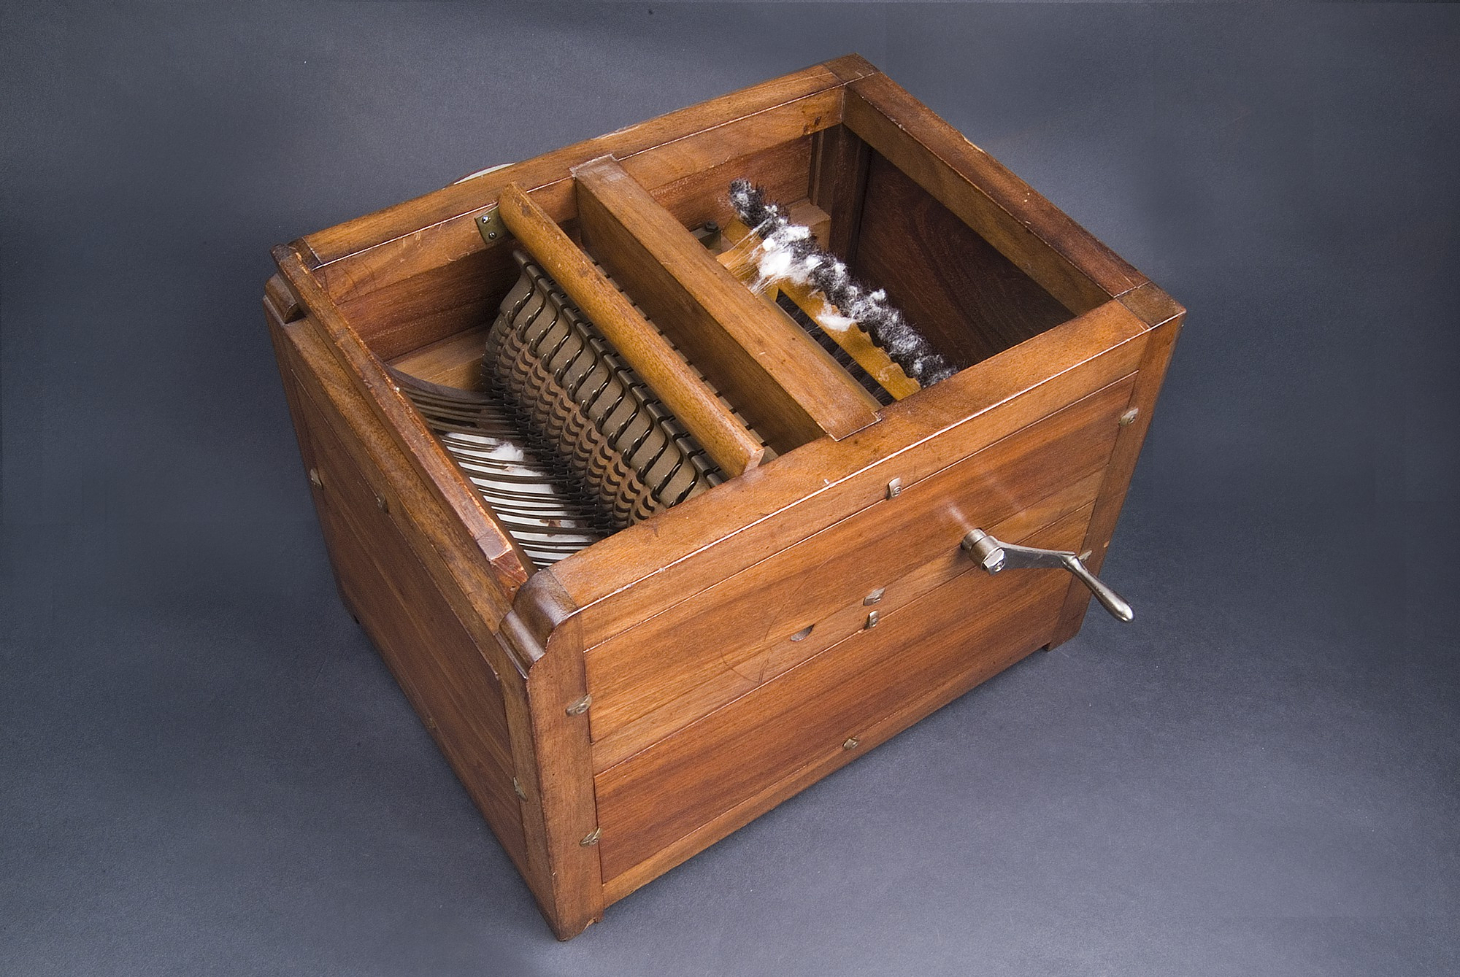
Agriculture in the South
“Cotton is King”
Cash Crop
The South became dependent on one crop
The South Grew it, the North bought it
Many slaves were needed to work the farms
This was because of the amount of time that
it took to remove seeds from the cotton puff.
Invention of the Cotton Gin

Slide 5
Political Problems
Western State Expansion and the balance of slave and free states
Should slavery be allowed in the new territories?
Wilmot Proviso-
Proposal to ban slavery in territories gained from Mexico
States rights
States wanting to make their own decisions (popular sovereignty)
Presidential Election of 1848
Lewis Cass- democrat
Martin Van Buren- free soil party
Zachary Taylor- Whig (WINS)

Slide 6
More Political Problems
The “Gold Rush” (1848-49) causes California to ask for statehood as a free state
The Compromise of 1850
California enters as a free state
Other Western territories have popular sovereignty
Slave trade abolished in D.C. but not slavery in general
Fugitive slave act is strengthened
Texas gives up territory (Santa Fe area) for Federal money
President Taylor dies, Millard Fillmore takes over
Presidential election of 1852- Franklin Pierce (Dem) wins.

Slide 7
The Compromise of 1850 in detail
West gains/changes
California enters as a free state
Other Western territories have popular sovereignty
Texas gives up territory (Santa Fe area goes to what is now New Mexico) for Federal money to cover war debts
North gains
Slave trade abolished in D.C. but not slavery in general
South gains
Fugitive slave act is strengthened

Slide 8
Problems in Politics… still
The Gasden Purchase in 1853
The US buys more land from Mexico which helps to build Transcontinental RR
The Kansas-Nebraska Act
Kansas enters as slave state, Nebraska as a free state
Bleeding Kansas
Northerners and abolitionist try to prevent Kansas from being a slave state
Leads to riots and protests

Slide 9
The Presidential election of 1856
Democrats choose James Buchanan instead of Pierce
The new Republican party chooses John Fremont
Former President Fillmore runs under the American “No-Nothing” party.
Buchanan wins,
Now he has to prevent a civil war from happening.

Slide 10
President Buchanan
Dred Scott decision angers abolitionists
Kansas remains a territory and a battleground between abolitionist and pro slavery people
Lincoln loses Senate election to Stephen Douglas in Illinois 1858
John Brown’s raid at Harper’s Ferry

Slide 11
The Election of 1860
Republicans Nominate Abraham Lincoln
Democrat party splits:
North chooses Stephen Douglas
South chooses John Breckinridge
The Constitutional Union party nominates John Bell
Lincoln ends up Winning the Election

Slide 12
The Nation Splits
Secession of the States begins with South Carolina
6 states follow closely in their footsteps
Congress attempts but fails to offer a plan to keep the states in the Union
The Confederate states of America
The government of the seceding Southern States
1st Organized in Montgomery, Alabama but would later move to Richmond, VA
Jefferson Davis chosen as President

Slide 13
THE CIVIL WAR
Chapter 1 Section 5
EQ: What were the advantages and disadvantages that the Union and Confederacy faced?

Slide 14
The Civil War Begins
The attack on Fort Sumter:
The South attacks Fort Sumter in South Carolina.
Federal troops hold out for 33 hrs. then surrender April 12th, 1861.
Lincoln calls for massive troop build up.
The war has officially begun!
Five more states secede, 11 states now make up the Confederacy. Including Florida.

Slide 15
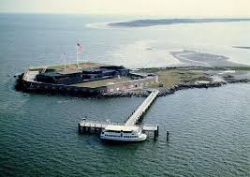
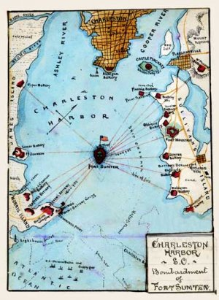
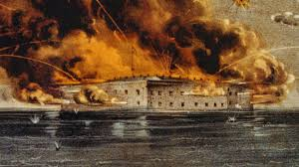
Fort Sumter

Slide 16
The Southern Advantages
Better officers – Robert E. Lee and “Stonewall” Jackson
Better fighting foot soldiers
Higher morale – Fighting to preserve their culture/economy
Southern agriculture
Strategy – fight a defensive war, keep the North out of the South.

Slide 17
The Northern Advantages
Larger population
Farms and factories
More railroad
More money
Bigger, better navy
Strong, organized federal government
Strategy- Cut the South in ½ by controlling the Mississippi river and blockade Southern ports.

Slide 18
The First Battle of the Civil war. The first battle of Bull Run
Confederate forces were located at the Bull Run River/ Manassas Junction in VA
Lincoln called for an attack on July 1861
The South Wins BIG
The North Realizes that this will not be an easy or short war
Lincoln calls for more recruits
By 1862 both sides of the war use the draft

