Slide 1
farmers and Native Americans on the last frontier
EQ: What factors led americans to move west in the late 1800’s and what challenges did they have to face?

Slide 2
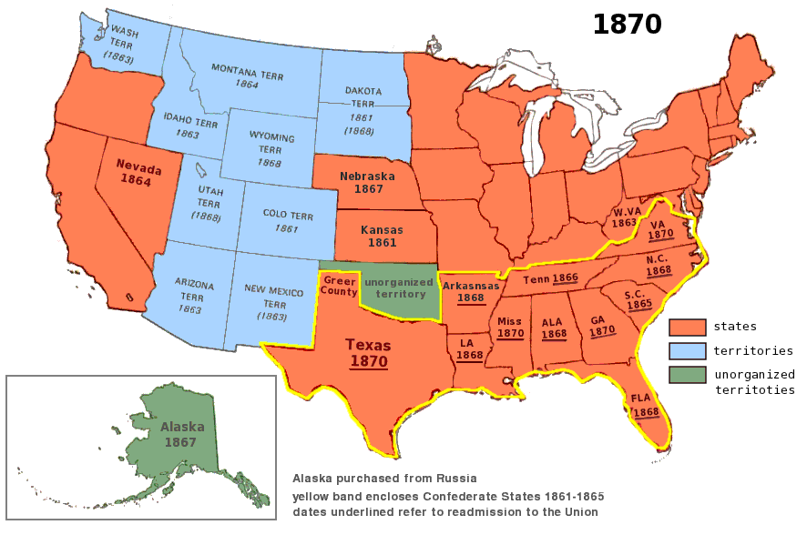

Slide 3
Human migration
Migration is the movement of people from one place to another.
“Push” Factors are things that cause people to leave a place, like war, drought, and natural disasters.
“Pull” Factors are things that cause people to move into a new place like economic opportunities, cheap land, and discovery of precious metals
The Frontier, or “unsettled land”, was the great plains, the Rocky Mts., the Great Basin, and the deserts of the SW.

Slide 4
“Pull” factors Leading to settlement of the Great plains and far west
Discovery of precious metals
Completion of transcontinental railroad
Cheap or free land: Homestead Act of 1862
Relocation of Indians: “Indian Wars” and Reservations

Slide 5
Discovery of precious metals
California Gold Rush of 1849 – most did not grow wealthy from this
Gold and silver later discovered in Colorado, Nevada, South Dakota, and Arizona
Growth of mining towns → clashes with Indians
Once the mines dried up mining towns → “ghost towns”

Slide 6
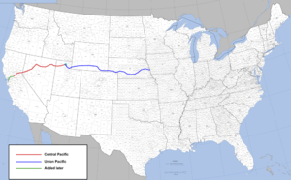
Transcontinental Railroad
Began being built in Sacramento, CA and Omaha, NE in 1863
Chinese immigrants worked from the West to East
Irish immigrants worked from the East to the West
Met in Promontory, UT in 1869

Slide 7
Homestead act of 1862
Government sold settlers 160 of land for $1.65 and acre or free after 5 years residency
Previously deemed “Indian Territory” mostly in OK
Land required intensive labor and new tools to farm
Many settlers forced to take out mortgages from banks

Slide 8
The native American experience
Beginning back in 1830 Congress had already ordered the removal of all Indians in Southern states
Sent West of the Mississippi River
“Trail of Tears” – ¼ of the Cherokee tribe dies during relocation
They were now settled in the Great Plains
40 years later they would be again be pushed from their new home there

Slide 9
“Indian Wars” of 1864-1890
After competition of the transcontinental railroad and further expansion western lands became highly desirable
Federal Troops stationed in the west to protect settlers
“Buffalo Soldiers” – African American troops stationed in Western forts
Indians would eventually be defeated and forced onto remote reservations

Slide 10
Reservation system
Tribes forced onto reserved lands, not permitted to leave
Typically dry and undesirable land
Some services like schools provided
Hoped to “Americanize” Indians
Loss of culture → way of life, language, religion
Indian men resented farming and wanted to hunt
Buffalo were their main source of food
Hunted nearly to extinction by white settlers

Slide 11
Dawes Act of 1887
Americans in the East shocked by mistreatment of Native Americans
Misguided attempt at reform despite good intentions
Males could claim 160 acres of reservation land as private property
Goes against idea of tribal sharing and tribal ways
Many unexperienced at farming
Many sold their land to white buyers
Those that moved to cities faced discrimination, unemployment and poverty

