Slide 1
AP WORLD HISTORY Period 1: c. 8000 – 600 BCE
Technological and Environmental Transformations

Slide 2
Key Concept 1.1 Big Geography & the Peopling of the Earth
Big Bang (13.75 Billion Years Ago)
Human-like creatures (2.7 Million Years Ago)
Paleolithic Age = 95% of man’s time on earth
Homo-sapiens evolved in East Africa (200,000 years ago)
Migrated “out of Africa” 100,000 to 60,000 years ago; Asia 70,000; Europe 45,000; Americas 30,000-15,000

Slide 3
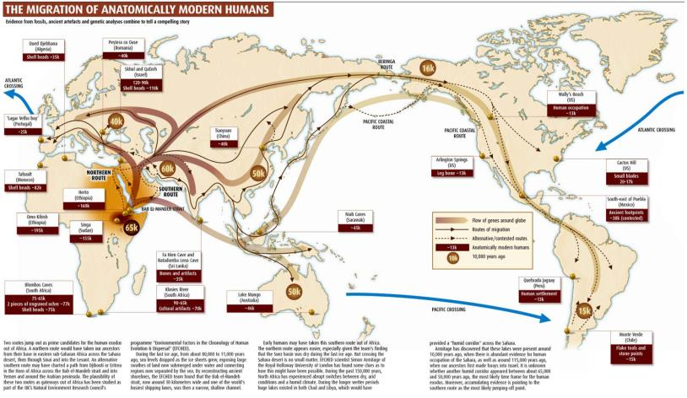
Migration of Humans Map

Slide 4
Key Concept 1.1 Big Geography & the Peopling of the Earth
What was life like in the Paleolithic Era?
Small hunting-foraging bands (30-40 people)
Egalitarian (men=women)
Used tools made from stone and wood (spears, bows, arrows, club, axe)
Used fire to adapt to different climates
Family and kinship ties
Animistic religious beliefs
Trade of goods and technology
Easier lives? - more free time (Worst Mistake in History?)

Slide 5
Key Concept 1.2 Neolithic Revolution and Early Agricultural Societies
Neolithic Revolution - 8,000 BCE (10-12,000 years ago)
Began in Middle East, but agricultural villages also emerged at different times in other areas
Changes
Agriculture & domestication of animals
Surplus of food
Permanent settlements
Denser populations
Job specialization
Social stratification (kings, religious leaders, warriors, scribes, crafts people)

Slide 6
Key Concept 1.2 Neolithic Revolution and Early Agricultural Societies
What was life like during the Neolithic Era?
New technologies increased food production
irrigation, wooden plows, wheels, sickles, traps, clay pots, woven baskets
Metallurgy (manipulating metals)
Bronze Age 3000 BCE (copper & tin)
Iron Age 1,300 BCE
Patriarchy Develops (continuity for rest of WH)
Human Impact on Environment (agriculture irrigation and pastoralism overgrazing and erosion)

Slide 7
Key Concept 1.3 Development & Interactions of Early Agricultural, Pastoral and Urban Societies
Rise of Civilizations 3000 BCE (5000 years ago)
Characteristics of Civilizations
Agricultural surplus, specialization of labor, cities, complex institutions (political bureaucracies, armies, religious hierarchies), stratified social hierarchies, long distance trade, record keeping &/or writing systems, technology and warfare

Slide 8
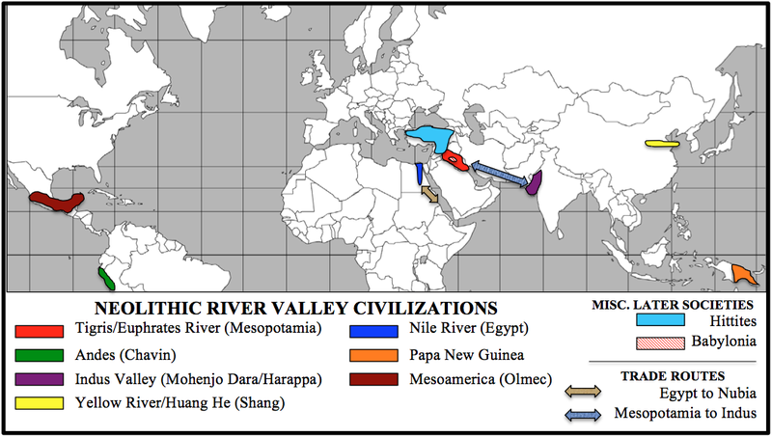
Period 1 Must Know Civilizations

Slide 9
Key Concept 1.3 Development & Interactions of Early Agricultural, Pastoral and Urban Societies
Mesopotamia
Middle East – crossroads, many invasions
Tigris-Euphrates Rivers, unpredictable flooding
Not centralized, city-states
Cuneiform writing system
Polytheistic
Ziggurats (religious temples)
Achievements: wheel, calendar
Babylonian Empire, King Hammurabi’s Law Code (harsh, evidence of social classes and patriarchy)
Epic of Gilgamesh

Slide 10
Key Concept 1.3 Development & Interactions of Early Agricultural, Pastoral and Urban Societies
Ancient Egypt
Nile River, predictable flooding
Highly centralized, unified under pharaoh (divine rule)
Hieroglyphics - writing system
Polytheistic
Contact with Nubian Empire to South

Slide 11
Key Concept 1.3 Development & Interactions of Early Agricultural, Pastoral and Urban Societies
Indus River Valley
Located in present day Pakistan (South Asia)
Two major cities Harappa and Mohenjo-Daro
Not able to decode written language
Indoor plumbing, more equal society
Indo-European Aryan Migration – 1750 BCE
Brought Vedas, beginning of Hinduism

Slide 12
Key Concept 1.3 Development & Interactions of Early Agricultural, Pastoral and Urban Societies
China
Shang – 1st dynasty
Ancestor worship
Oracle bones and Shaman
Zhou – longest dynasty
Mandate of Heaven

Slide 13
Key Concept 1.3 Development & Interactions of Early Agricultural, Pastoral and Urban Societies
Exceptions to the River Valley Rule
Olmecs of Mesoamerica (Central America)
Chavin of the Andean Region (South America)
Don’t Forget About the Pastoralists
Animal herders, follow migratory patterns
Found in mountainous regions and/or areas with insufficient rainfall to support other settlements
No permanent settlement
Spread diseases and encourage trade

Slide 14
Key Concept 1.3 Development & Interactions of Early Agricultural, Pastoral and Urban Societies
Notable Groups from Period 1
Indo-Europeans from Central Asia
Horses, Aryans in India and Huns
Bantus 2,000 BCE
Sub-Saharan migration, spread of language, farming techniques, use of iron
Hebrews
Development of Monotheism, influenced development of Christianity and Islam
Phoenicians
22 letter alphabet, adopted by Greeks, influences later languages
Hittites
Brought iron knowledge to Mesopotamia

Slide 15
Major Themes for Period 1
Migrations
Neolithic/Agricultural Revolution
Iron Metallurgy
Development of Patriarchy
Ancient River Valley Civilizations

Slide 16
Period 1Review Questions
1. All of the following were features of the civilizations in Mesopotamia, Mesoamerica, the Indus River Valley, and the Yellow River Valley EXCEPT
A degree of craft specialization
A level of social stratification
Religious sacrifice rituals
Development of irrigation systems

Slide 17
Period 1Review Questions
2. In the Zhou dynasty, the Mandate of Heaven meant that rulers
Had an absolute right to rule over the governed as they wished
were direct descendants of the gods
Were encouraged to spread Buddhism through the building of monasteries
Were allowed to keep their power if they ruled justly and wisely

Slide 18
Period 1Review Questions
3. Which of these was NOT an outcome of the Bronze Age?
Increased agricultural efficiency
The fall of centralized governments
The rise of an aristocratic military class
Increased contact among different cultures

Slide 19
Period 1Review Questions
4. The Neolithic Revolution was characterized by the
Change from nomadic herding to settled farming
Growth of iron tool making technology
Migration of early peoples to the Americas
The development of written legal codes

Slide 20
Period 1 Essay Question
Compare the social and economic structures of Paleolithic and Neolithic communities

