Slide 1
Japanese American Incarceration

Slide 2
Japanese Immigration
Store run by Japanese immigrants in Honolulu (c. 1895-1910)
Notes:
Image retrieved from the Library of Congress: https://www.loc.gov/pictures/resource/det.4a20736/

Slide 3
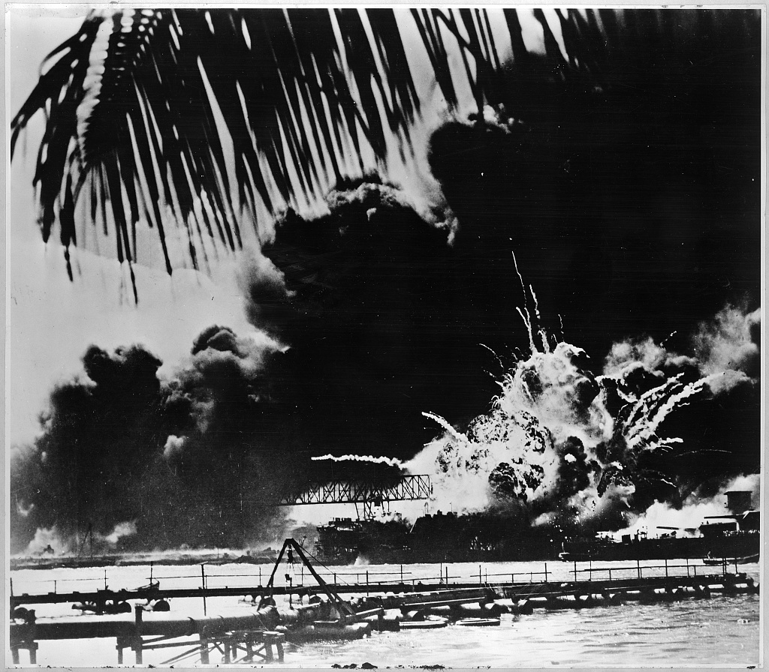
Pearl Harbor – Dec. 7, 1941
USS Shaw explodes in Pearl Harbor
Notes:
Image retrieved from the Library of Congress: https://www.loc.gov/item/98506923/

Slide 4
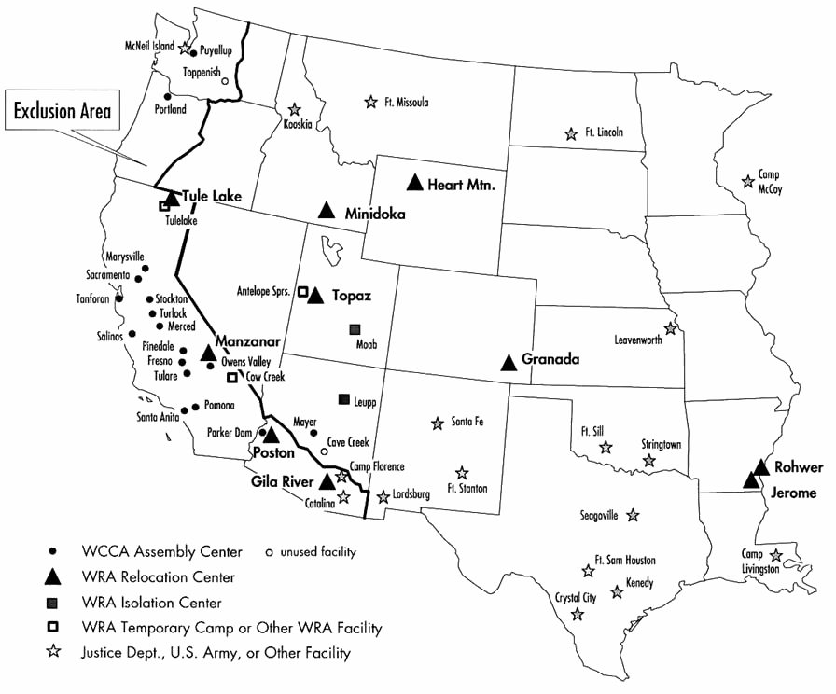
Executive Order 9066
Incarceration Sites
Posters in San Francisco, spring 1942
Notes:
Image on the left retrieved from the Library of Congress: http://www.loc.gov/pictures/resource/cph.3a35053/
Image on the right retrieved from Wikimedia Commons: https://commons.wikimedia.org/wiki/File:Map_of_World_War_II_Japanese_American_internment_camps.jpg

Slide 5
Incarceration
A line for the dining hall at Manzanar, an incarceration camp in California
Notes:
Image retrieved from the Library of Congress: https://www.loc.gov/resource/ppprs.00368/

Slide 6
Incarceration of Other Groups
Italian Immigrants on Ellis Island (c. 1910-1920)
Notes:
Image retrieved from the Library of Congress: https://www.loc.gov/item/2001704438/

Slide 7
Release and Apology
Ronald Reagan signing the Civil Liberties Act of 1988
Notes:
Image retrieved from Wikimedia Commons: https://commons.wikimedia.org/wiki/File:Ronald_Reagan_signing_Japanese_reparations_bill.jpg

Slide 8
Central Historical Question
Why did the United States government incarcerate Japanese Americans during World War II?

