Slide 1
Islamic Architecture
Local cultures will have their own impact on architecture as Islam spreads but some elements of Islamic architecture are traceable no matter how much local influence is injected.

Slide 2
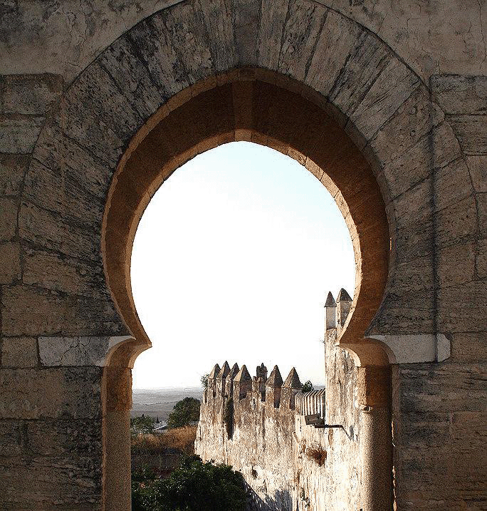
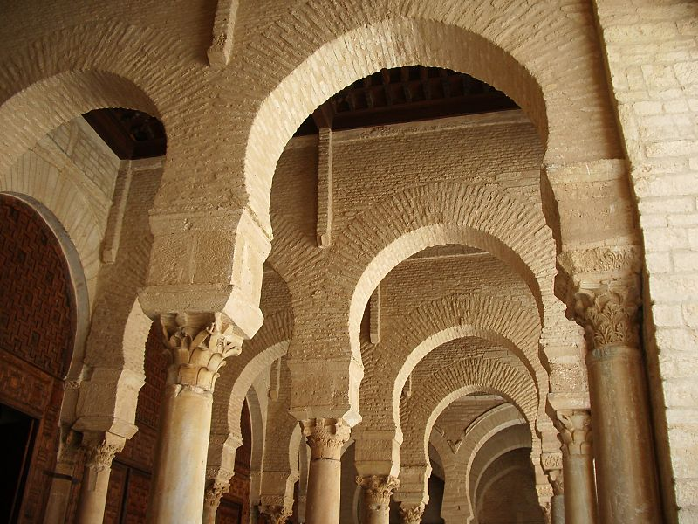
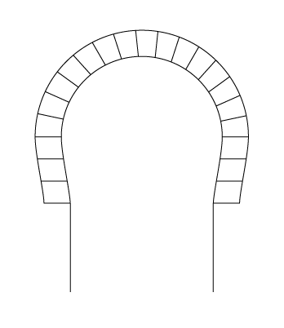
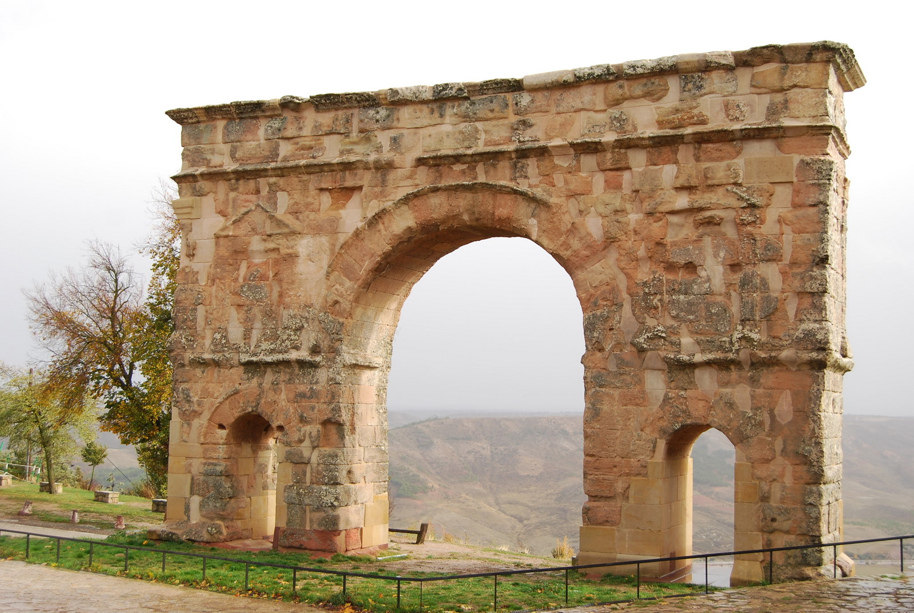
Horseshoe Arch
Origin unknown
Some say Umayyad, others say Visigoth (Spain), and still others say Byzantine or Sassanid
Compare to this Roman Arch

Slide 3
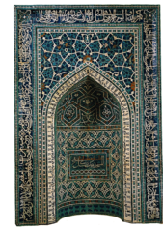
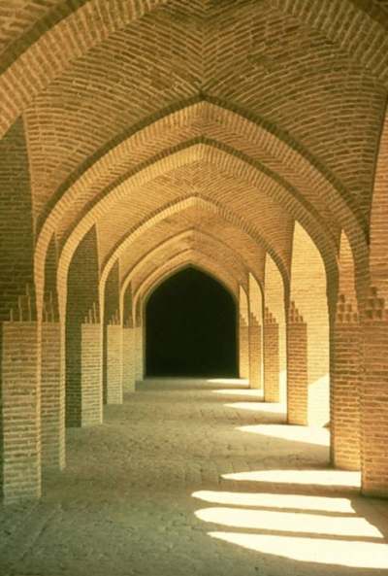
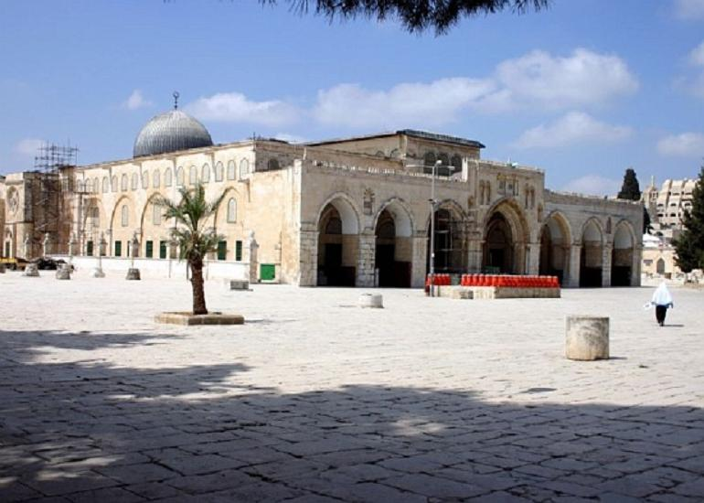
Pointed Arch
First used by Byzantines it will become the characteristic arch of Islamic Architecture
Later it becomes a center of Gothic Medieval Architecture

Slide 4
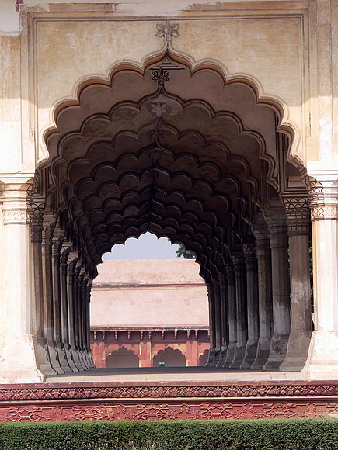
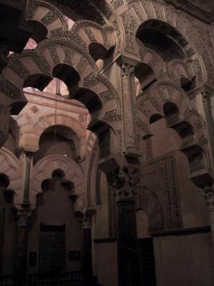
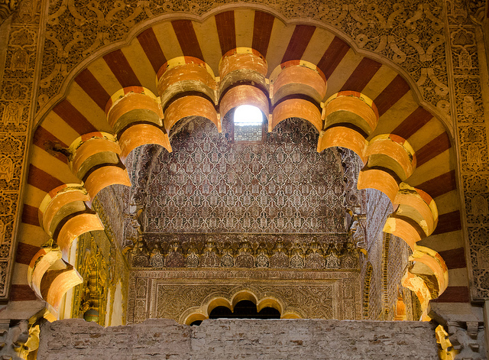
Scalloped Arch
Variation on the Horseshoe
Arch

Slide 5
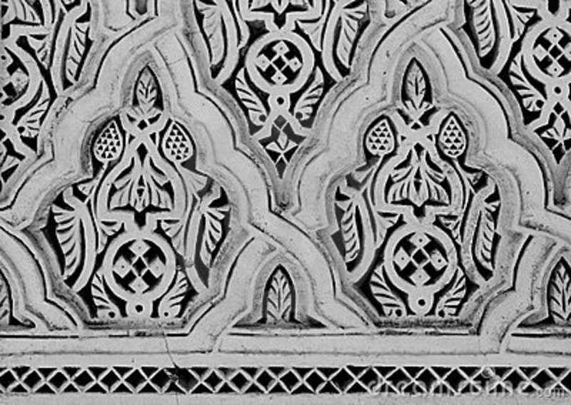
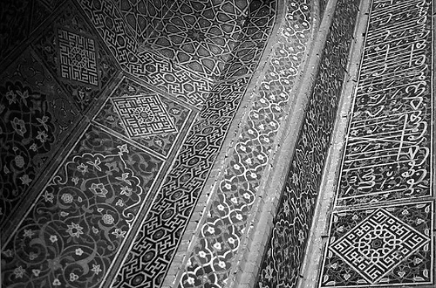
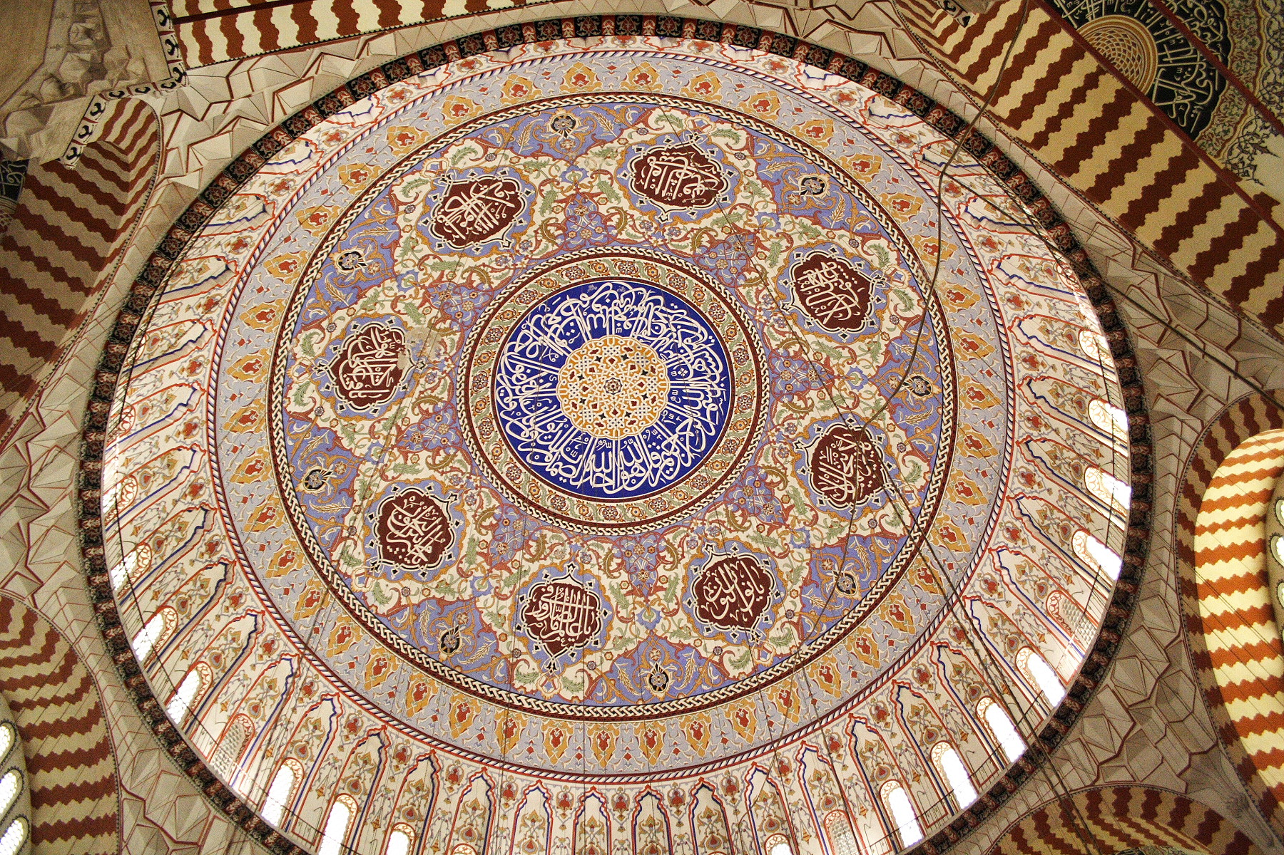
Arabesque
Means repeating geometrical patterns
Major feature of Islamic Architecture due to fact that they do not
depict living things
in their art.

Slide 6
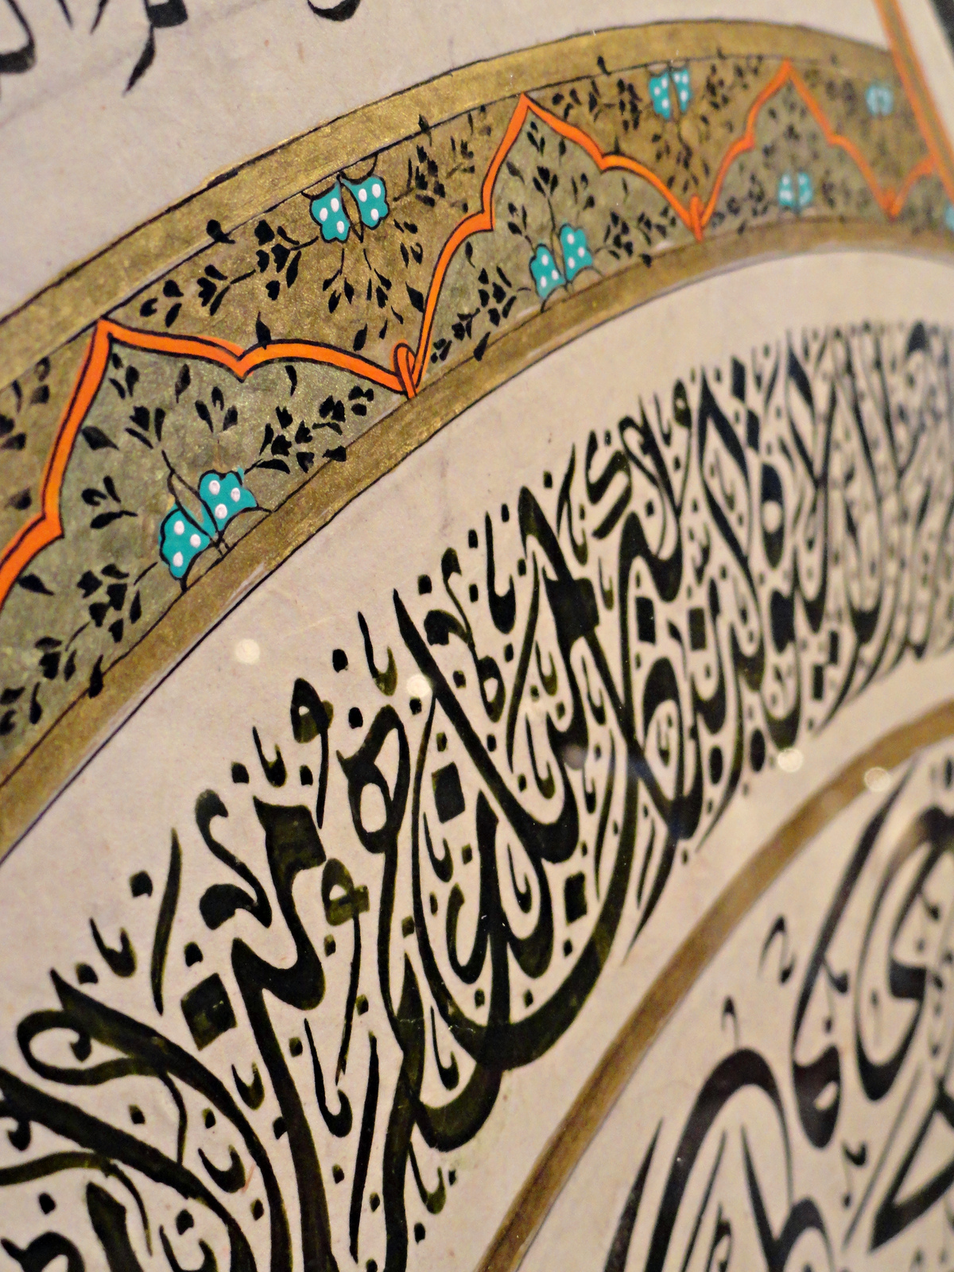
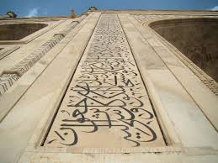
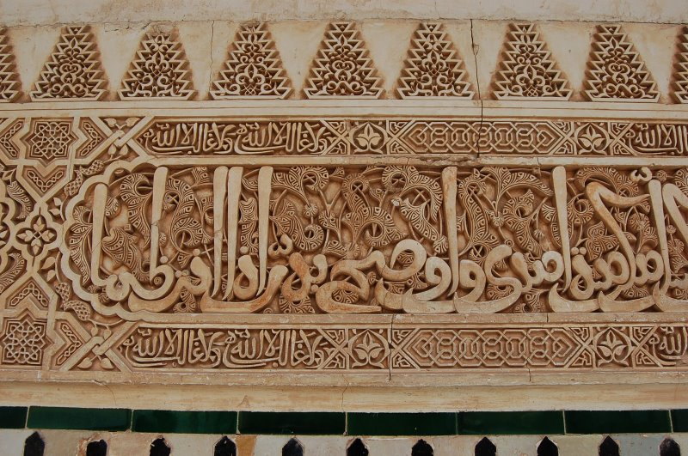
Calligraphy
Quotations from Qur’an
Emphasizes Islam and the unification of their empire due to fact all had to learn Arabic to become Muslim or pay Jizya.

Slide 7
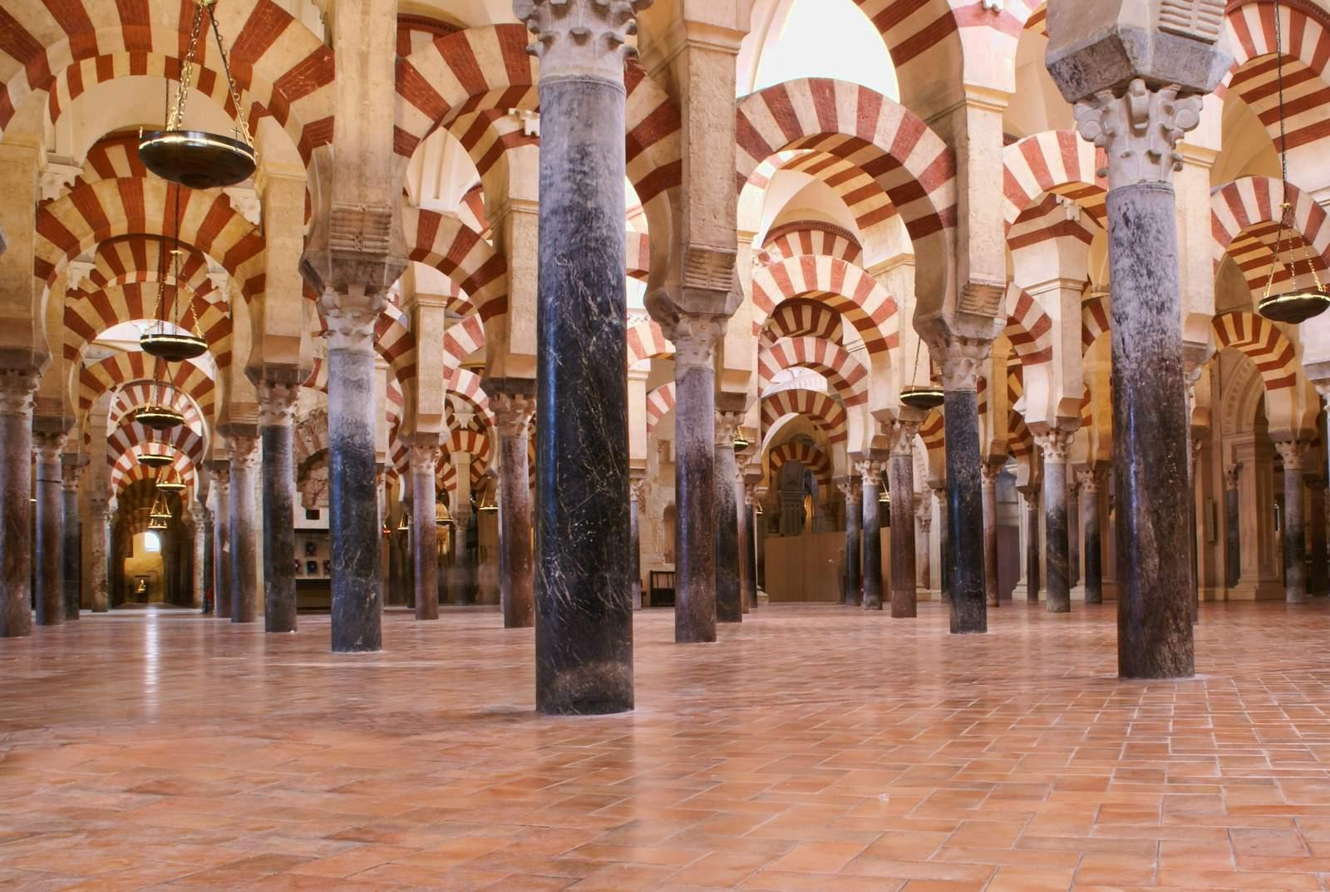
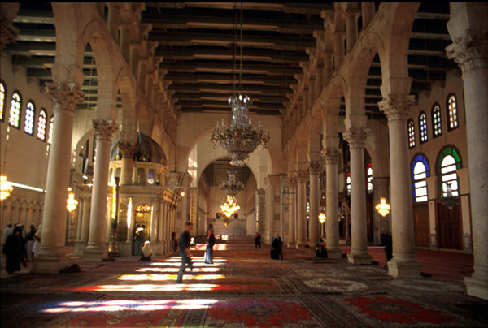
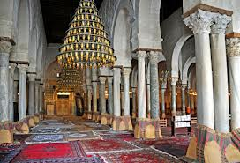
Hypostyle
Greek word meaning “under columns
Not specific to Islam but used extensively in
a mosque’s prayer
hall which had to
be a large room

Slide 8
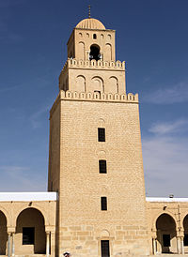
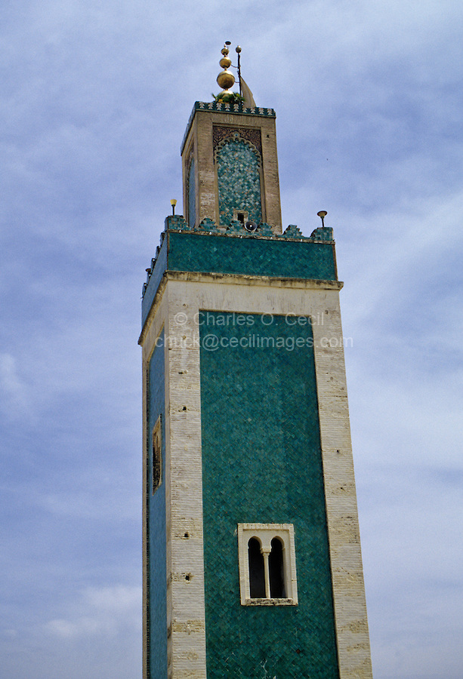
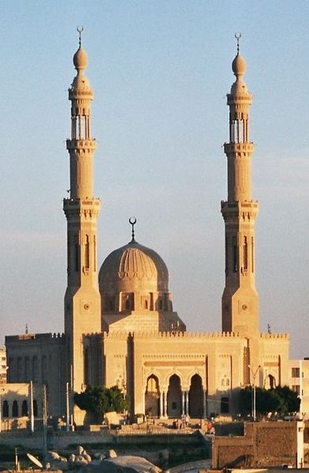
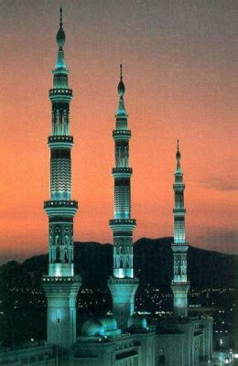
Minaret
Oldest Standing Minaret
Used to call Muslims to prayer
Word originates from the term for “an object that gives light”
First mosques did not have minarets.
Can vary drastically depending on local cultural influences

Slide 9
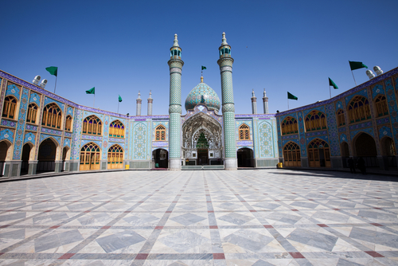
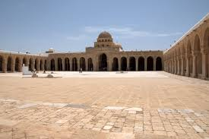
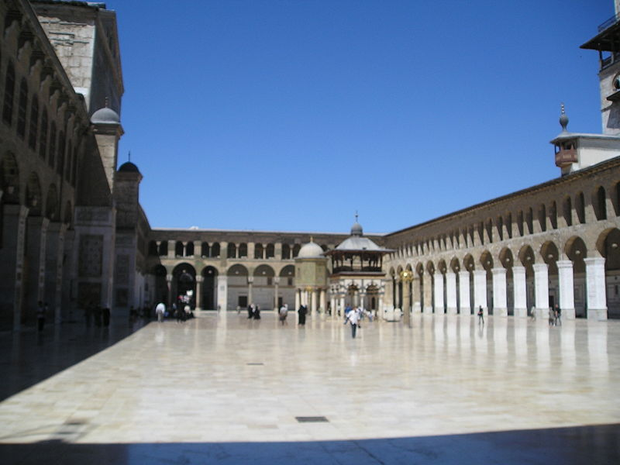
Large Courtyards
The actual meeting place in the first mosque Muhammad built had a courtyard which is where the people gathered to pray.
Mosques are multipurpose buildings and serve religious, political and cultural roles. Courtyard= Town Square
Symbolically separates the outside world from the prayer hall (mentally prepare)

Slide 10
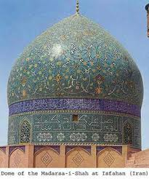
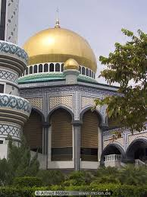
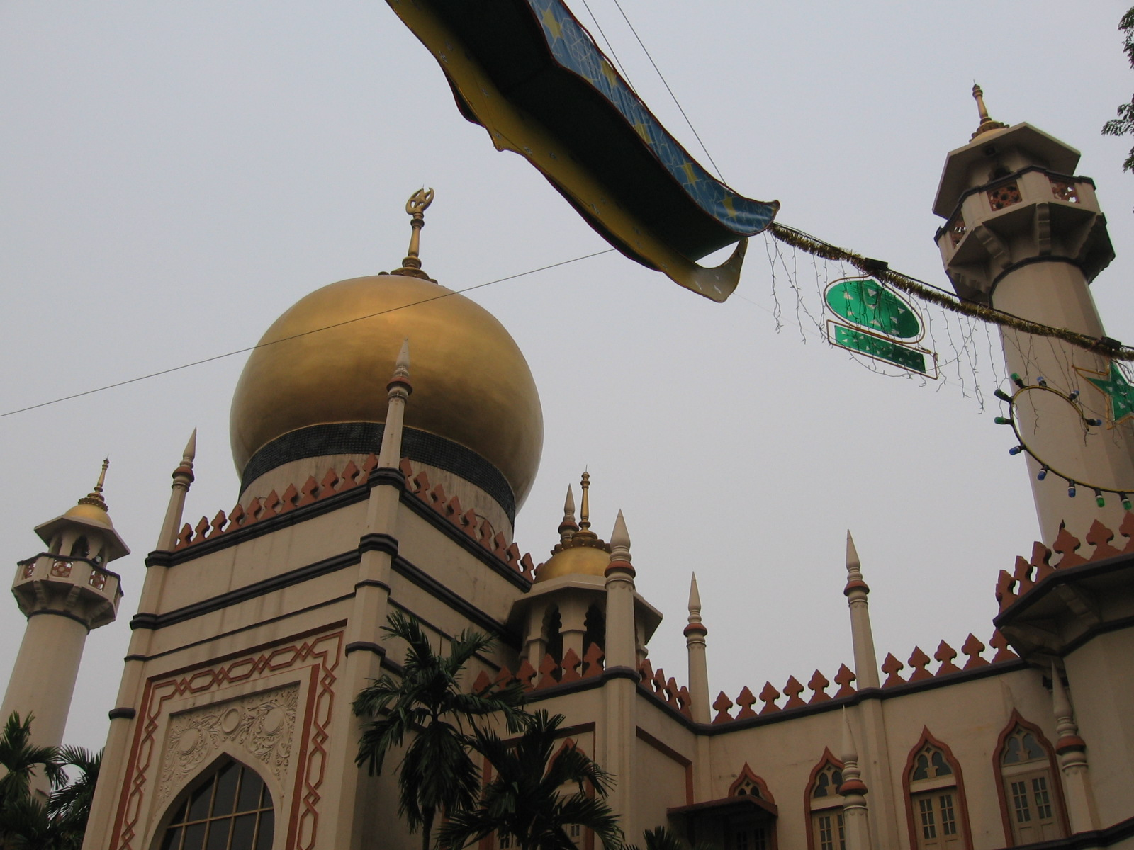
Large Domes
Again, not a unique feature of Muslim architecture as the Greeks and Romans perfected the dome
The Dome of the Rock (right) is one of the holiest sites of Islam and was patterned off of nearby Byzantine churches and Byzantine workers help to build it.
Sometimes the domes are pointed at the top.

Slide 11
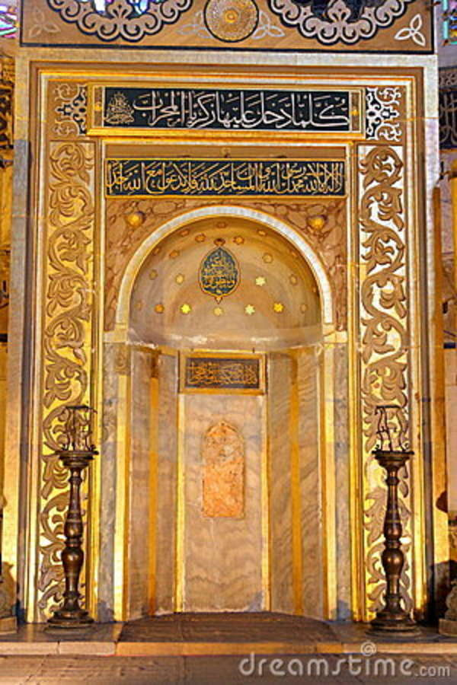
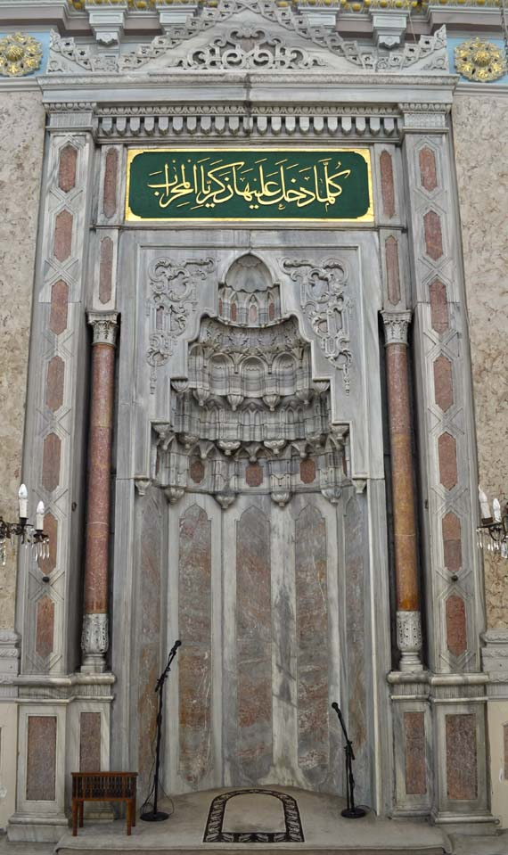
Mihrab
Is a niche built into the wall of the Mosque which is usually accompanied by a pulpit
The Mihrab indicates the direction of the Kaaba (الكعبة) in Mecca which is the direction Muslims face when they pray.

Slide 12
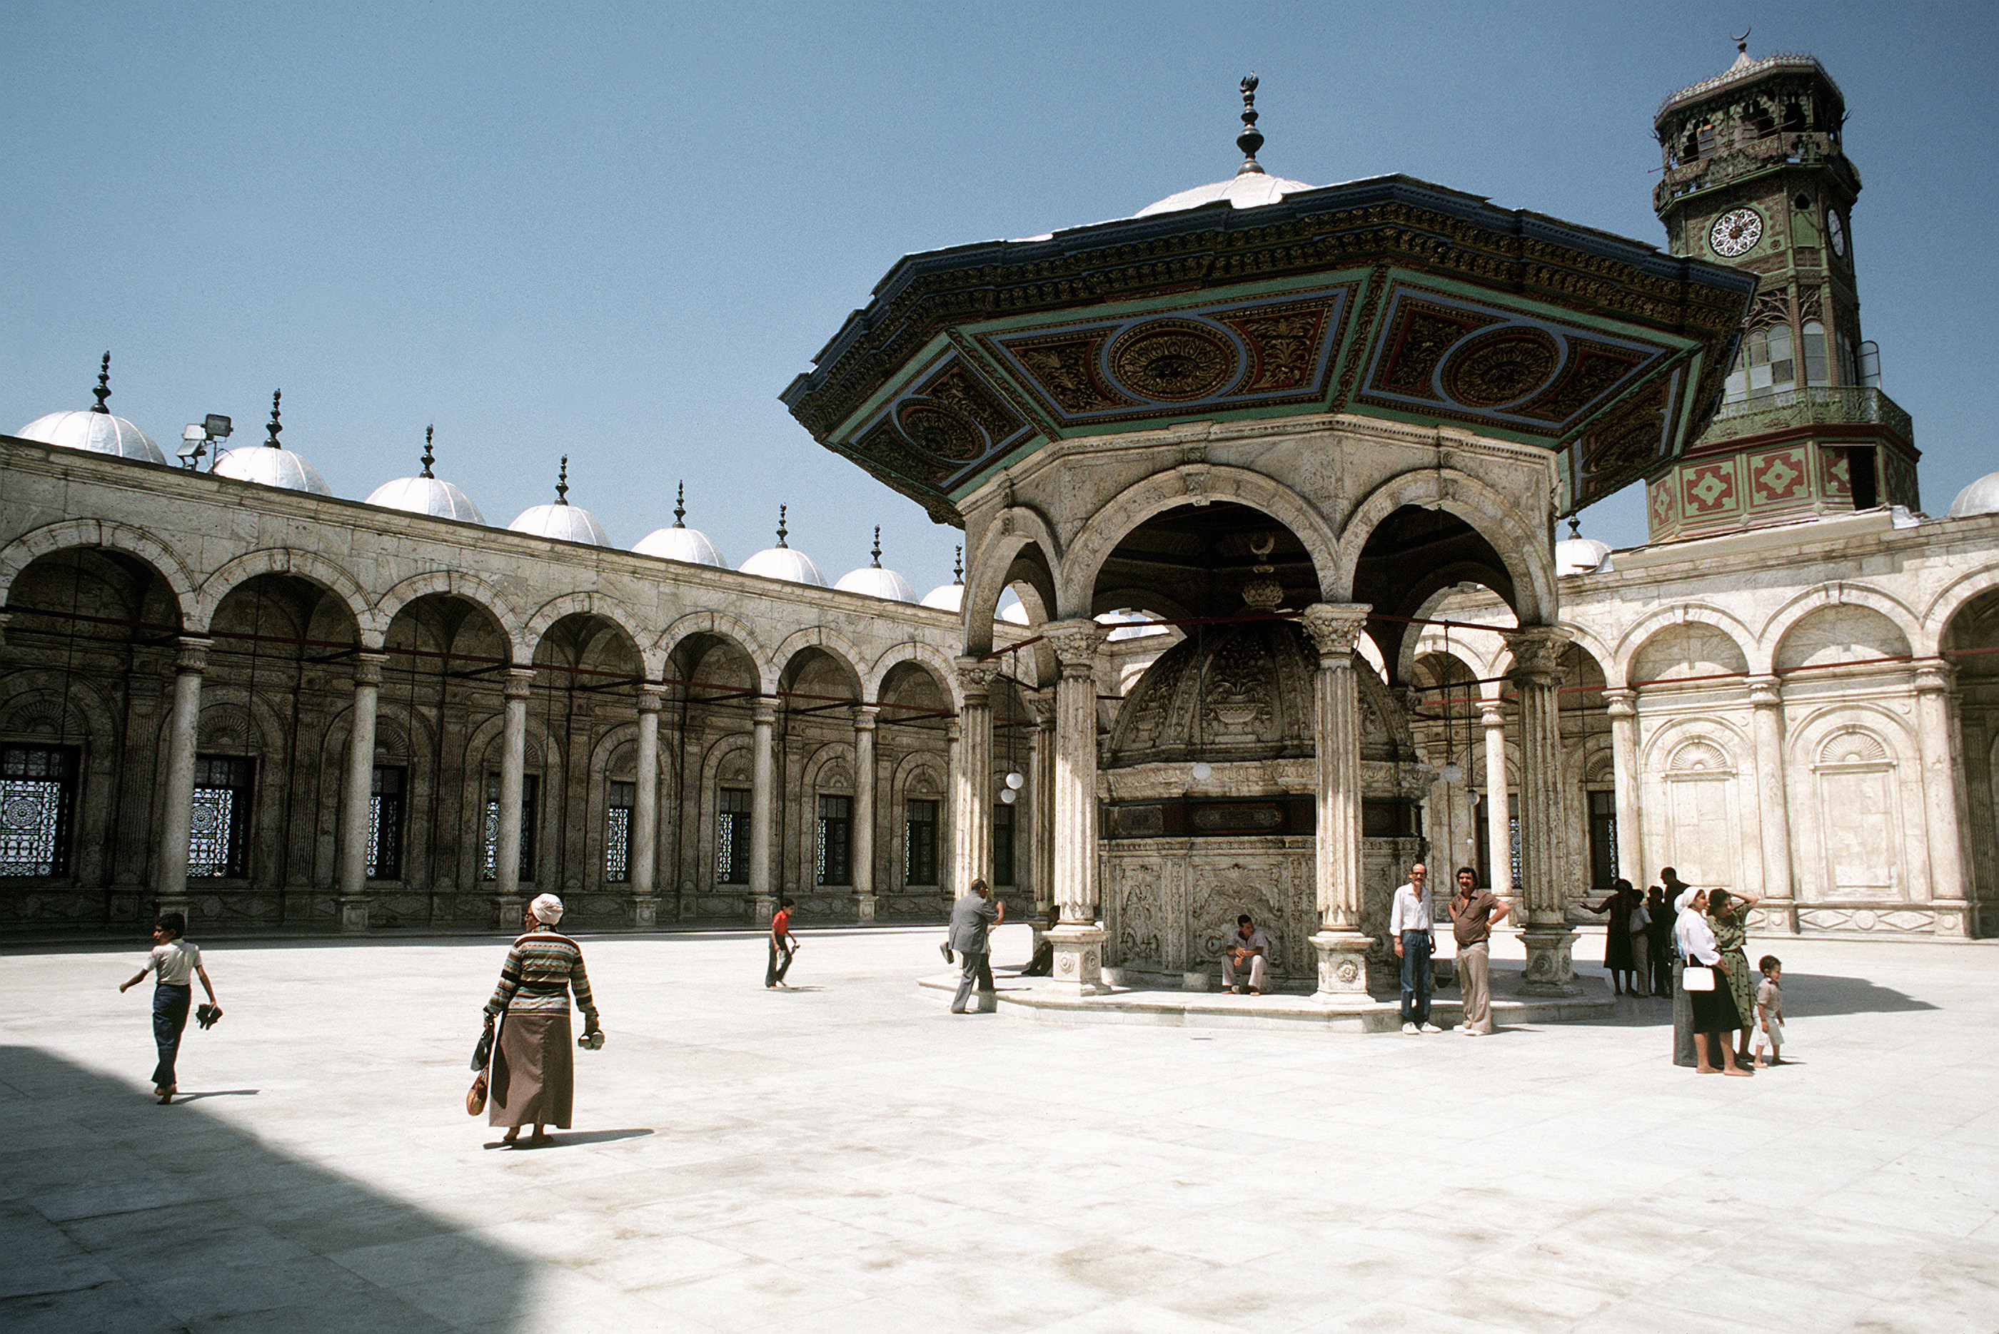
Other Elements
Bright Colors
Symmetric Design
Ablution Fountains
Focus put into interiors rather than exteriors “beauty of the veil”
An ablution fountain is where Muslims perform a ritual washing before entering for prayer. It is usually located in the courtyard.

