Slide 1
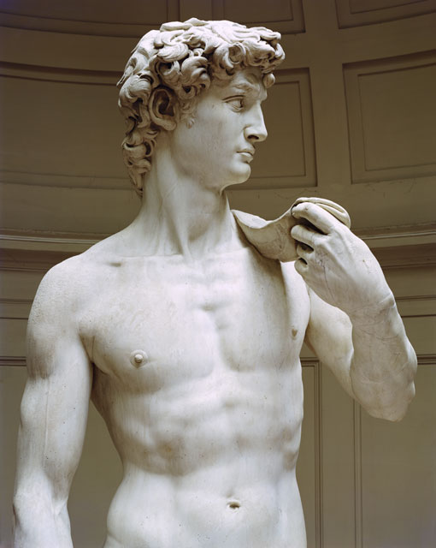
Italy: Birthplace of the Renaissance
David (1501-1504), Michelangelo
17.1
The Italian Renaissance is a rebirth of learning that produces many great works of art and literature.

Slide 2
Italy’s Advantages
The Renaissance
Renaissance—an explosion of creativity in art, writing, and thought
Started in northern Italy
Lasted from 1300-1600

Slide 3
Italy’s Advantages
Merchants and the Medici
A wealthy merchant class develops
More emphasis on individual achievement
Banking family, the Medici, controls Florence
Looking to Greece and Rome
Artists and scholars study ruins of Rome, and study Latin and Greek manuscripts
Scholars move to Rome after the fall of Constantinople in 1453.

Slide 4
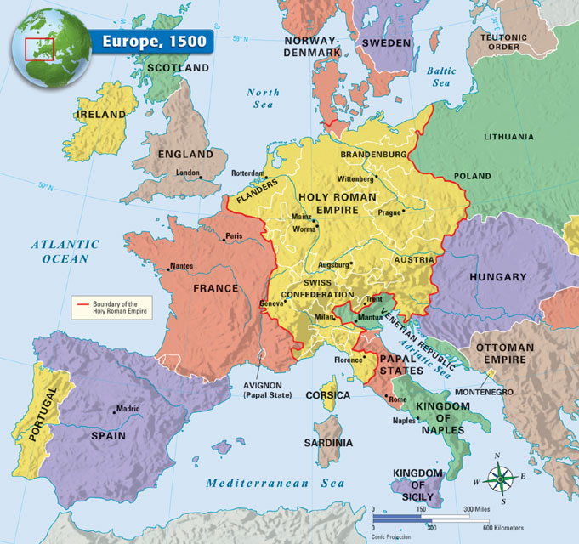

Slide 5
Classical and Worldly Values
Classics Lead to Humanism
Humanism—intellectual movement focused on human achievements
Humanists studied classical texts, history, literature, and philosophy
Worldly Pleasures
Renaissance society was secular—worldly
Wealthy enjoyed fine food, homes, and clothes

Slide 6
Classical and Worldly Values
Patrons of the Arts
Patron—a financial supporter of artists
Church leaders spend money on artworks to beautify cities
Wealthy merchants also patrons of the arts
The Renaissance Man
Excels in many fields: the classics, art, politics, and combat
Baldassare Castiglione’s (pictured right)The Courtier (1528) teaches how to become a “universal” person

Slide 7
Classical and Worldly Values
The Renaissance Woman
Upper-class, educated in classics, charming
Expected to inspire art but not create it
Isabella d’Este, patron of the artists, wields power in Mantua

Slide 8
The Renaissance Revolutionizes Art
Artistic Styles Change
Artists use realistic style copied from classical art, often to portray religious subjects
Painters use perspective—a way to show three dimensions on canvas
Realistic Painting and Sculpture
Realistic portraits of prominent citizens
Sculpture shows natural postures and expressions
The biblical David is a favorite subject among sculptors (although he looks more like a classical Greek)

Slide 9
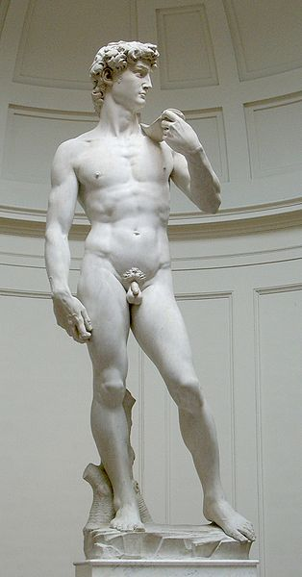
CENSORED

Slide 10
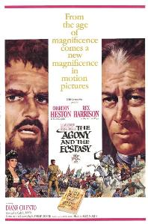
Michelangelo di Lodovico Buonarroti Simoni
Portrait painted after 1535 of Michelangelo at the age of 60 by Jacopino del Conte
The novel and film The Agony and the Ecstasy is about him painting the Sistine Chapel for Pope Julius II.

Slide 11
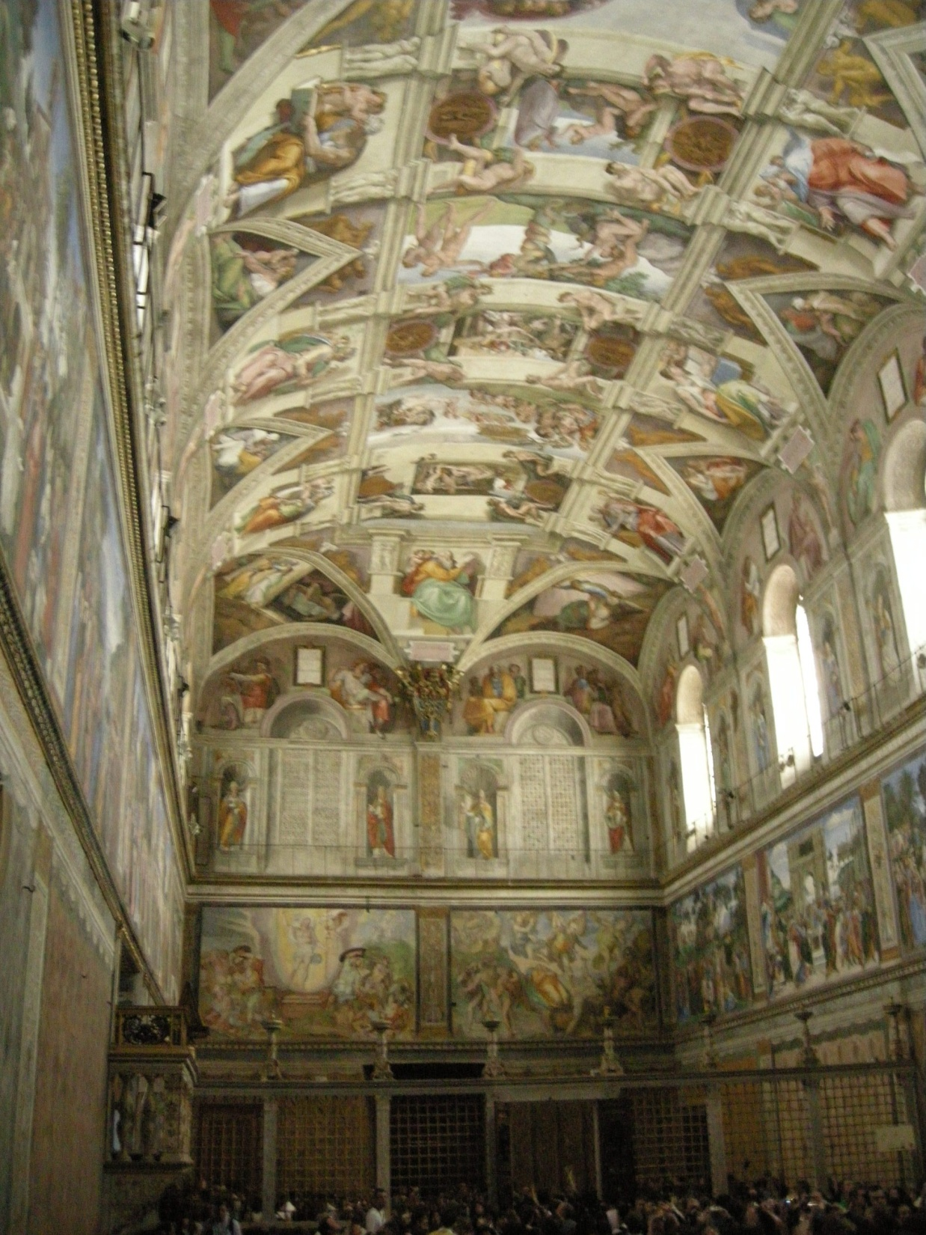
Photo of the ceiling of the Sistine Chapel

Slide 12
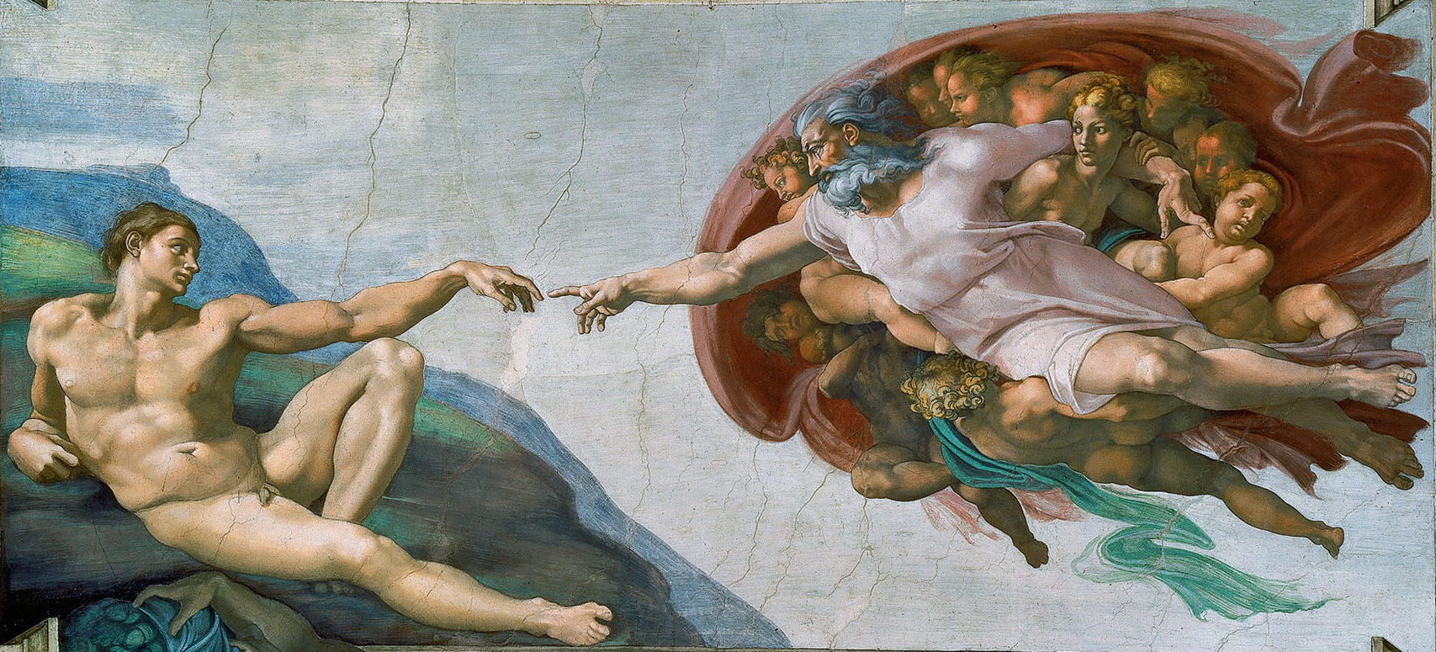
The Creation of Adam by Michelangelo, found of the ceiling of the Sistine Chapel

Slide 13
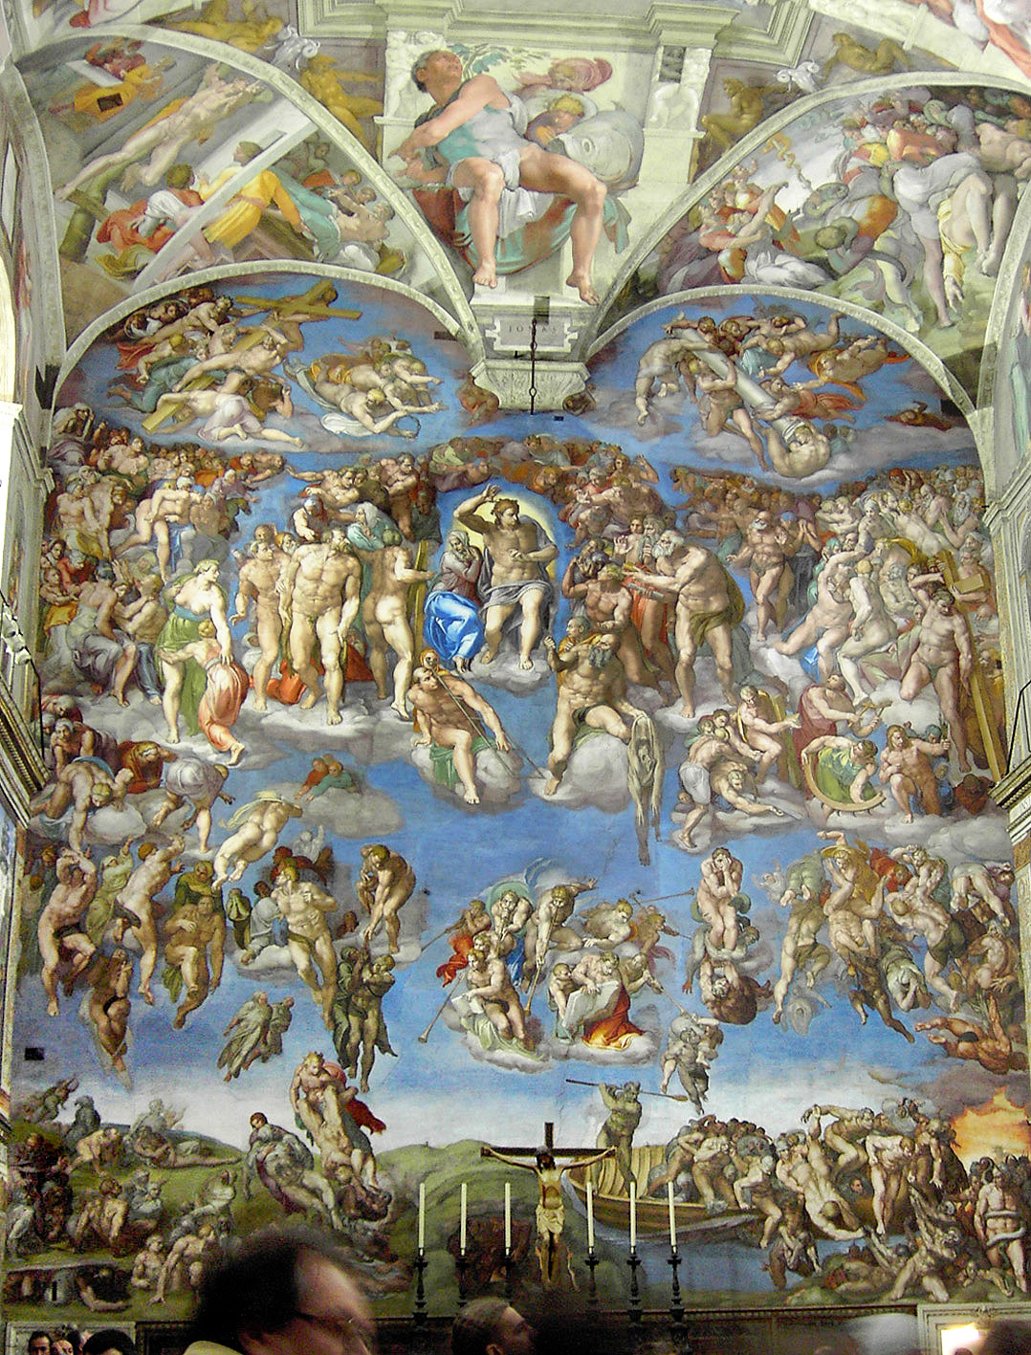
Michelangelo’s The Last Judgment in the Sistine Chapel

Slide 14
The Renaissance Revolutionizes Art
Leonardo, Renaissance Man
Leonardo da Vinci—painter, sculptor, inventor, scientist
Paints one of the best-known portraits in the world: the Mona Lisa
Famous religious painting: The Last Supper

Slide 15
Leonardo’s Work: Painting
Left: Mona Lisa
Above: The Last Supper

Slide 16
Leonardo’s Work: Science & Medicine
The Vitruvian Man
Studies of a fetus from Leonardo's journals

Slide 17
Leonardo’s Work: Science & Medicine
Investigating the motion of the arm
Organs of a Woman’s Body

Slide 18
Leonardo’s Work: Inventions
Design of a flying machine based on bat’s wings

Slide 19
The Renaissance Revolutionizes Art
Raphael Advances Realism
Raphael Sanzio, famous for his use of perspective
Favorite subject: the Madonna and child
Famous painting: School of Athens

Slide 20
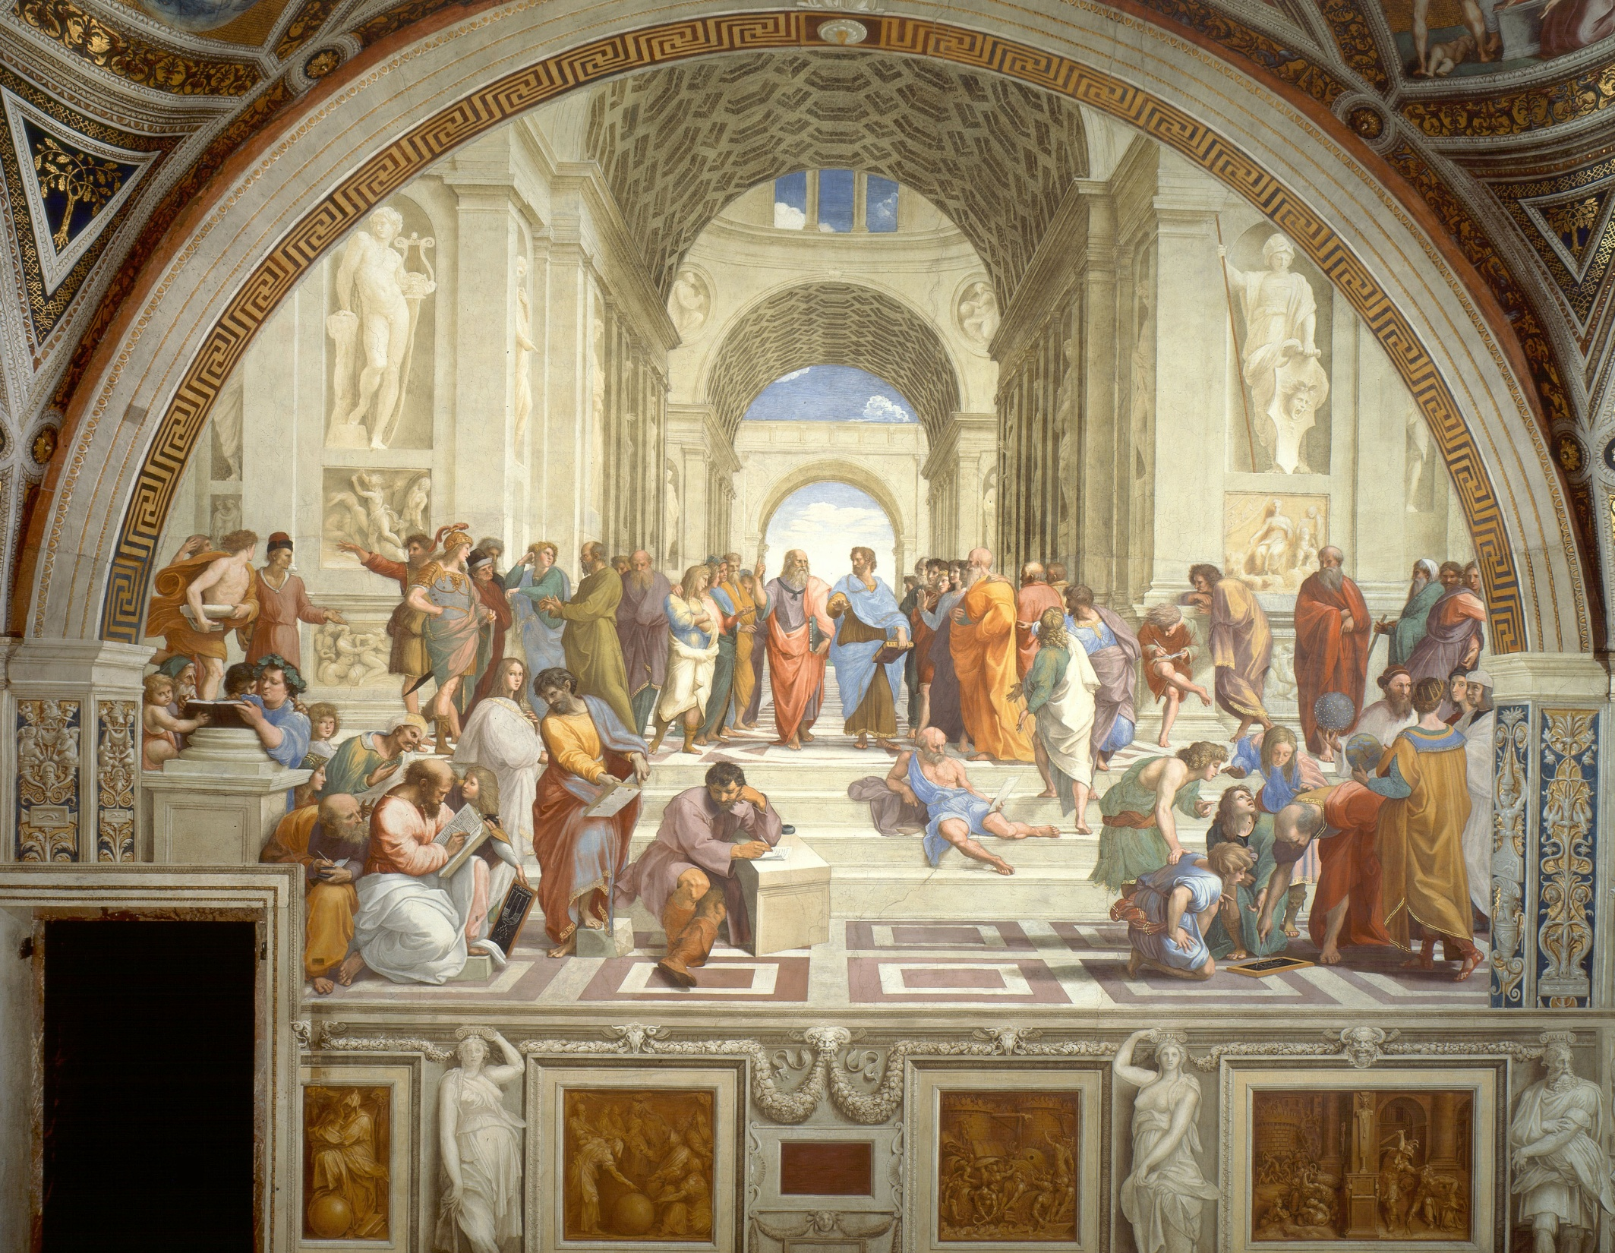
School of Athens by Raphael

Slide 21
The Renaissance Revolutionizes Art
Women Painters
Sofonisba Anguissola (pictured right): first woman artist to gain world renown

Slide 22
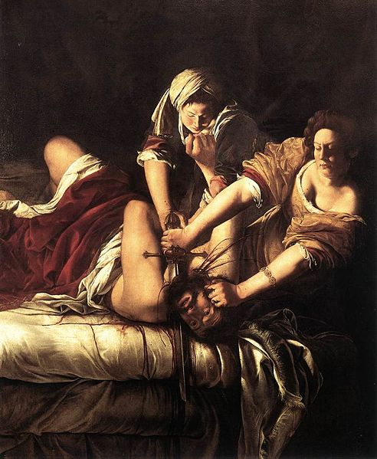
The Renaissance Revolutionizes Art
Women Painters
Artemisia Gentileschi (self portrait below) paints strong, heroic women (see right).
Judith Slaying Holofernes (1614-20) Oil on canvas 199 x 162 cm Galleria degli Uffizi, Florence

Slide 23
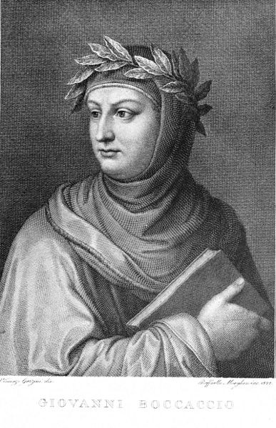
Renaissance Writers Change Literature
New Trends in Writing
Writers use the vernacular—their native language
Self-expression or to portray individuality of the subject
Petrarch and Boccaccio
Francesco Petrarch, humanist and poet; woman named Laura is his muse
Boccaccio is best known for the Decameron, a series of stories

Slide 24
Renaissance Writers Change Literature
Machiavelli Advises Rulers
Niccolo Machievelli, author of a political guidebook, The Prince
The Prince examines how rulers can gain and keep power

Slide 25
Renaissance Writers Change Literature
Vittoria Colonna
Woman writer with great influence
Poems express personal emotions

