Slide 1


Unit 4 :
World War I
EQ: Why was Europe a “Powder Keg” in 1914? What drew the U.S. into this foreign conflict?
It’s possibly the single most pondered question in history – what caused the unbound, senseless slaughter that was World War One?

Slide 2
Unit 4 – World War One
Key facts
World War I, also known as the First World War, the Great War, the Seminal Catastrophe, and initially in North America as the European War, was a global war originating in Europe that lasted from July 28, 1914 to November 11, 1918 (Today known as Armistice Day). Why didn’t we get it off?
Start date:
Jul 28, 1914
End date:
Nov 11, 1918
Notes:
QuickStarter has created an outline to help you get started on your presentation. Some slides include information here in the notes to provide additional topics for you to research.
Summary:
World War I, also known as the First World War, the Great War, the Seminal Catastrophe, and initially in North America as the European War, was a global war originating in Europe that lasted from 28 July 1914 to 11 November 1918. Contemporaneously described as "the war to end all wars", it led to the mobilisation of more than 70 million military personnel, including 60 million Europeans, making it one of the largest wars in history. It is also one of the deadliest conflicts in history, with an estimated nine million combatants and seven million civilian deaths as a direct result of the war, while resulting genocides and the resulting 1918 influenza pandemic caused another 50 to 100 million deaths worldwide.

Slide 3
Background
Described as "the war to end all wars", it led to the mobilization of more than 70 million military personnel, including 60 million Europeans, making it one of the largest wars in history.
It is also one of the deadliest conflicts in history, with an estimated nine million combatants and seven million civilian deaths as a direct result of the war
While resulting genocides and the resulting 1918 influenza pandemic caused another 50 to 100 million deaths worldwide.

Slide 4
Causes for WWI
M.A.I.N.
M = Militarism – countries building strong armies
  “We must protect this house!”
A = Alliances – Many European nations agreed to help each other if war breaks out.
  Triple Entente aka Allied Powers = Great Britain, Russia, France (*U.S. joins them in 1917)
  Triple Alliance aka Central Powers = Austria-Hungary, Germany, Italy (Italy drops out in ….. And switches sides!)

Slide 5
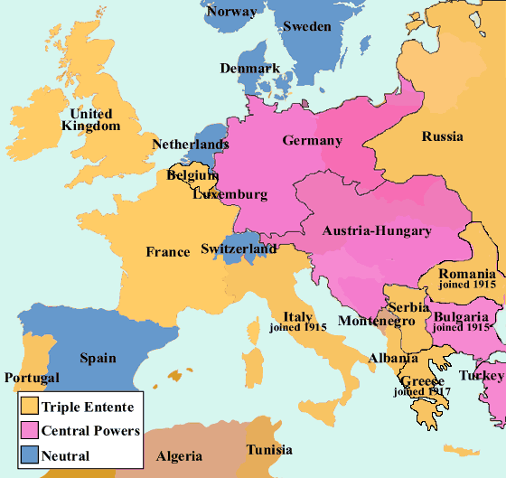
A l
I a n c e s

Slide 6
Causes for WWI
M.A.I.N.
I = Imperialism – Imperial competition also pushed the countries towards adopting alliances
  Colonies were units of exchange that could be bargained without significantly affecting the host country.
  Provided a sense of power, resources, and a larger market to sell industrial goods to.

Slide 7
Causes for WWI
N = Nationalism – Pride in ones country/ethnicity
  The “Big” event that starts WWI…
    Archduke and heir to the Austro-Hungarian throne visits the Bosnian capital of Sarajevo.
    A revolutionary terrorist named Gavrilo Princip belonging to a terrorist group called the “Black Hand” assassinates him.
    This event puts the various alliances into action and at war with each other.

Slide 8
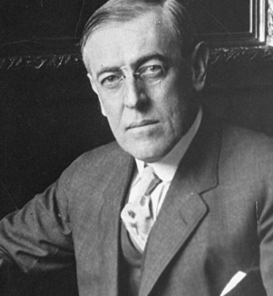
July 28, 1914. World War I Begins
Austria-Hungary declares war on Serbia
World War I really starts when each country supports their allies
President Wilson and the USA vow to stay out of the war and remain neutral.

Slide 9
Why is there a Stalemate on the Western Front of the war?
German troops attack France
French and British troops stop them at the border.
Both sides dig trenches to fight on the Western Front.
Stalemate – neither side makes much gain, forward progress is halted.
Trench Warfare/stalemate lasts for 2 years
https://www.youtube.com/watch?v=SXtsiqrhqsU
https://www.youtube.com/watch?v=0A136W6br_0

Slide 10
America Moves Closer to Entering WWI
Why?
New German Naval Weapon the U-Boat (small submarine)
  Torpedo/Sink any ships seen as enemy
  British cruise ship the Lusitania is sunk by a German U-Boat
  Torpedo kills 1,198 total including 128 Americans
  The Arabic and Sussex British ships are also attacked and sunk
    Sussex Pledge - the German government issued a pledge to the United States that the Imperial navy would not attack passenger ships and would further allow the crew of merchant ships which carried war material to exit their vessels before they would be sunk. (didn’t hold up)

Slide 11
The Presidential Election of 1916
    Wilson promises to stay neutral -“Vote for me I’ll keep us out of the war”
    President Woodrow Wilson (D) wins reelection.
    Promises to loan allies $$$$, & war supplies.
    However he reluctantly gets drawn into war.

Slide 12
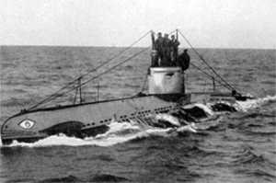
What Caused America to Enter WWI
    President Wilson asks Congress to declare war on Germany –April, 1917.
    The Zimmerman note - Germany asks Mexico to join them and attack USA.
http://www.history.com/news/ask-history/what-was-the-zimmermann-telegram
Germans sink American ships and
Declare “unrestricted submarine warfare”
President Wilson asks Congress to
declare war on Germany –April, 1917.

Slide 13
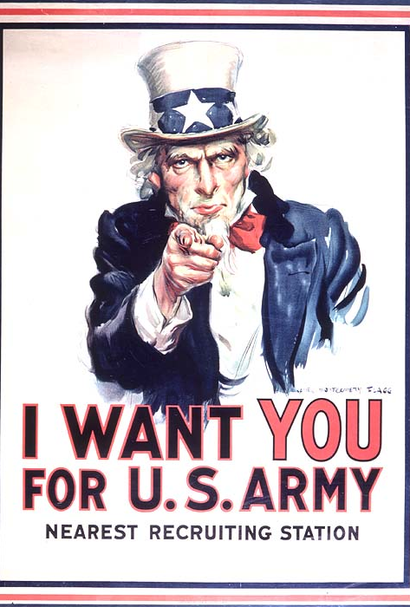
How Does America Prepare For WWI?
Mobilization
  Factories start producing war materials.
  Farms start growing more food.
  Rationing is encouraged.
  Government agencies (WIB) are created to prepare for war.
  America starts the draft-selective service act.

Slide 14
How Does America Prepare For WWI?
  Raising money to pay for the war
    Selling U.S. War Bonds
    Raise Taxes
  Committee of Public Information = Propaganda
  (the more or less systematic effort to manipulate other people’s beliefs, attitudes, or actions by means of symbols like words, gestures, banners, monuments, music, clothing, insignia, hairstyles, designs on coins and postage stamps, and so forth)

Slide 15
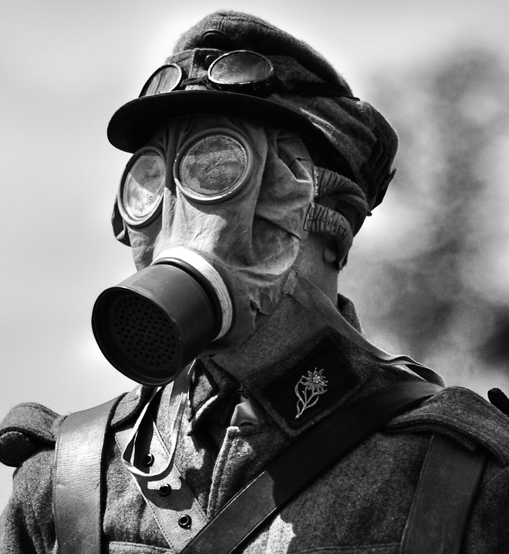
New Weapon Technology in WWI
  Machine gun
  Tank
  Flame throwers
  Airplanes
  U Boat
  Chemical warfare… now you need gas masks

Slide 16
The War “to end all wars” Comes to an End
American soldiers led by General John Pershing land in France to help the Allies
Russian drops out of the war because of domestic problems
  The Russian Revolution begins
  Topples the Czar and brings about the USSR a Communist Nation
The Allies beat the Germans at The Battle of the Argonne Forest In France
“On the 11th hour of the 11th day of the 11th month the war was officially over
  11/11/1918 = Today known as Veterans' Day

Slide 17
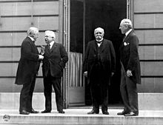
The Treaty of Versailles
Officially ends the war and pretty much starts the second World War
The “Big Four” victorious nations:
  It was composed Woodrow Wilson of the United States, David Lloyd George of Britain, Vittorio Emanuele Orlando of Italy, and Georges Clemenceau of France.

Slide 18
Why Treaty no Worky?
First and foremost too much punishment on the country of Germany
  Made them pay war reparations = $$ = Bankrupt
  Forced to dramatically downsize their military
  Return land seized from France
  Restricted military presence along French boarders

Slide 19
President Wilson’s Fourteen Point Plan
His plan for world peace falls on deaf ears
European Allies want to push blame and punishment somewhere
Summary of Plan:
  Stated no secret treaties of alliances
  Called for freedom of the seas
  Economic cooperation between nations
  Ethnic groups given self rule
  The creation of a World Peace Keeping Organization
However, the U.S. Congress rejected entry into the League of Nations

Slide 20
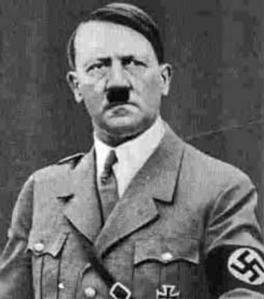
All of These Factors Led to This Little Guy Coming to Power

