Slide 1
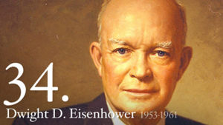
The Cold War: Eisenhower Years 1953-1961
EQ: 1) In what ways did Eisenhower continue come Cold War policies of Truman and in what new policies did he implement? 2) What social changes took place in the U.S. during the Eisenhower administration?

Slide 2
Major Themes of Unit 9
Nuclear Proliferation and the continuation of the Arms Race
The Arms Race is now coupled with a Space Race
Civil Rights becomes a hot issue in the U.S.
Significant Supreme Court decisions on Segregation vs. Integration
A time of prosperity emerges in the U.S.

Slide 3
Transition from Truman to Eisenhower
Truman narrowly won re-election in 1948 and does not run in 1952
By the election of 1952 may Americans are disenchanted by the Korean War
Loss of American lives
Financial burden of war
Back and forth success and loss = no change; 38th parallel remains dividing line
Dwight Eisenhower runs on a platform promising to bring an end to the war
Wins in a landslide in 1952 and wins a second term in 1956
America a place of “peace, progress, and prosperity”

Slide 4
Arms Race Continues
Timeline
1945 – U.S. introduces the atomic bomb to the world by dropping two on Japan to bring about an end to WWII
1949 – The Soviet Union successfully tests its first atomic bomb
1952 – U.S. attempts to create an even more powerful weapon, successfully tests the first hydrogen bomb, or H-bomb
1953 – The Soviets successfully test their own H-bomb
1950’s – U.S fearing nuclear attack conduct air-raid drills and construct fallout shelters
Brinksmanship – the willingness to go to the edge, or brink, of war
This is very dangerous when nuclear weapons are in play

Slide 5
The Space Race
U.S. and USSR competing to be the first to send a rocket into space
Yet another competition between the two competing for superiority
Thought that satellites could be used militarily/spying
USSR launches first satellite, “Sputnik I”, into orbit in1957
The U.S. fails their first attempt to launch a satellite but is later successful in Jan. of 1958
Living things travel to space
First living creatures in space were dogs and monkeys
Yuri Gagarin, a Soviet pilot, became the first man in space 1961
Later in 1961, Alan Shepard became the first American in space

Slide 6
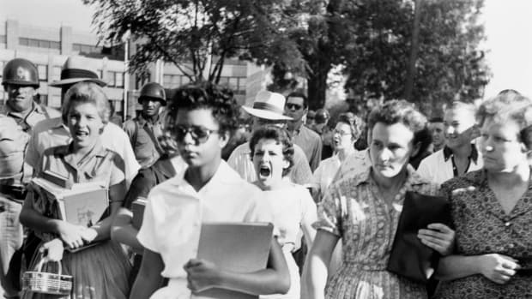
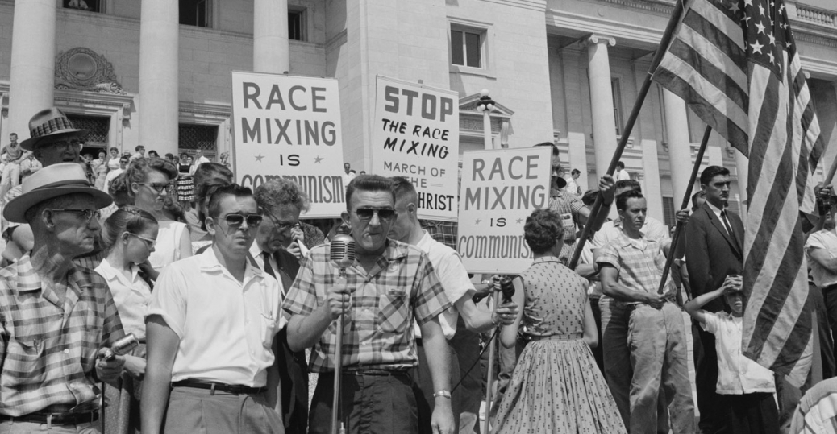
Eisenhower and Civil Rights
Brown v. Board of Education 1954
Supreme Court decided that public schools could not be segregated
Arkansas Nine – African American students who were initially denied by the governor entrance to a “white” public school in 1957
Eisenhower sent in federal troops to integrate the school

Slide 7
Eisenhower and Civil Rights
Bus Boycotts of Montgomery and Tallahassee
African Americans refused to ride public buses to protest segregated seating
Montgomery, AL – Dec. 1955 through Dec. 1956
Tallahassee, FL – May 1956 through Dec. 1956
Sparked by Rosa Parks arrest
Ended with the U.S. Supreme Court ruling that segregation on public buses is unconstitutional
Segregation gives way to integration
Civil Rights movements would go on to include women and other minority rights

Slide 8
American Prosperity in the 1950’s
The Baby Boom-population explosion from 1945-1963
Largest generation in history
Increased need for schools and products for children
Americans are economically and financially better off after WWII.
Youth activities, such as Scouts and Little League
“White Collar” workers outnumber “Blue Collar” workers
From the factory to the office
Jobs in sales and communications

Slide 9
American Prosperity in the 1950’s
New products, goods for sale
We become a “throw away” society
Planned Obsolescence – products are purposely made to become outdated or wear out so consumers must replace them
People measured success by their consumerism
Marketing in magazines, TV ads, and radio common
New methods of doing business
Franchises
Conglomerates
Fast Food (McDonald’s 1955)
Credit Cards

Slide 10
American Prosperity in the 1950’s
Many new homes built - American’s leave the city and move to the suburbs
Suburban life required a car – 40 to 60 million increase in cars on the roads
Interstate Highways constructed
Family road trips/vacations more popular
Medical advancements in the 50’s – vaccines
Polio had once crippled or killed 58,000 kids a year

Slide 11
New fads and entertainment of the 1950’s
More leisure time and money to spend on entertainment – sports, books, clubs, etc.
TV’s and TV shows become wildly popular
Hollywood Movies on “The Big Screen”
Advent of Rock and Roll Music
Elvis Presley “King of Rock and Roll”
New dance styles
https://www.youtube.com/watch?v=Rf55gHK48VQ
New fashion trends

