Slide 1
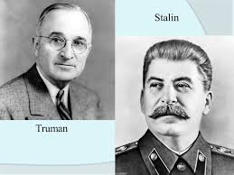
Unit 8 The Cold War Under Truman 1945-1953
EQ: How did the Cold War emerge after the end of WWII and how did it affect the U.S. at home and abroad?

Slide 2
What was the Cold War?

Slide 3
USA VS. USSR

Slide 4
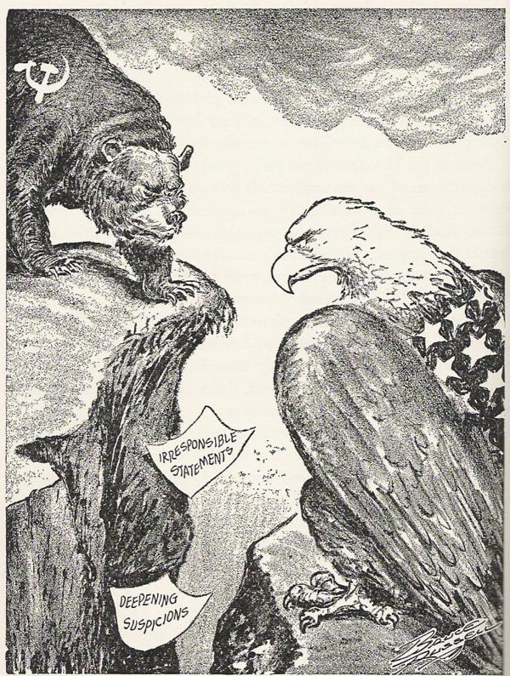
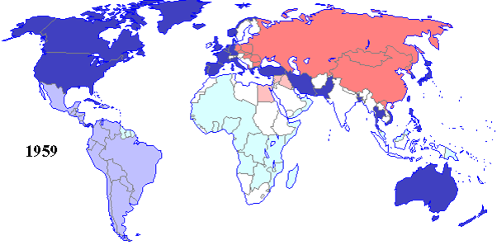

Slide 5
Causes of the cold war
Nuclear weapon build up between the U.S. and USSR. The “arms race” begins.
The USSR spreading communist government ideas to other countries in Eastern Europe (Iron Curtain) and Asia.
“Satellite Nations”
Churchill “Iron Curtain Speech”
https://www.youtube.com/watch?v=S2PUIQpAEAQ

Slide 6
Causes of the cold war
U.S.A. Containment Policy = prevent the spread of communism
Truman Doctrine – Would support/help countries who are resisting communism from the Soviet Union
Marshall Plan – Plan to aid Europe after WWII in attempt to prevent countries from falling to communism
$17 billion to 16 countries in Europe

Slide 7
Causes of the cold war
“Domino Theory” – If the U.S. doesn’t fight communism, then countries will fall to communism like dominos
“Brinksmanship” – pushing a situation to the point of disaster/war without quite going over the edge

Slide 8
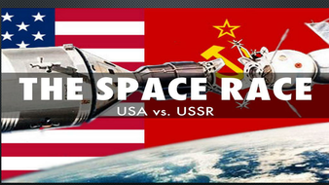
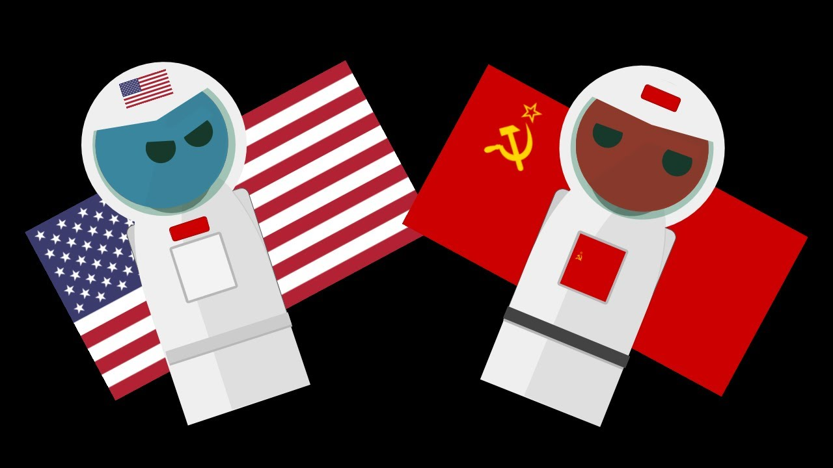
Causes of the cold war
Communism vs. Capitalism
Freedom and Democracy vs. Tyranny and Absolute Rule
The Cold War also revolved around the Space Race/science and technology

Slide 9
The battle over the division of Germany after WW II
This is the first confrontation of the Cold War
Germany is divided into East and West as is the capital Berlin
The Soviets control the East
France, Great Britain, and the U.S. control the West
In total there are 4 zones
Berlin Blockade – Soviets blocked all entrances and exits to the city in 1948
Berlin Airlift – U.S.A. and allies fly in supplies until Soviets lift blockade

Slide 10
Alliances during the cold war
The U.S.A. and The U.S.S.R. create alliances during the Cold War
NATO – The U.S., Canada and countries of West Europe
Warsaw Pact – USSR and Eastern European communist countries

Slide 11
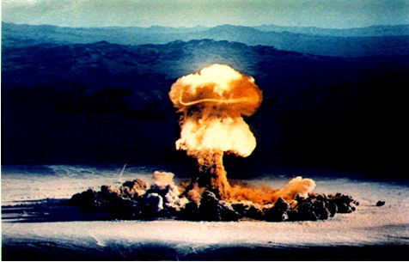
The new “red scare”
The USSR creates / tests its first atomic bomb. The Cold War “Arms Race” has begun! Video below
https://www.youtube.com/watch?v=RNYe_UaWZ3U

Slide 12
“Red Scare” in the U.S.
J. Edgar Hoover leader of the FBI looks for communists in America
HUAC investigates communists among us
Joseph McCarthy / U.S. Senator leads a “witch hunt” searching for communist among Americans. “McCarthyism”
The Rosenberg spy case

Slide 13
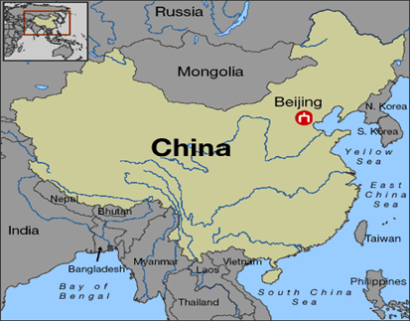
The Cold War Spreads to Asia
China
Communism takes over in China led by Mao Zedong aided by USSR. China and USSR form an alliance
Democratic/Nationalist Chinese are aided by U.S. but lose revolution and are forced to island of Formosa – they create the country of Taiwan

Slide 14
The Korean War
After WW 2 Korea was divided at the 38th line of Latitude
The USSR controlled North Korea
The U.S. controlled South Korea
Communist North Korea invaded South Korea trying to take over all of Korea
This begins the Korean War 6-25-1950
The U.S. helps South Korea because of the Truman Doctrine & ”Domino Theory”

Slide 15
The Korean War
President Truman wants to fight a limited war. General MacArthur is fired for disagreeing with Truman

Slide 16
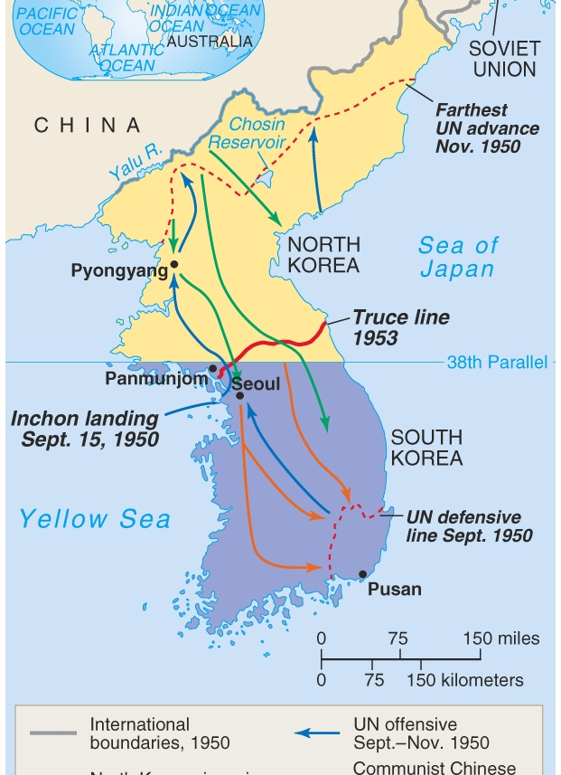
The Korean War
The Korean War ends in 1953
Korea is divided at the 38th parallel
North Korea becomes a communist nation led by a dictator
South Korea becomes a democratic / capitalist nation

