Slide 1
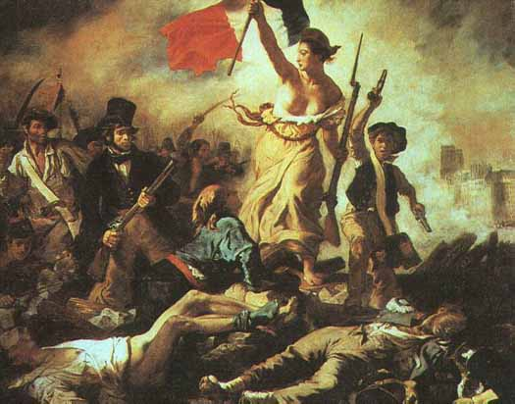
The French Revolution (1789-1799)

Slide 2
Key Causes of the Revolution
The French Revolution was greatly influenced by the American Revolution and the Enlightenment.
The French government was almost bankrupt.
When attempting to fix their government, a group of French men declared themselves the National Assembly and claimed sole authority of lawmaking.
The National Assembly created the Declaration of the Rights of Man and Citizen.
The French became outraged because these actions were illegal according to “the old regime”
The French Revolution broke out and radicalized many participants of the National Assembly.

Slide 3
Goals of the revolutionaries
To overthrow King Louis XVI and create a republic instead of a monarchy.
To destroy the Ancien regime (an unfair political system ) and to instead write a constitution for France (the Declaration of the Rights of Men and Citizen).
For the lowest class of France (the third estate) to gain more rights and release them from the pressure to have to pay France’s debts.

Slide 4
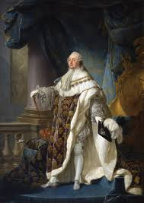
King Louis Xvi (1754-1793)
Born at Versailles on August 23, 1754.
After the death of his grandfather Louis XV, he ruled as King of France and inherited substantial debt.
Reluctantly agreed to much of the radicals' agenda, hoping in this way to retain his a constitutional monarchy.
Forced to leave Versailles in October 1789.
Found guilty of treason by the National Convention, he was executed on January 21, 1793.

Slide 5
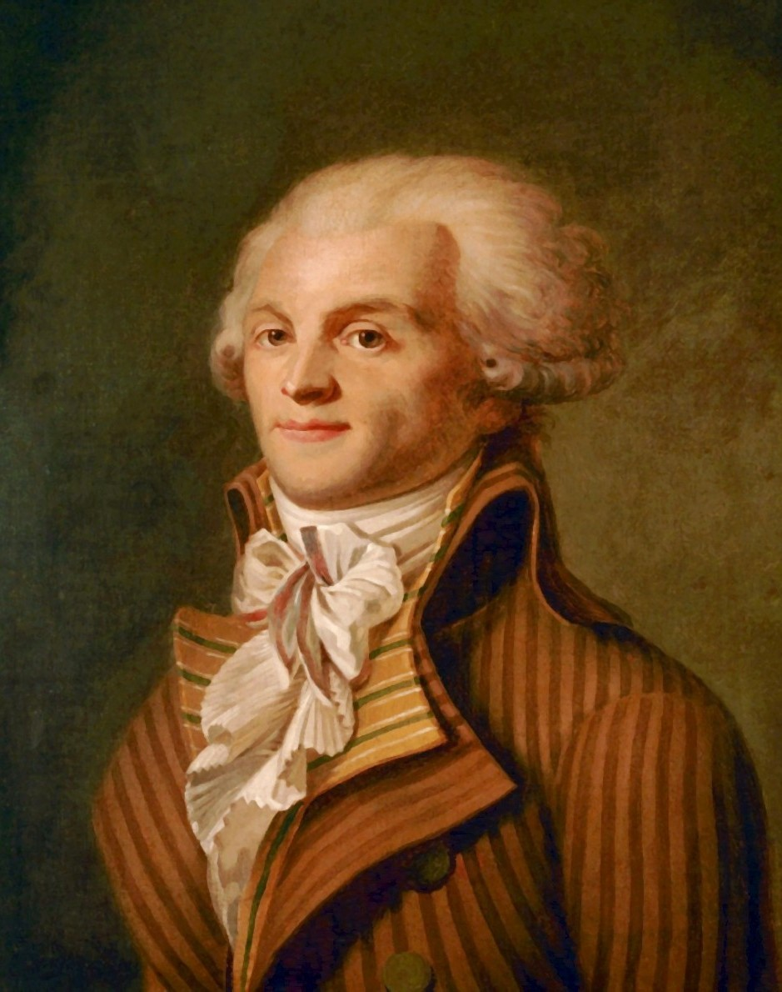
Maximilien Robespierre (1758-1794)
In 1793, the Convention elected Robespierre to the Committee of Public Defense.
He led the French into the Reign of Terror, under the Jacobins, in which he tried to suppress any potential enemies of the radicals with the guillotine.
He was guillotined without trial on July 28, 1794, marking the end of the Reign of Terror.

Slide 6
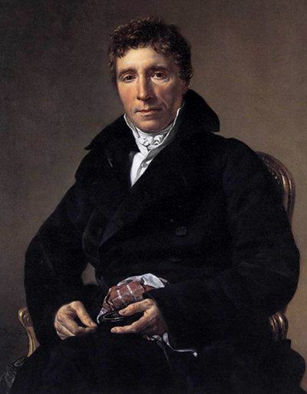
Emmanuel Joseph Sieyes (1748-1836)
Became an Abbe: a lower-ranking clergyman in the French Roman Catholic Church.
Abbe Sieyes wrote his pamphlet, Qu'est-ce que le tiers état? ( What is the third estate? ) in 1789.
This pamphlet called to the first and third estates to join the third estate in the revolution.
The Abbe also wrote the Declaration of the Rights of Man and Citizen, which became influential and was written to become the constitution of France.
Was also politically active during Napoleon’s rule.

Slide 7
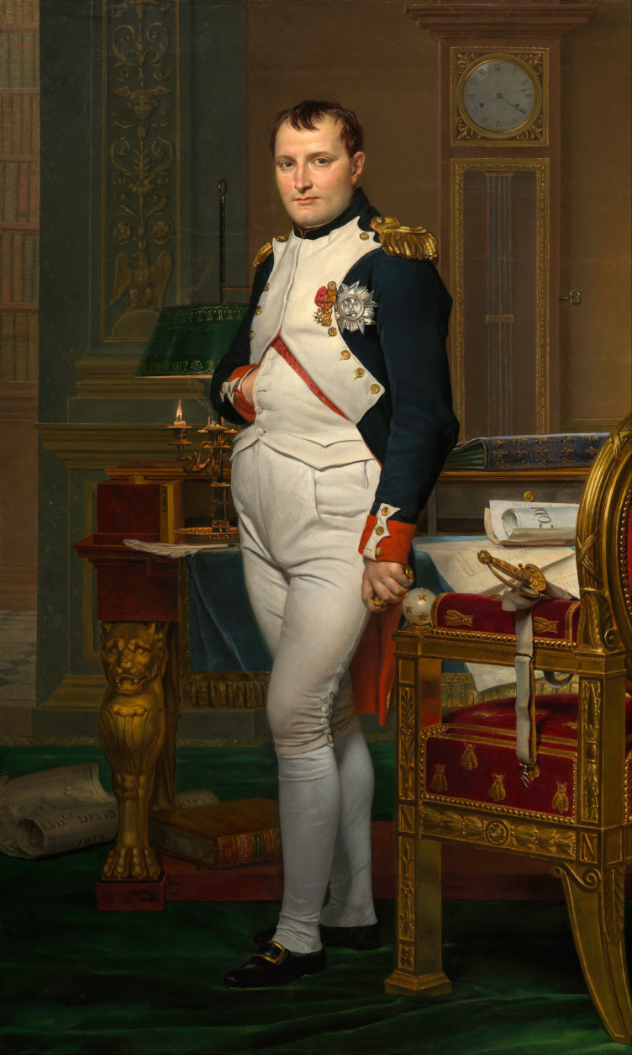
Napoleon Bonaparte (1768-1821)
As a general, Napoleon seized power of France and marked the end to the French Revolution.
He led France through his conquest of much of Europe and established the continent’s biggest empire since the Romans.
Napoleon promoted Enlightenment ideals like civil equality, freedom of religion, and practice promotion by merit, not birthright.
Developed Napoleonic code which was a new legal code, mostly based off of Roman Law.
He was eventually overthrown in 1815 particularly by the British and Russian armies, who disliked Napoleon and his power over Europe.

Slide 8
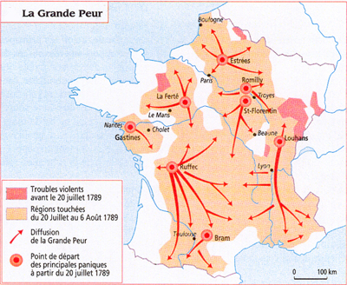
The great fear
JULY & AUGUST 1789- The Great Fear: A period during which rural peasants revolted against their feudal landlords and wreaked havoc in the French countryside. Including: July 14, the date of the storming of the Bastille.

Slide 9
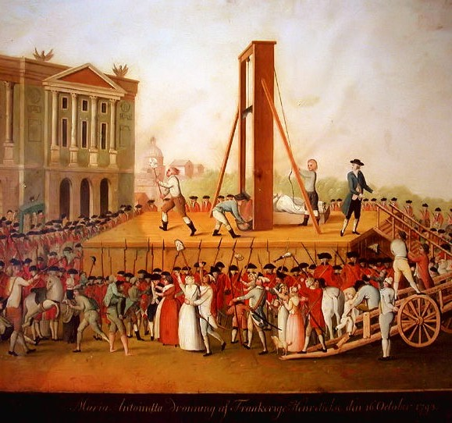
Reign of terror
1793 TO 1794 - A ten-month period of oppression and execution, in which the Committee of Public Safety tried to suppress any potential enemies of the radicals.

Slide 10
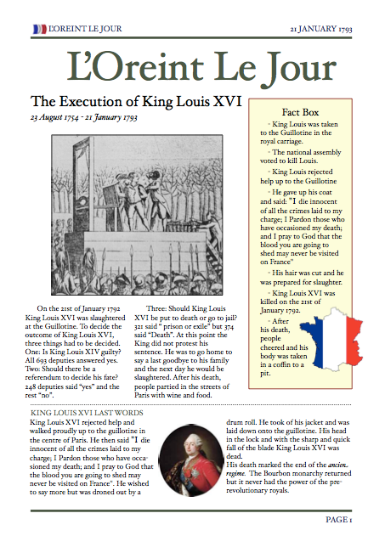
Execution of king Louis Xvi
JANUARY 21, 1793- King Louis XVI Executed: After putting the king on trial and constant debate within the National Assembly for six weeks, the National Assembly sent King Louis XVI and his wife, Marie Antoinette to the guillotine to be executed.

Slide 11
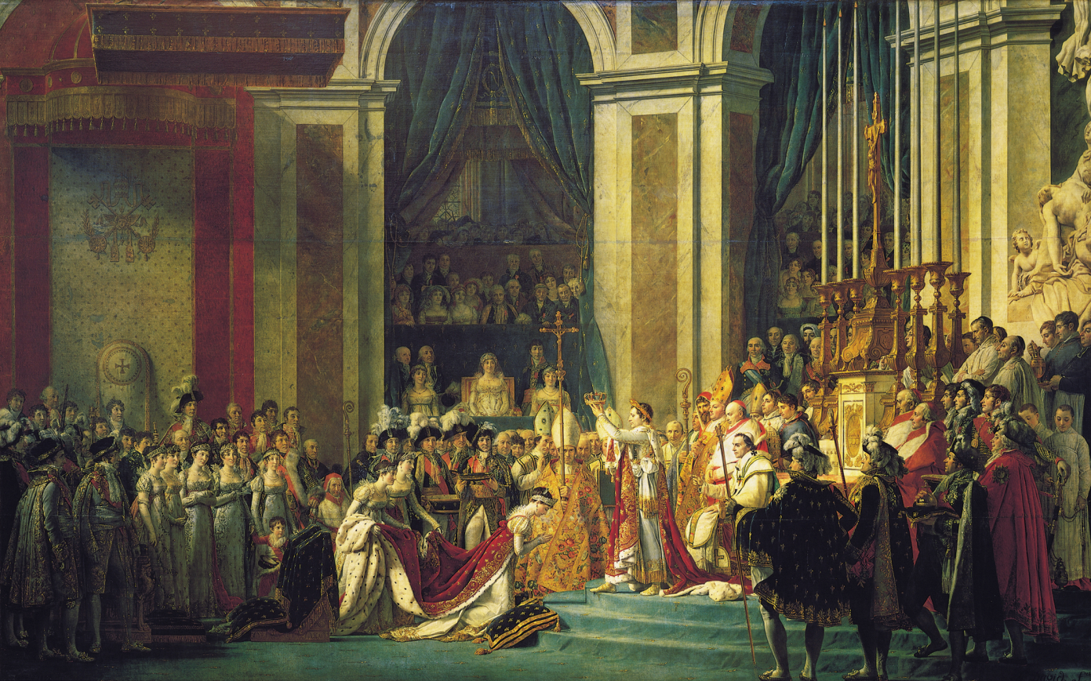
Napoleon Named “First Consul” of France
NOVEMBER 9, 1799- Napoleon declared dictator of France: As a famous and successful general, Napoleon seized power of France and tamed the French Revolution, marking its end.

Slide 12
Results of the revolution
Napoleonic Wars (1803-1815), series of conflicts that brought France against all of Europe’s major powers
Allowed France to hold and control most of Western Europe as satellite countries
Helped spread key revolutionary legislation throughout most of Western Europe
Initiated an era of modern and total warfare
Facilitated nationalism inside and outside of France
End of feudalism
Establishment of religious freedom, substantial equity, among other rights for men
Failure to establish a constitutional monarchy or a representative government

Slide 13
Similarities with the American revolution
Both revolutions were borne of dire economic conditions.
The American and French Revolutions were greatly shaped by Enlightenment ideals such as natural rights and equality.
Both produced seminal political documents that reflected these ideals.
Similarly, the Americans and the French aimed to rid themselves of absolute and abusive monarchs: Louis XVI and George III.

Slide 14
Differences with the American revolution
The French Revolution was more violent, far-reaching, and radical than its American counterpart.
The two also differed in that the Americans sought to restore and build on earlier freedoms while French revolutionaries aimed to start from scratch and looked to the future.
The French Revolution, unlike the American Revolution, raised the question of female political equality more explicitly.
Both revolutions spread their influence in different matters: the Americans via its revolution and its constitution and the French via conquest under Bonaparte.

