Slide 1
Religion in the Classical Era 600 BCE – 600 CE
c. 600 BCE – c. 600 CE
Ch 4, p. 43
Source: AP World History Crash Course by J.P. Harmon

Slide 2
600 BCE – 600 CE
Known as the Classical Era
Greatly influenced later generations as well as today
Many religions that developed during this era had long-term effects world-wide
Various cultural foundations also grew from this era
Greek theatre and democracy
Confucianism
Religious art and literature
Mediterranean architecture

Slide 3
Religious and Cultural Developments
c. 600 BCE – c. 600 CE

Slide 5
Classical Faiths Develop

Slide 6
Existing Belief Systems Spread
Hebrew (Judaism) spread to eastern Mediterranean and Central Asia by the Assyrians (600 BCE) and the Romans (70 CE)
Hinduism created spiritual and social caste system and a long-term (still extant) foundation for society
Influenced by Vedic beliefs brought to India by the Indo European group – the Aryans – and merged into local tradition

Slide 7
Hinduism
Early on, beliefs passed through oral tradition
Later recorded in sacred texts, including the Vedas and the Upanishads
Hinduism Teaches that there are many manifestations of the Great Soul of the Universe (Brahman)(a trinity= trimurti)
Hindus believe themselves to be Monotheistic
Westerners believe them to be Polytheistic

Slide 8
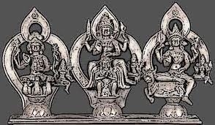
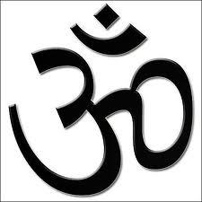
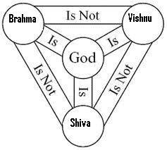

Slide 9
Hindu Pantheon
http://video.about.com/hinduism/Introduction-to-Major-Hindu-Gods-and-Goddesses.htm

Slide 10
Hinduism
No single founder
Developed over many years in South Asia
A blend of many traditions, many from outside of India

Slide 11
Hinduism
Caste System was of central importance in India
All living things participate in the caste system
Cycles reincarnation elevate their souls to the highest level of spirituality or MOKSHA, when the soul becomes one with Braman, the Great Soul
The process can take hundreds of years and thousands of lifetimes
A soul can move up or down the ladder toward Moksha depending on Dharma (deeds) and sincerity

Slide 12
Hinduism
Karma
Teaches one’s social position in life was a sign of good or bad deeds performed in a previous life
Levels of Caste
If one moved higher on ladder they had demonstrated good karma in a previous life
If one moved down, …bad karma

Slide 13
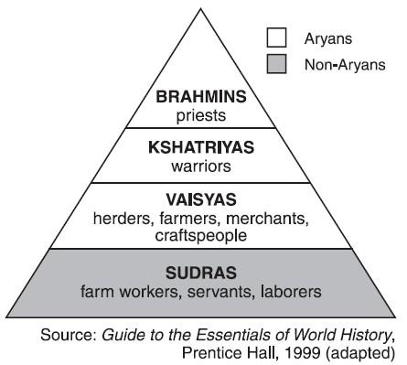
Hinduism
The Caste System
Brahmin
Priestly
Kshaytria
Ruling
Vaisyas
Sudra
Laborer
Pariah
Untouchable
Pariah

Slide 14
Hinduism
The strongest social glue of India
“The Big Constant”
Empires come and go
Many invaders
Other Religions

Slide 15
New Religions Emerge From Old

Slide 16
Buddhism
Began in South Asia (Northern India) c. 500 BCE
Founder: Prince Siddhartha Gautama
Hindu of the Brahman class
Called the Buddha or The Enlightened One
Maintained Hinduism’s belief in reincarnation
NO Caste System
ALL share the same ability to reach NIRVANA
The closer to Nirvana, the less troubled one would be by the cares of this worls

Slide 17
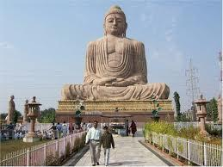
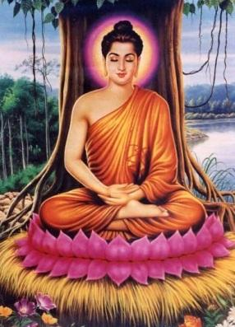
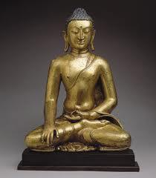
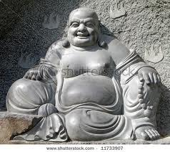

Slide 18
Buddhism
Main teachings maintain that the point to live and to achieving Nirvana was to bring about the end of suffering
The Four Noble Truths
In life, there is suffering
Suffering comes from selfish desire
Those seeking the path to nirvana should strive to end suffering
Suffering can end by following the Eight-Fold Path

Slide 19
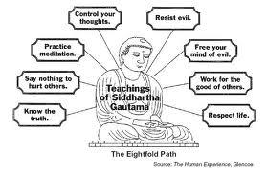
Buddhism
The Eight-Fold Path
Right View
Right Intention
Right Speech
Right Action
Right Livelihood
Right Effort
Right Mindfulness
Right Concentration

Slide 20
Buddhism
The Buddha taught that questions about the existence of God were immaterial.
Those who truly followed the Eight-Fold Path would discover the truth regarding a Supreme Being when they reached nirvana

Slide 21
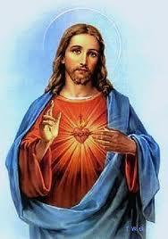
Christianity
Began in Southwest Asia in the first century CE
Founder: Jesus of Nazareth, a Hebrew
Preached salvation through faith in him, the Son of God
Jesus’s teachings were recorded in the Gospels and developed in other writings

Slide 22
Christianity
Teaches equality among believers
Does not teach eternal life (as Buddhism does)

Slide 23
Spreading Faiths
Both Buddhism and Christianity gained more followers outside of their region of origin
Buddhism spread east across the Indian Ocean and by the Silk Roads by missionaries and merchants
Message of peace very appealing
Buddhism changed to a Salvationist faith as it spread east – Mahayana
Theravada – closer to original form not quite atheist but…

Slide 24
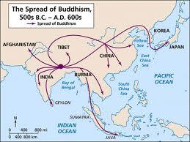
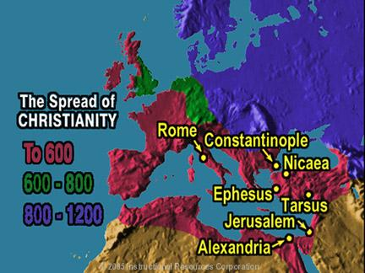
Religions Spread

Slide 25
Spreading Faiths
Christianity also gained popularity beyond it’s original birthplace
Initially seen by the Roman government as disloyal to emperor and Christians were persecuted
Emperor Constantine officially accepted Christianity in 4th century CE
Spread west by missionaries and merchants
Eternal life and equality very appealing
Was the “glue” that held Europe together during the chaos after the fall of Rome

Slide 26
Confucianism
During the Warring States period in China (c. 500 BCE)
Founder: Kong Fu Zi, (Confucius)
Teaching compiled post-mortem in The Analects
Set a clear set of rules for moral behavior and family and political order
Filial Piety
utmost respect for parents
Obedience to those in political control

Slide 27
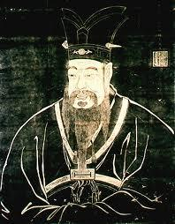
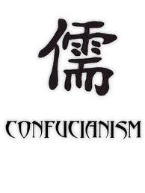

Slide 28
Confucianism
Five Relationships
Ruler to Subject
Father to Son
Elder Brother to Younger Brother
Husband to Wife
Friend to Friend
Shaped family and gender relationships as well as political and social relationships
Patriarchal society

Slide 29
Confucianism
Confucius did not promise an eternal reward
Confucianism is a philosophy for this life, not a religion
By 1200 CE, developed into Neo-Confucianism developed
Confucianism lasted and held China together for centuries

Slide 30
Daoism
Also spelled Taoism
Founder: Laozi – best known Taoist philosopher
Developed around the same time as Confucianism in China and for the same reasons
Teaches
of the close connections between humans and nature
Balance and harmony in all things
Deep respect for ancestors

Slide 31
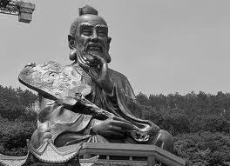

Slide 32
Daoism
Encourages humans to look away from human creations and find peace and balance in nature’s examples
Influential in Chinese medical practices such as acupuncture
Architecture blends into the landscape
Best known symbol – Yin-Yang
Neo-Confucianism incorporated some ideas from Taoism as well as Buddhism

Slide 33
Animism and Shamanism
Do not have written guidelines to shape adherents beliefs
Most began in the oral tradition before writing
Both hold great reverence for deceased ancestors who guide the lives of the living
Continue to be popular in areas of Africa, Andes and some parts of the East Asia and Native America
Animism
Shamanism

Slide 34
Animism and Shamanism
Animism
Belief that the natural world has spiritual powers
All things have a spirit and all spirits must be appeased
Shamanism
Belief that human spirit guides (shamans) are contacts between this world and the spirit world
Shamans are also believed to have the power to heal physical and spiritual illnesses

Slide 35
Belief Systems and Gender Roles
Belief systems play a major part in development of gender roles
Men dominate the leadership of all major religions
Women sometimes served in similar capacities as priestesses, prophets and missionaries
Both Buddhism and Christianity offer women opportunities to serve the religious communities as nuns

