Slide 1
Unit 3 U.S Imperialism 1890 – 1909 (and maybe forever after that)
EQ: How did the U.S. become a world power?

Slide 2
What is Imperialism?
The domination and / or control of one country over another and its lands.
To expand ones borders for political, economic and military gain.

Slide 3
Reasons for Imperialism
Gain new territory / land.
Acquire raw materials.
Open new markets for trade.
Display power

Slide 4
Reasons for Imperialism con’t
Humanitarian – civilize the people of a foreign
land. Spread the Anglo religion and values.
U.S. feelings of economic, military and cultural
arrogance. “We are better than you, be like us!”
Militarism - Alfred Mahan writes “The Influence of
Sea Power Upon History, 1860-1883”.

Slide 5
Reasons for Imperialism con’t
Improve diplomacy (managing international
relations)
Enforce the Monroe Doctrine
Everybody else was doing it so why not?

Slide 6
Early u.S. expansion
Commodore Mathew Perry opens trade in Japan through “Gunboat Diplomacy” 1854
Acquired Midway Island 1859. West of Hawaii
Alaska - 1867 purchased from Russia, becomes our 49th state. $7.2 million = steal! Basically tripled our territory
Pago Pago, Samoa 1878 – Still considered “American Samoa” today. Use U.S. currency. Located in the S. Pacific

Slide 7
Early u.S. expansion - Hawaii
Early on…
Served as a stop over for American
merchants heading to Asia
Home for many American farmers growing
sugar and fruits
But it was an independent island nation
ruled by a monarchy

Slide 8
Early u.S. expansion - Hawaii
American farmers helped lead a revolt
against Queen Liliuokalani in 1893
Hawaii was annexed by the U.S. in
1898. Became an official state in 1959
*Provided a naval base at Pearl Harbor

Slide 9
The Spanish-American War
Apr 21, 1898 – Aug 13, 1898
Only lasted 4 months!
U.S. victory

Slide 10
what were the reasons/causes
The war originated in the Cuban struggle for independence from Spain, which began in February 1895
Spain refused to give up control due to the lucrative cash crops such as sugarcane that grew there

Slide 11
what were the reasons/causes
Cuba is only about 90 miles off of the coast of Florida
Many Americans travelled there for vacation or temporary work
When the Cuban Rebellion broke out in 1885 the US government kept a watchful eye
To protect American interests, the battleship USS Maine was sent from Key West, FL to Havana, Cuba

Slide 12
what were the reasons/causes
Yellow Journalism – exaggerated news stories written to sell more papers
The New York Journal & The World
Both told of atrocities in Cuba committed by Spanish Authorities

Slide 13
February 15, 1898 - A mysterious explosion sinks the US Battleship Maine in Havana harbor, killing 266 of 354 crew members.
Many of those sailors were later buried in Key West, where a memorial stands to them today.
"Remember the Maine, To Hell with Spain" became the rallying cry for the Spanish-American War

Slide 14
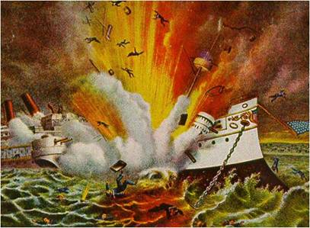
The USS Maine blows up!
Mysteriously blows up
Yellow Journalists are quick to blame the Spanish
Still unknown as who planted underwater mine or if it was a mine at all ??????????????????????

Slide 15
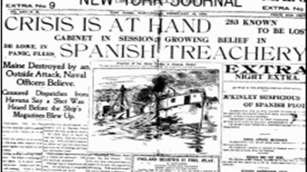

Slide 16
The Spanish-American War
McKinley & Congress demand Spain to withdraw from Cuba.
Spain refused and declares war April 1898
The U.S. orders a naval blockade of Cuba and an attack on the Philippines (another Spanish imperial stronghold which harbored the majority of its naval fleet)

Slide 17
The Spanish-American War
The US navy quickly attacks the Spanish navy in the Philippines to cut off supplies to Cuba.
Quick success with some support of Filipino guerillas
Many Americans train in Tampa for war in Cuba
17,000 U.S. army forces battle the Spanish at Santiago, Cuba. Americans win in Cuba and Puerto Rico

Slide 18
The Spanish-American War
Cease fire between Spain and U.S. 8/14/1898
Leads to…
Treaty of Paris – 12/10/1898
The short war has many significant and long lasting effects not only on the participants but the entire world

Slide 19
Results of the War
Cuba becomes independent but…
Guantanamo Bay, Cuba becomes a U.S. naval base
U.S. gets Guam and Puerto Rico
U.S. pays Spain 20 million for Philippines

Slide 20
The Philippine-American War
Philippine insurgents who had fought against Spanish rule soon turned their guns against their new occupiers.
The Philippine-American War began in February of 1899 and lasted until 1902.
Ten times more U.S. troops died suppressing revolts in the Philippines than in defeating Spain.

Slide 21
Other U.S Imperialistic moves
Open Door Policy “Trade or else!”
McKinley called for China to have open trade with all countries instead of just a few
The Boxer Rebellion was a Chinese attempt to rid the nation of foreigners

Slide 22
Other U.S Imperialistic moves
McKinley assassinated! Anarchist upset about labor conditions.
Theodore “Teddy” Roosevelt becomes President by Constitutional Law but also reelected in 1904
He too supported an “Open Door Policy”
He was shot but not killed at the beginning of a speech and finished it before going to the hospital

Slide 23
Other U.S Imperialistic moves
He sent out “The Great White Fleet” to show the strength of the U.S. Navy and intimidate foreign nations
Issued the Roosevelt Corollary which strengthened the Monroe Doctrine
Began the Panama Canal project to create a faster route from the Atlantic to Pacific oceans

