Slide 1
Chapter 7
French Revolution

Slide 2
CORNELL Questions
What were the…
-Causes of the French Revolution
-Short term effects of the French Revolution
-Long term effects of the French Revolution
Listen/Look for key words and terms.

Slide 3
France and the three estates.
First Estate- Clergy
Second Estate- Nobility
Third Estate- Everyone else from
peasants to wealthy merchants

Slide 4
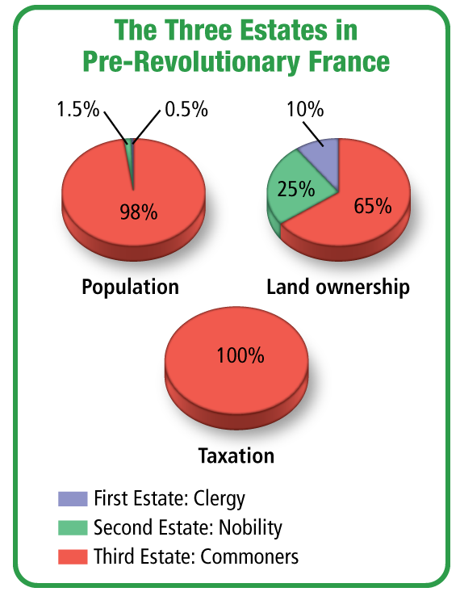
Template Provided By

Slide 5
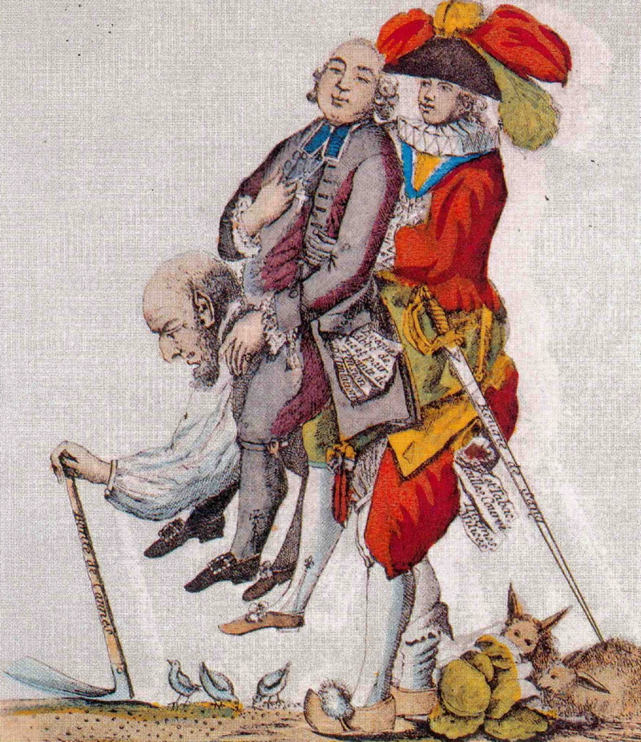

Slide 6
The First and Second Estates controlled most of the wealth but were exempt from paying the taille, or tax.
The Third Estate had to pay taxes to the government. In addition, peasants owed duties to the nobles, such as harvesting their crops.

Slide 7
Why?
The bourgeoisie, or middle class, was unhappy not to have the same privileges granted to the nobility.
The immediate cause of the
revolution was a near collapse
of the French economy.

Slide 8
Causes of the financial collapse
bad harvests
slowdown in manufacturing
food shortages
rising prices of food (bread)
unemployment

Slide 9
Causes…
LOUIS XVI SPENDING SPREE
Wars, lots of wars
Court luxuries (Palace of Versailles)
$ to America against the British
Foreign wife Marie Antoinette aka “Madame Deficit” $$$
INCREASE TAXES
Called meeting of Estates General

Slide 10
Anger on it’s way…
The Estates-General met to discuss the needed tax increase on May 5, 1789.
The Third Estate wanted the clergy and nobility to pay taxes too.
Under the current system, each estate had one vote, so the Third Estate could easily be outvoted by the First and Second Estates.

Slide 11
Tennis Court Oath
Third Estate goes to assembly to find the doors locked.
Move the meeting…
Devise a constitution

Slide 12
Storming of the Bastille
Louis XVI is ready to use force
July 14th 1789 900 Parisians gathered in the Courtyard of the Bastille (old fortress used as a prison)
Stormed and tore down, brick by brick
Bastille Day!

Slide 13
Old Regime Ends
The National Assembly adopted the Declaration of the Rights of Man and the Citizen.
All men were free and equal before the law.
Appointment to public office should be based on talent.
No group should be exempt from taxation.
Freedom of speech and press were affirmed.

Slide 14
Stubborn King Louis XVI
King stays at Versailles – Keeps absolutism
Thousands of women march to Versailles
Armed
Starving Children
King is expected to visit Paris
King and family bring food… Now They are prisoners of Paris

Slide 15
Not just the king
Corrupt Catholic Church is forced to reform.
Civil Constitution of the Clergy
Bishops and Priests were to be
elected by the people, not
appointed by the pope.
State would pay the salary of the
bishops and priests.

Slide 16
FEAR…
Europeans feared that revolution would spread to other countries, and the rulers of Austria and Prussia wanted to restore Louis XVI to full power.
The Legislative Assembly declared war on Austria and Prussia in April 1792.
French Victory Sept. 1792

Slide 17
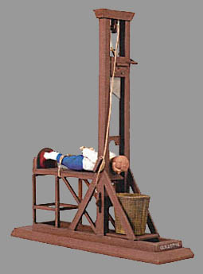
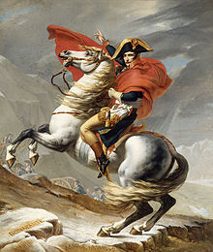
French troubles far from over…

