Slide 1
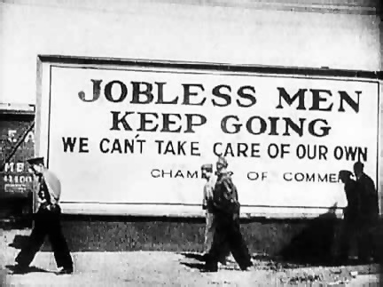
Entrance to St. Petersburg During The Great Depression

Slide 2
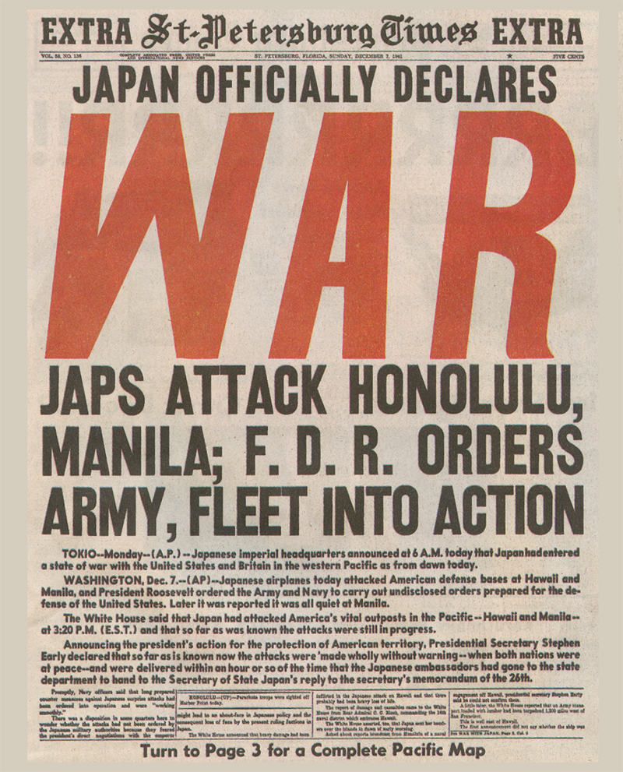
Front page of the St. Petersburg Times, December 7, 1941.

Slide 3
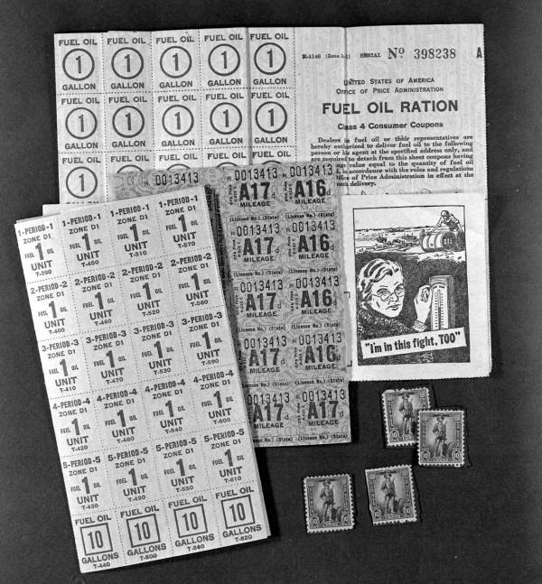
Fuel Ration Tickets: Rationing Hurt Travel to Florida

Slide 4
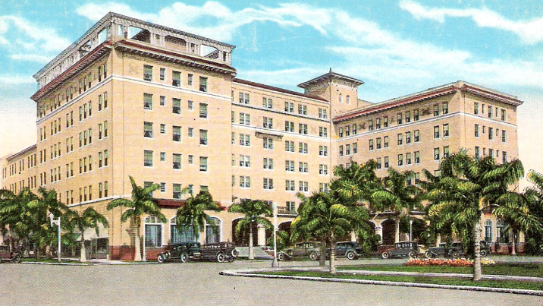
Tourism Grinds To A Halt At The Outbreak of WWII – Resort Hotels Sit Nearly Empty
Soreno Hotel in St. Petersburg

Slide 5
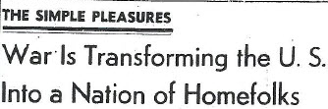
Document 2a: Tampa Morning Tribune
Headline of a 1942 story in the Tampa Morning Tribune about how Americans were not traveling because of the war.

Slide 6

A 1942 U.S. Defense Department poster encouraging Americans not to travel.

Slide 7
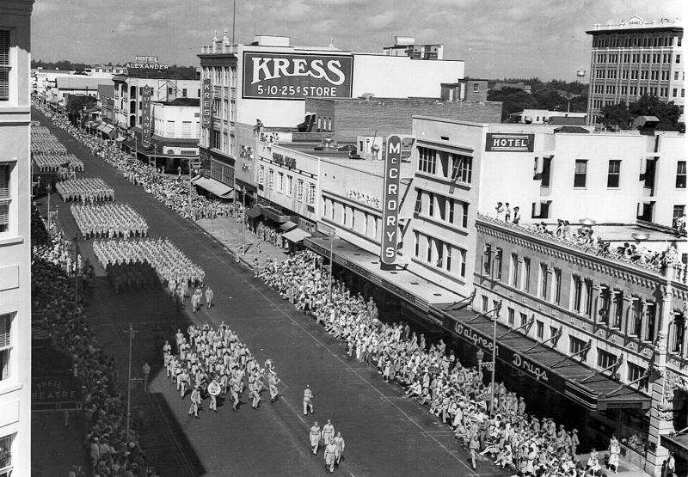

Slide 8
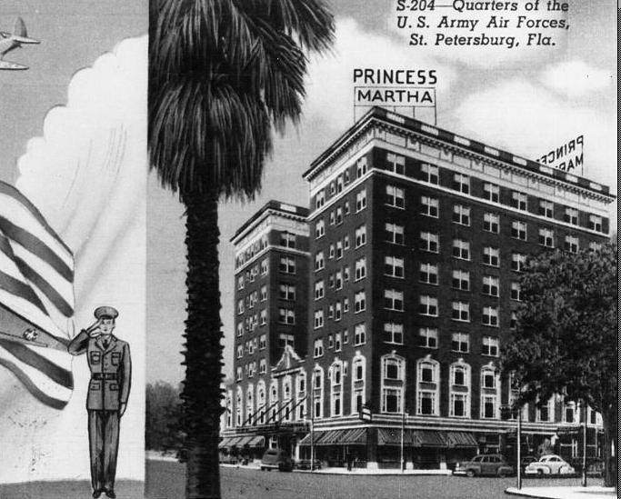
A 1942 postcard from St. Petersburg, showing the Princess Martha Hotel – transformed into quarters for the U.S. Army Air Corps.

Slide 9
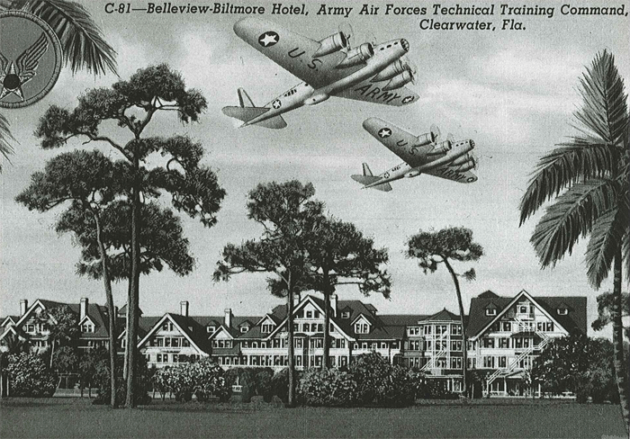
Document 4b: Clearwater Postcard
A 1943 postcard from the Belleview Biltmore Hotel in Clearwater, Florida.
Document 4b: Clearwater Postcard
1943 postcard from the Belleview Biltmore Hotel in Clearwater, Florida.

Slide 10
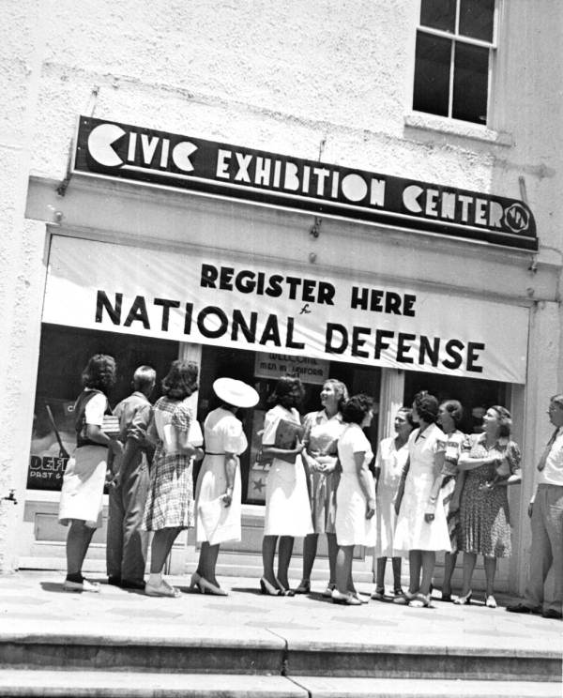
A 1942 photo of volunteer registration at the Civic Exhibition Center in St. Petersburg, Florida.

Slide 11
A map printed in the St. Petersburg Times showing German submarine attacks around Florida and in the Gulf of Mexico.

Slide 12
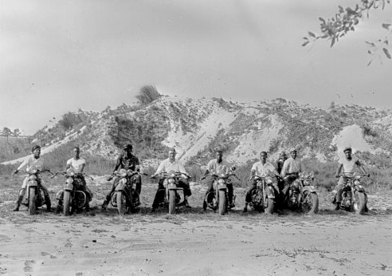
A 1942 photo of African American motorcycle troops for civil defense.

Slide 13
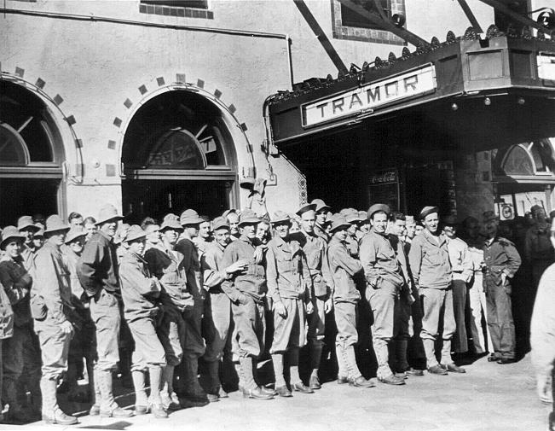
A 1943 photograph of U.S. Army Air Corps troops lined up for dinner at the Tramor Cafeteria on 4th Street and 1st Avenue South.

Slide 14
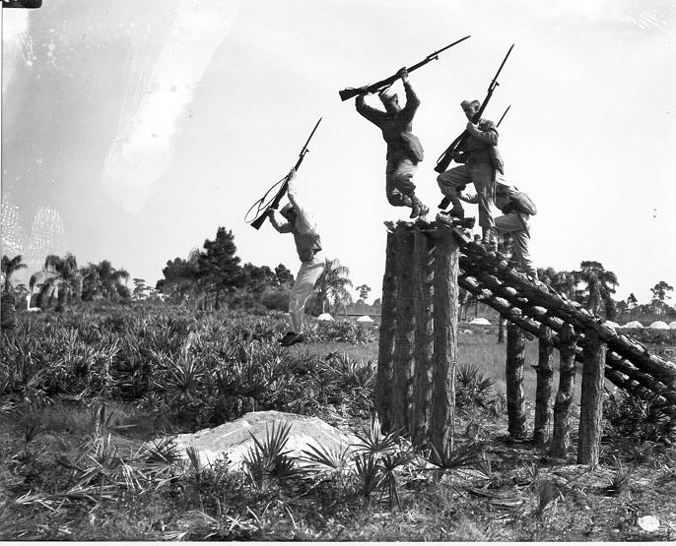
Training Near Park Street

Slide 15
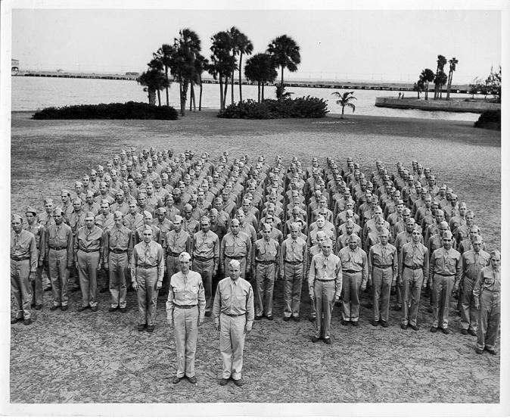
Troops Training in Vinoy Park

Slide 16
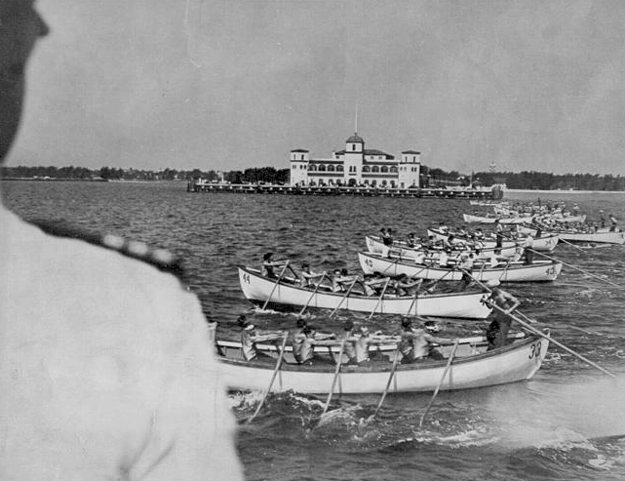
Naval Training off The Pier

Slide 17


Slide 18
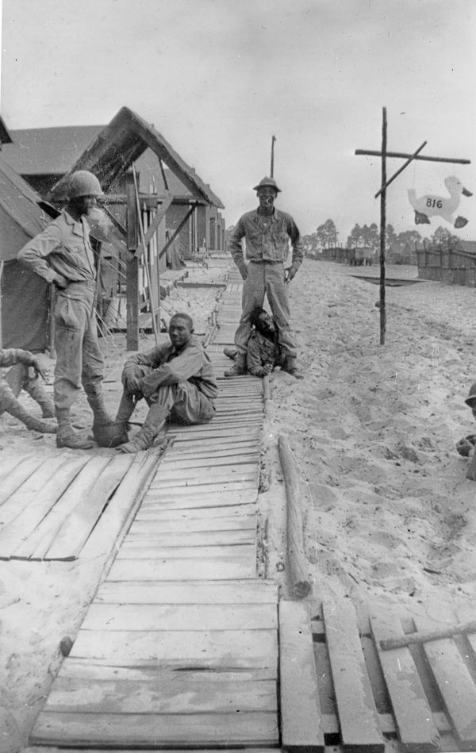
A 1943 photograph of African American soldiers in front of barracks at Camp Gordon Johnston, Florida.

Slide 19
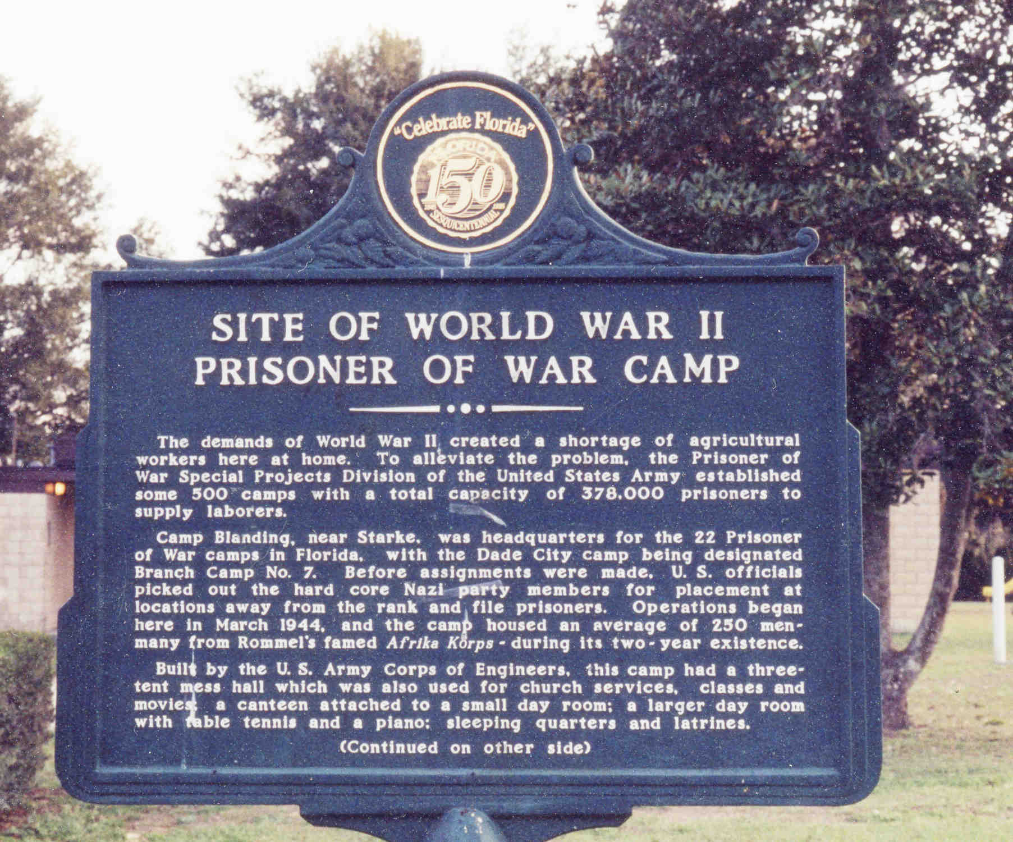
German POW Camp Near Dade City

Slide 20
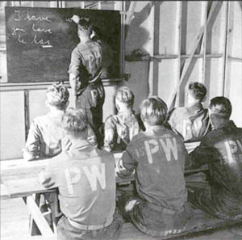
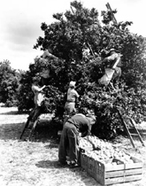
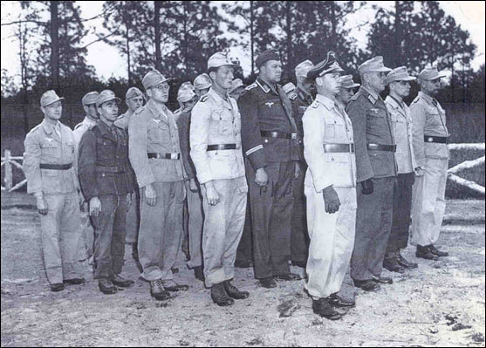

Slide 21
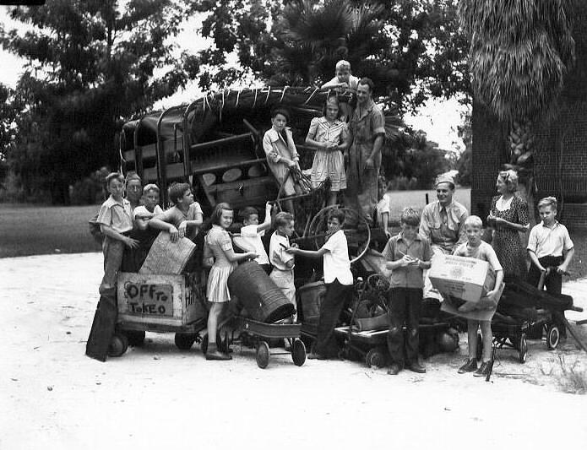
Civilian Scrap Drives

Slide 22
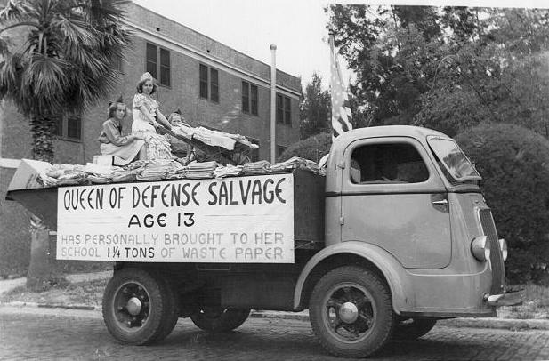

Slide 23
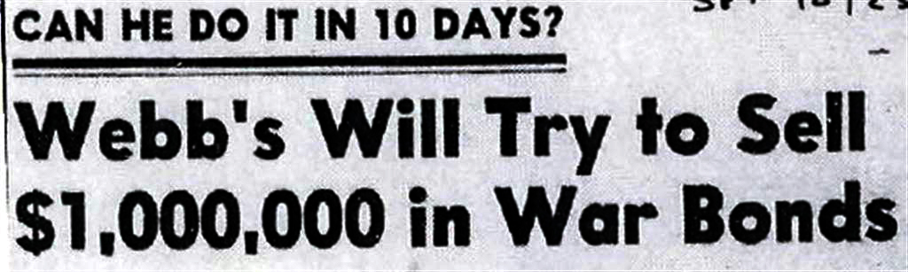
St. Petersburg Times Oct 25, 1942

Slide 24
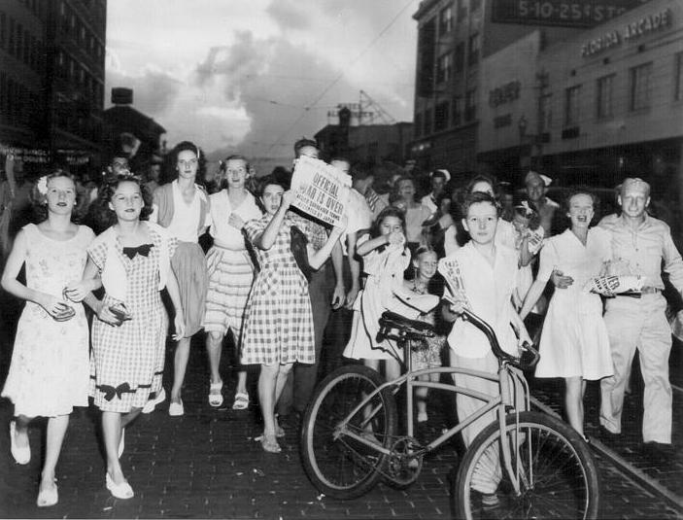
V-J Day - Central Avenue

Slide 25
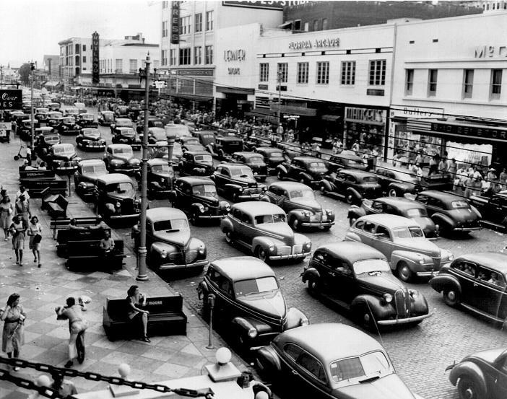
V-J Day Traffic Jam

Slide 26
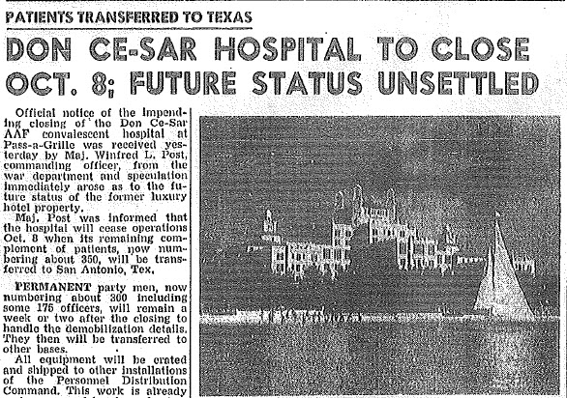
An article appearing in a 1946 edition of the St. Petersburg Times announcing that the Don CeSar Hotel will no longer be a military hospital.

Slide 27
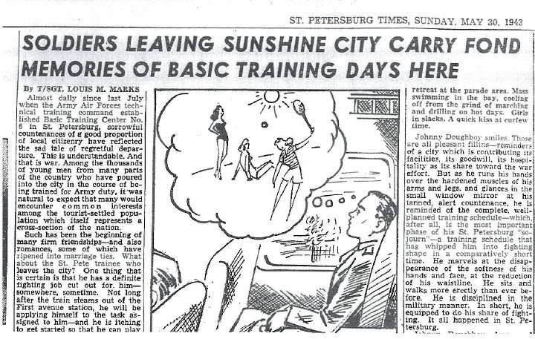
A 1943 story in the St. Petersburg Times covering the feeling U.S. soldiers had after leaving St. Petersburg for the war.

Slide 28
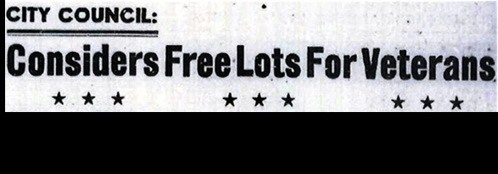
St. Petersburg Times Sept 20, 1944

Slide 29
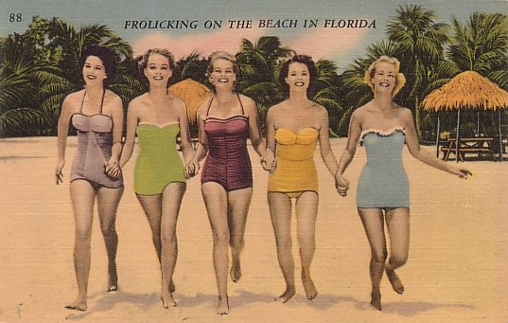
Selling Florida After The War

Slide 30

A 1947 sales brochure for the State of Florida. Florida started luring former soldiers back to the Sunshine State after the end of World War II

Slide 31
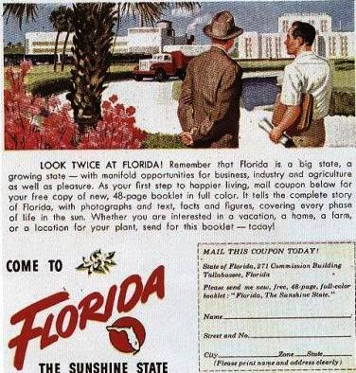
A 1947 sales brochure for the State of Florida. Florida started luring former soldiers back to the Sunshine State after the end of World War II

