Slide 1
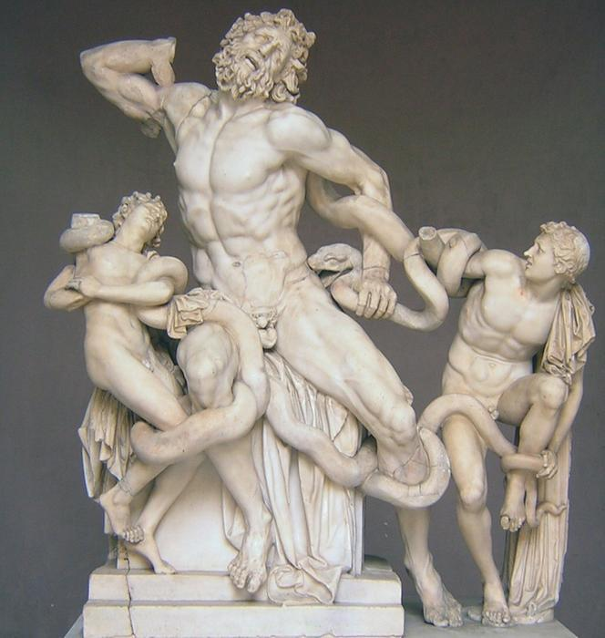
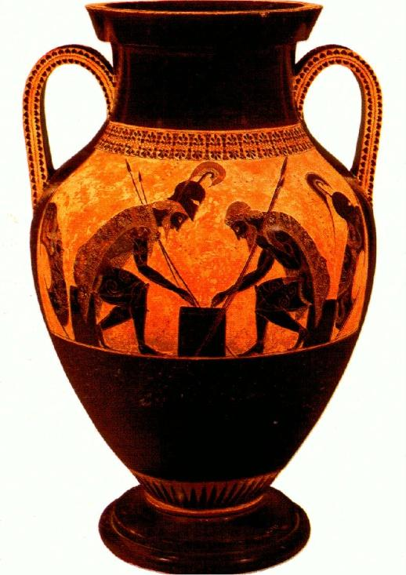
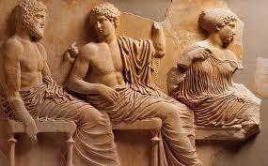
Greece

Slide 2
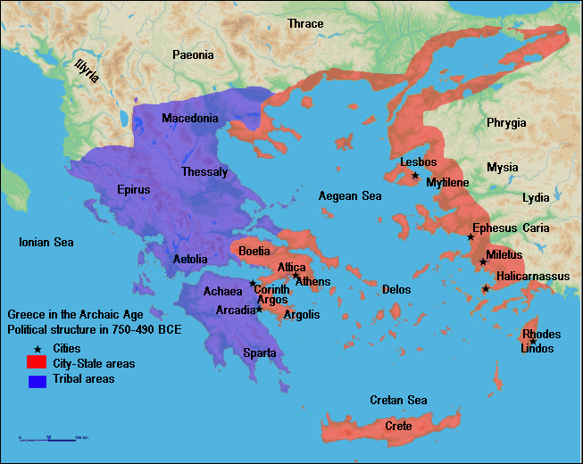

Slide 3
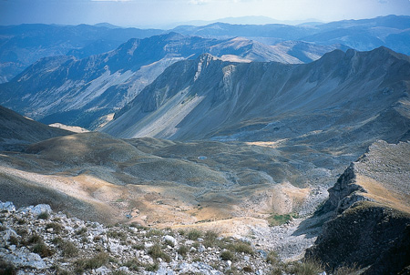
The Aegean Area
3/4 of Greek mainland = mountains
Protected Greeks from foreign invaders/attackers
Kept Greeks isolated from other communities
Prevented Greeks from uniting under one government
Between the mountain ranges = fertile plains good for farming

Slide 4
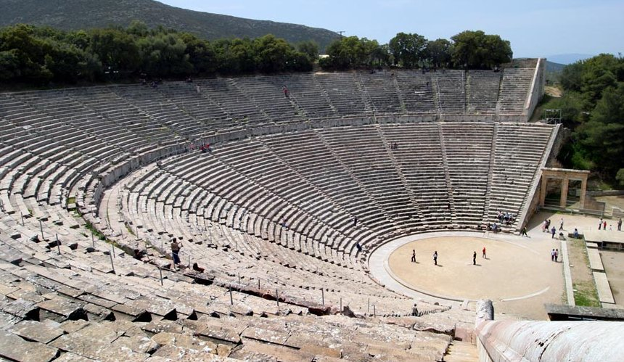
The Aegean Area
Mild climate
So people spent much of their time outdoors
Despite lack of government Greeks spoke same language & practiced same religion (polytheistic)
Greeks turned to the seas to earn a living --> no place in Greece is more than 50 miles from a coast

Slide 5
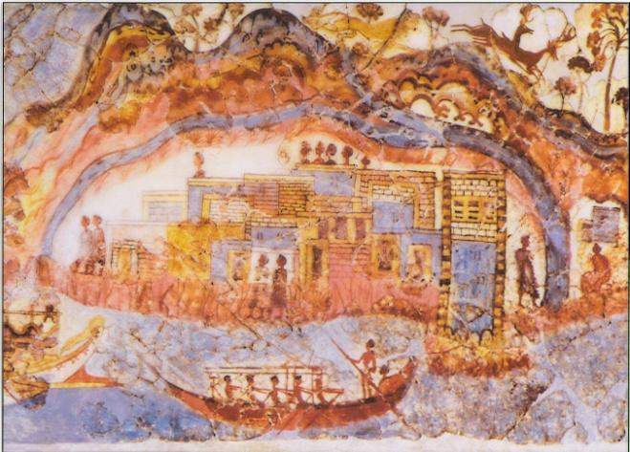
Early Greece
Crete/Minoan civilization
Environment not suitable for
farming – turned to the sea
Replace by Mycenaeans
chaotic time – at war with Troy
Dorians conquer Myceneans- Dark Ages around 1100 BCE
Seafaring Phoenicians visit and re-establish contact
Invented the first alphabet

Slide 6
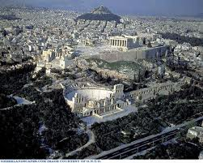
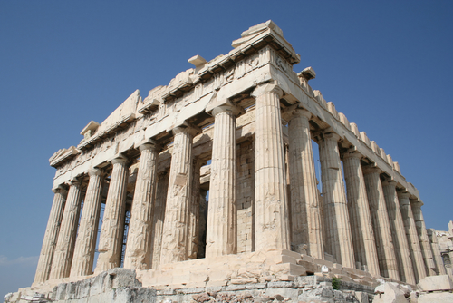
The Polis
Polis = city-state
Each polis developed independently, but shared certain features with other city-states
Polis included: a city and the surrounding villages, fields, and orchards
At the center of the city = an Acropolis = fortified hill
On top of Acropolis = temple of the local god or goddess
Foot of Acropolis = the agora = public square

Slide 7
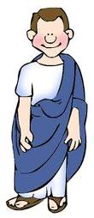
The Typical Polis
Citizens = those who took part in government
Could vote and hold public office
Could speak for themselves in court
Could own property
In return: expected to serve in government and protect the polis
Most Greeks were NOT citizens
Slaves, foreign-born, and women couldn’t be citizens
Slaves were prisoners, criminals, foreigners, and people in debt.

Slide 8
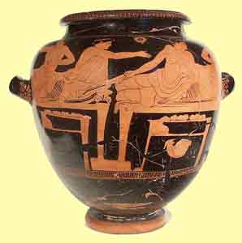
Greek Colonies & Trade
Farmers on mainland produced wine, olive oil, and other cash crops for export
Greek trade expanded throughout the Mediterranean region
600s BCE = Greeks replaced barter system with money system
Began producing textiles (cloth) and pottery

Slide 9
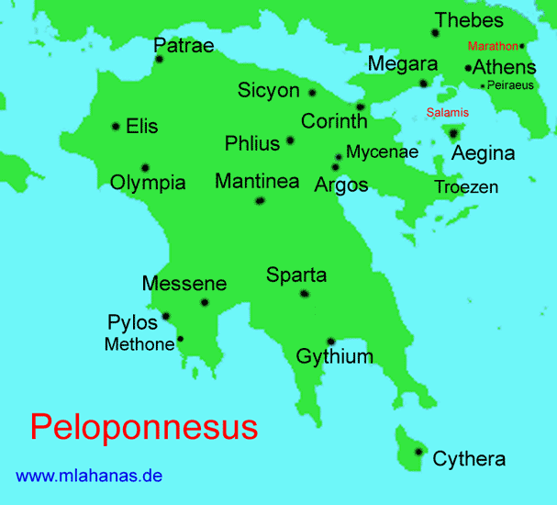
Sparta
Founded by descendants of Dorian invaders (from “dark ages”)
Located on the Peloponnesus Peninsula (southern Greece)
Invaded neighboring city-states & enslaved people
Slaves were called helots
Slaves farmed the estates of the Spartans

Slide 10
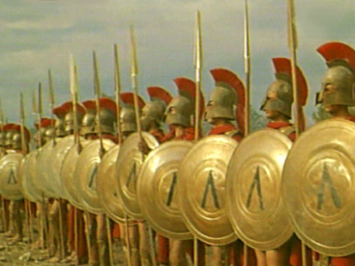
Sparta
Spartans developed a militaristic society to keep control over the people
Started this after they suppressed a 30 year revolt by the helots
All life revolved around the army
Only healthy babies were allowed to live
Boys entered the military at age 7
Stayed in the military until age 60
Hoplite soldiers used the phalanx formation.

Slide 11
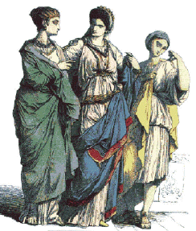
Role of Women
Women, like men, were expected to exercise and be strong
Spartan women trained in gymnastics, boxing, and wrestling
Needed to produce healthy babies
Had more freedoms than other Greek women
Could go shopping in the marketplace, express political opinions, own property, etc. → could NOT take part in government though

Slide 12
Sparta’s Government
2 kings ruled Sparta, but had little power
Led the army & conducted religious services – that’s it
Assembly had most power = group of male citizens over age of 30
Council of Elders served as Supreme Court and proposed laws to the Assembly = 28 men over age of 60
Sparta was behind other city-states in economics, philosophy, science, and arts
Rulers afraid of change; afraid of outside influence

Slide 13
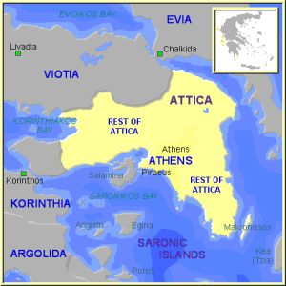
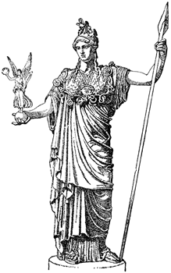
Athens
Founded by descendants of Mycenaeans
Athens’ citizenship included more people than Sparta’s did
Constitution (plan of government) = said that all free, Athenian-born men were citizens, whether they owned land or not
Reduced friction between social classes
Athenians practiced democracy- citizens could direct government decision by voting.

Slide 14
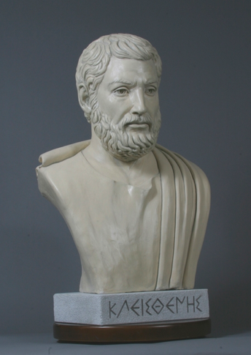
Athenian Democracy
Assembly became the most powerful political body
Members were chosen by a lottery system – limit of 500 people
Open to all citizens
Note: Citizens still only 20% of population → excluded slaves, women, and foreign-born
Citizens considered equal before the law; granted freedom of speech

Slide 15
Athenian Education
Depended on social & economic status
Athenian citizens were required to educate their sons
Girls didn’t receive a formal education – were trained in household duties
Main textbooks were the Iliad and the Odyssey
Learned arithmetic, geometry, drawing, music, gymnastics, and rhetoric (art of public speaking)
At 18, boys entered the military for 2 years

Slide 16
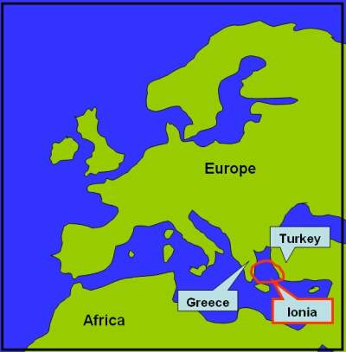
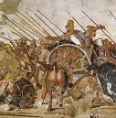
Quick Overview
400s BCE → Persian Empire had strongest military in the world
Persian Empire wanted to invade Europe and expand
Greek city-states cooperated in resisting Persian attacks
Battle of Marathon- Greeks win victory in first invasion.
Battle of Thermopylae- 300 Spartans in the second invasion.
Battle of Salamis- Naval battle where the Greeks sealed victory in the second invasion.
After victory against Persia, the Greeks enjoyed a “golden age”

Slide 17
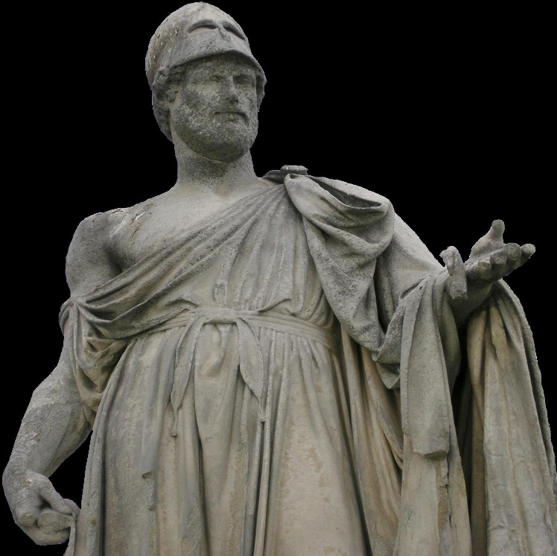
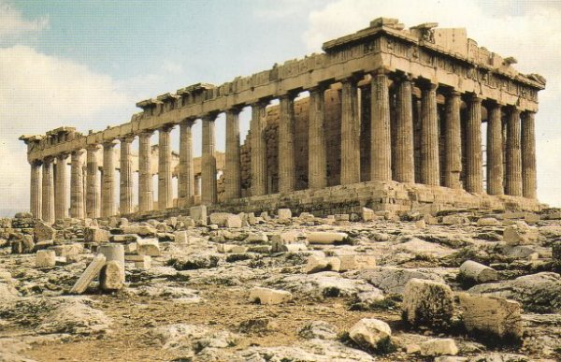
Golden Age of Athens
Athenian general Pericles rebuilt Athens to become the most beautiful city in Greece
Public buildings = fancy; Athenian homes = simple
Most famous building built = Parthenon atop the Acropolis
Greek civilization reached its peak in the mid-400s BCE, particularly in Athens
Known as the Golden Age
Artists created beautiful architecture, sculptures, paintings
Artistic style was classical = simple, graceful, and balanced
Advancements in philosophy, literature, and drama

Slide 18
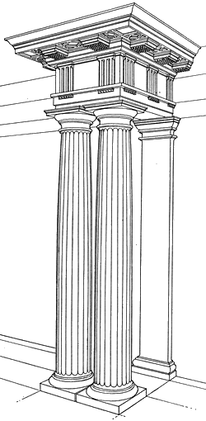
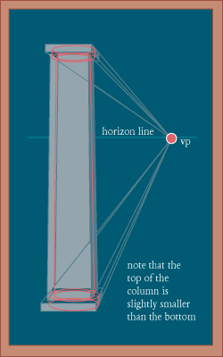
Building for the Gods
Temples were where deities could live
Greek architects understood illusion and perspective = the artistic showing of distances as they appear to the eye
Created the impression of perfection

Slide 19
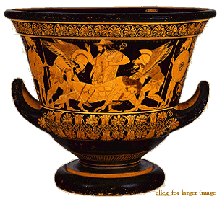
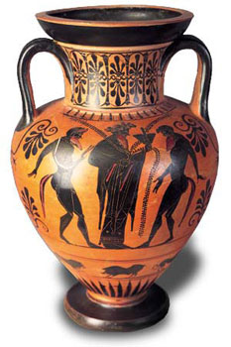
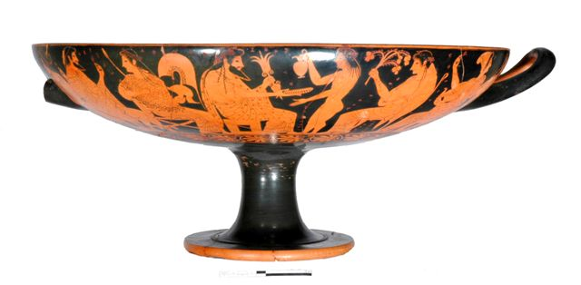
Greek Arts
Excelled at portraying the human form
Some ancient Greek vases still exist
Different shapes for different purposes
Krater = two-handled vase with a wide mouth --> good for mixing water and wine
Amphora = large vase for storing oil & other supplies --> decorated with art showing mythology
Kylix = drinking cup --> decorated with scenes of everyday life

Slide 20
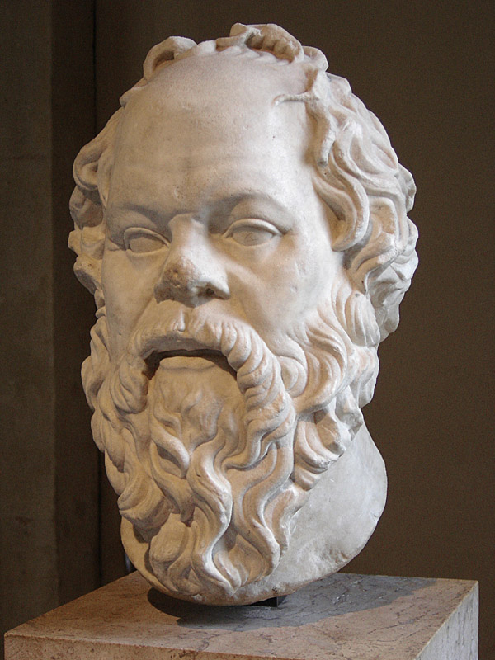
Philosophy
1) The formation of Greek cultural traditions: philosophy based on human reason
2) Socrates (470-399 BCE): “An unexamined life is not worth living”
a. Encouraged reflection on questions of ethics and morality b. Was condemned to death on charge of corrupting Athenian youths
3) Plato (430-347 BCE): A zealous disciple of Socrates
a. The theory of Forms or Ideas—world of ideal qualities
b. This world is imperfect reflection of world of Forms c. His Republic expressed the ideal of philosophical kings
4) Aristotle (384-322 BCE): Plato’s student, but distrusted theory of Forms
a. Devised rules of logic to construct powerful arguments
b. Philosophers should rely on senses to provide accurate info
5) Legacy of Greek philosophy
a. Intellectual authorities for European philosophers until 17th century CE
b. Intellectual inspiration for Christian and Islamic theologians

Slide 21
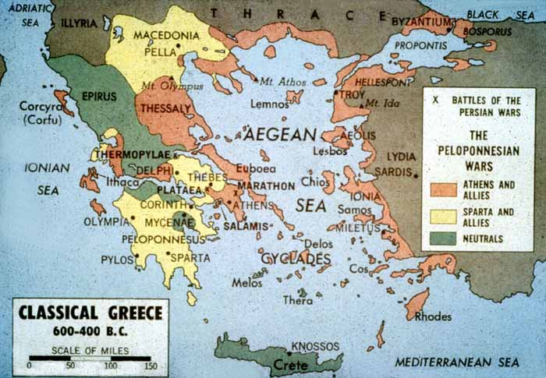
The Peloponnesian War
Persian threat remained even though they lost the Persian Wars
Most city-states (but not Sparta) joined together in Delian League to protect themselves from the Persians
They freed Ionia from Persian rule
Made Greece rich because trade grew
Athens began to dominate the other city-states
Several city-states formed an alliance against Athens
Led by Sparta
Threatened by Athens’ economic and political power and influence
Sparta was afraid and jealous of Athens

Slide 22
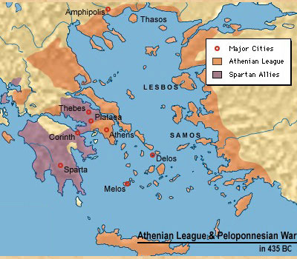
The Conflict [431 BCE - 404 BCE]
Peloponnesian War = fought between Athens (and its allies) and Sparta (and its allies)
Sparta allied itself with Persia -- made a deal for their help
Plague hit Athens -- killed 1/3 of its people (including General Pericles)
After Pericles died, some Athenians wanted to surrender and others wanted to keep fighting
No decision made -- fighting continued for many years
Athens surrenders in 404 BCE- Weakens democracy and all city states.

