Slide 1
Chapter 14 – The Formation of Western Europe
Section 1 – Church Reform and the Crusades

Slide 2
The Age of Faith
Began in the 900’s
Return to basic principles
Removing the problems
1100’s and 1200’s the Church reorganized to resemble a kingdom
Cannon law – law of the church. Topics: marriage, divorce, inheritance
Collection of tithes for social services

Slide 3
Cathedrals – Cities of God
Very large and extravagant churches in cities
Around the 1100’s there was a shift from Romanesque to Gothic architecture
Size and light through stained glass windows meant to inspire worshipers
500 cathedrals built between 1170 and 1270 CE

Slide 4
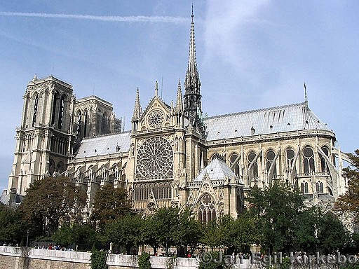
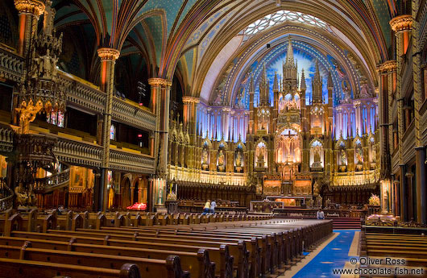
Cathedral of Notre Dame
Paris, France

Slide 5
The Crusades
Age of Faith inspired conquest
Muslims closed in on Constantinople in 1093
Pope Urban II calls for a holy war
Goal: regain the holy land, Palestine
Hope: reunite Christendom which had split in 1054
Motivation: Those who went were absolved of their sins, according to Pope
Crusaders came from all walks of life and social classes; many bored feudal knights

Slide 6
The Crusades
By 1097 about 60,000 knights and volunteers gathered at Constantinople
No strategy and no knowledge of geography, climate, and culture of the Holy Land
On the first Crusade only about 12,000 actually reached Jerusalem
After a month they had captured the city and a narrow strip of land to the North about 650 miles long

Slide 7
Second and Third Crusades
In 1144, the northern city Edessa was recaptured by the Muslims
Second Crusade formed in response but failed
In 1187, the Muslims recaptured Jerusalem as well, led by Saladin
Third Crusade formed in response
English King Richard the Lion Hearted led the Crusaders
Richard and Saladin agreed to truce in 1192 but Jerusalem remained under Muslim control

Slide 8
Crusading Spirit Fades
Fourth Crusade, 1204, Crusaders only made it as far as Constantinople
Looted the city
By this time the spirit had faded
Several weak attempts later but failed terribly
Children’s Crusade of 1212
Spanish “Crusade” – Reconquista and Inquisition

Slide 9
Effects of the Crusades
Example of the power of the Church and people’s religious devotions
Opportunities at home for European women
Merchants in Crusader states profit from war
Trade benefited both sides
The failure weakened the power of the Pope
Feudal nobility weakened, kings’ power increased

Slide 10
Effects of the Crusades
Large loss of life
Fall of Constantinople weakened Byzantine Empire
Intolerance and prejudice displayed by Christians left behind a legacy of bitterness and hatred still around today
European Jews saw increase in persecution
Energy turned toward growth of trade, towns, and education

