Slide 1
Persian Empires
(558 BCE – 651 CE)

Slide 2
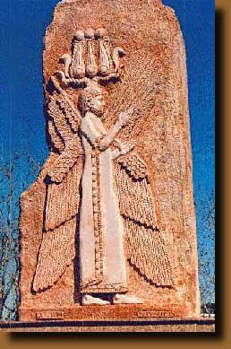
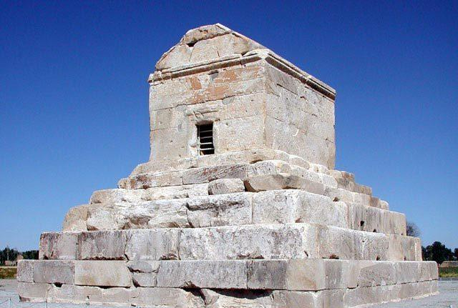
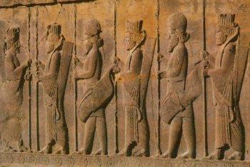

Slide 3
The Rise of The Persian Empire
Before the Persians came, there were the empires of the Assyrians (known for their ruthlessness) and the Chaldeans (known for King Nebuchadnezzar II)
The Chaldeans of Babylonia fell to Persia in 539 B.C.E.
Notes:
-The Persians were an Indo-European group related to the Medes (Media is under the Caspian Sea)
-Around 700 BCE, the Medes formed a monarchy and so did the Persians in southern Iran.
-In 559, Cyrus became the leader of the Persians and eventually defeated all other surrounding areas, most importantly the Lydians.

Slide 4
Persia
In 550 B.C., Cyrus the Great of Persia took over Medea, making this the first Persian satrapy.
546 conquer Lydia
539 conquer Babylon
525 conquer Egypt (under his son, Cambyses)
Why was he Great?
Set the Jews free from Babylonian captivity
Wise and compassionate
Used locals as government officials
He used Assyrian, Babylonian, Egyptian and Lydian practices
Notes:
-Cyrus was a man of considerable wisdom and compassion.
-He won approval of native peoples he conquered. He allowed them to keep positions of power.
-He had a reputation for mercy, unlike the Assyrians. (The Shepherd)
-Appreciation for ancient civilizations and culture.
-Cambyses was made king of Babylon and when his father died, he took over and conquered Egypt and took the title of pharaoh

Slide 5
Persian Empire
Persian kings were said to be elected by the Persian god, Ahuramazda. They seldom were accessible to the public and lived in splendid palaces.
The army was truly international, the elite infantry was known as the Immortals.
Notes:
-Zoroastrianism introduced by Zarathustra (Zoroaster). Components of one god and evil enemy. A day of Judgment with a concept of Heaven and Hell. Influenced Judaism, Christianity and Islam???
-Manichaeism also became popular as well. Mani had been a devout Zoroastrian, but started to draw influence from Christianity and Buddhism. Syncretic religion that blended elements of all.
-
-There was a cavalry of 10K and and infantry of 10K. Immortals were called this as they were never allowed to fall below 10 thousand and were immediately replaced when someone died. See the Army in 300!
-Immortals enjoyed special privileges. They could take concubines and servants to war. They could bring their own special food as well.
_They had a navy as well that consisted of ships built by people like the Phoenicians.

Slide 6
Persian Empire
Best organizer among Persian kings = Darius I (521-486) Divided empire into 23 provinces
Each province ruled by a satrap = governor
Satraps collected tributes, administered justice, raised taxes for the army and led the army in their provinces
Moved the capital from Susa to Persepolis
Ruled more than 35 million people
Empire stretched more than 3000 miles – from Nile to Indus River
Notes:
-Darius was a member of the Achaemenid ruling family and emerged as king after a year of civil war. He took power in 521.
-He continued to expand the empire into Thrace and Macedonia (Europe) – expansion of the empire was the largest extent
-Entered into the Persian Wars with Greece and lost the Battle of Marathon to the Athenian fleet.
-He divided the empire into approxiamately 20 provinces, satrapies. The satraps (governors) collected tribute in the province that they would pay to the central government in Susa. Darius was fair in that he considered the amount based on production levels. Satrapies also provided soldiers for the royal army Satraps had both civil and military duties. They were miniature kings.
-Roads were maintained to provide rapid transit of military and government personnel. The staging posts allowed messengers to rest and get fresh horses.
- He thought Susa was hot and oppressive. Once he moved to Persepolis, he became withdrawn and largely secluded. Persian resented him not being easily available. He widened the gap between the kings and subjects.

Slide 7
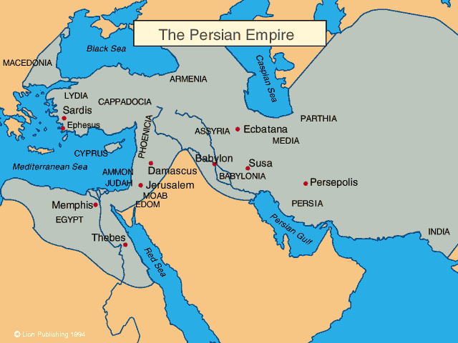

Slide 8
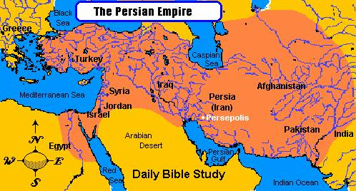
Persian Empire

Slide 9
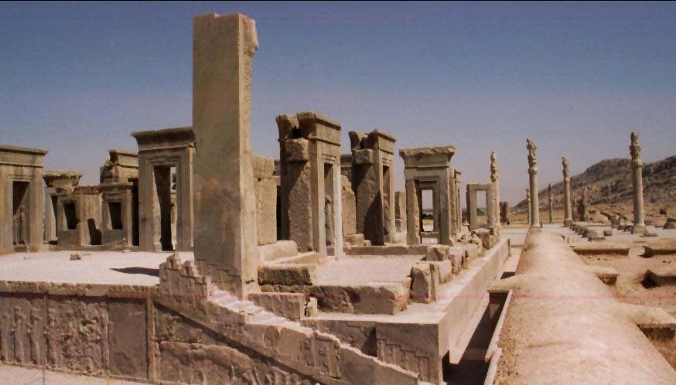
The Persians
Persians = very tolerant rulers
Allowed conquered people to keep own languages, religions, and laws
Zoroastrianism popular religion and endorsed by emperors
Monotheistic religion
Artisans built city of Persepolis = most magnificent city in the empire
Cities had underground canal systems built called qanat
Slaves used in countryside and outside of cities- prisoners of war and debtors
Big network of roads
Allowed for trade between different peoples/cultures in the empire
Allowed for easy movement of soldiers
Royal Road = longest road in the empire → had stations along it so travelers could get food, water, and fresh horses

Slide 10
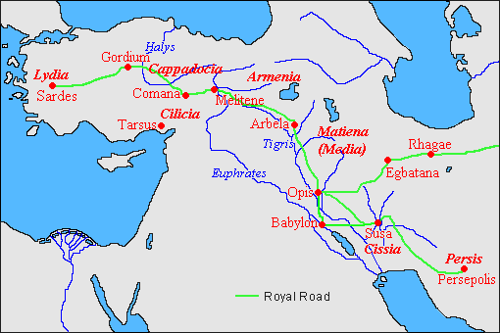
ROYAL ROAD

Slide 11
The Greco-Persian Wars
Rebellions in Ionia (Greeks living in Persian Empire)
Darius sent troops, Athens went to aid Greeks (492-490 BCE)
Darius sent troops to punish mainland Greeks but were defeated at Battle of Marathon.
Xerxes succeeded Darius and a second series of battles results in defeat for Persia; battle of Thermopylae and Battle of Salamis. (480-479 BCE)
Persian Wars significance:
Sparked decline of Persia
Boost to Athens and development of Delian League
Athens and Sparta involved in Peloponnesian Wars which weakened all city-states and leaving them vulnerable to the Macedonians.

Slide 12
The Hellenistic Synthesis
Macedonia a frontier state
King Phillip II built a powerful military, consolidated his power and turned his attention to the quarreling Greeks
Conquered the city-states one by one and brought all of Greece under his control.
20 year old Alexander inherits and becomes a legend
Conquers one area after another. Moves From Greece to Anatolia to Egypt
Persia was weak which made it easier for Alexander’s troops.
Conquered in 331 BCE.

Slide 13
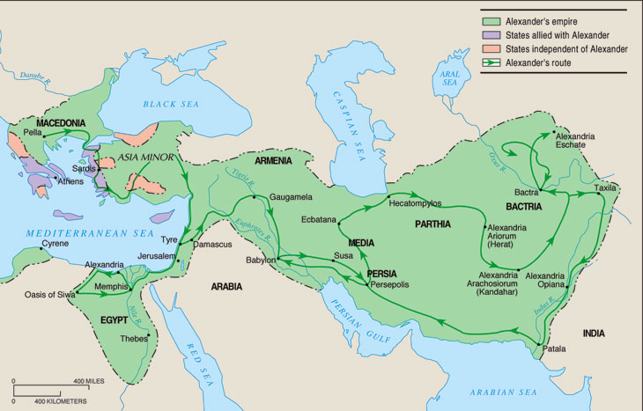

Slide 14
The Hellenistic Synthesis
Alexander forced intermarriage between his men and Asian women to forge a new, blended civilization.
Named many cities Alexandria.
Died at 33; empire fell apart but left huge cultural impact.
Spread Greek culture
Empire divided into three large states and many Greeks left their homelands to settle, bringing Greek culture and creating cosmopolitan centers
Religion
Fashion
Customs
Language
Values

Slide 15
Beyond Achaemenid Persia
The Seleucid (323-83 BCE)
Hellenistic Persia
The Parthian (247 BCE-224 CE)
Iranian cultural empire
The Sasanid (224-651 CE)
Last of the Zoroastrian empires
Assimilated into the Islamic Caliphates 651 CE
Notes:
-The Seleucids – Started by Alexander the Great’s general (Seleucus). He retained the Achaemenid systems of politics. Created new cities that stimulated trade. Faced opposition from native Persians. Many rebellions and finally fell to the Romans in 83 BCE.
-The Parthians – Empire based in Iran and extended into Mesopotamia. They did not have a centralized government and retained customs of the locals. They were good warriors. Known for their cavalry that fed on alfalfa and grew to be large and strong. Mostly nomadic dynasty. Got independence from Seleucids. Fell due to internal rebellions.
-The Sasanids – Came from Persia and claimed to be direct descendants of the Achaemenids. Traded widely (wealthy). Shapur I created a series of buffer states between them and the Roman Empire. Fighting with the boarder states zapped the Sasanid of power and wealth. The empire came to an end in 651 CE when Arabs killed their last ruler.

