Slide 1
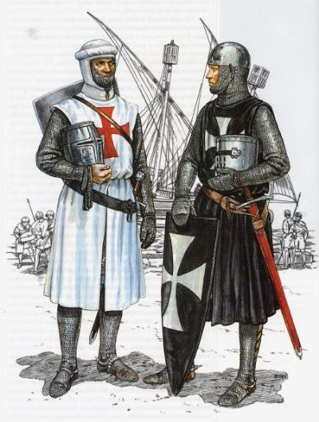
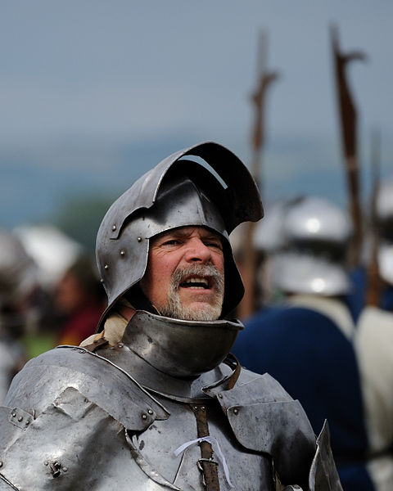
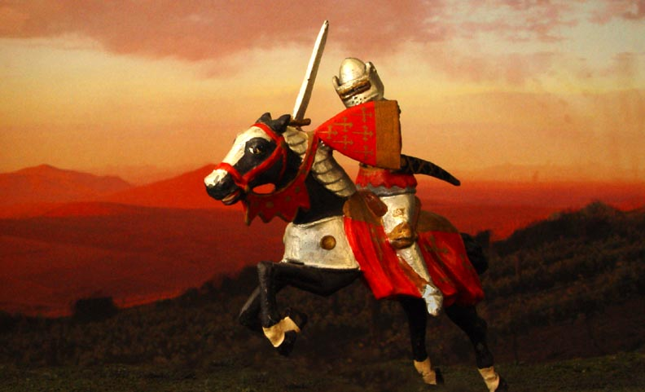
13.3 The Age of Chivalry
The code of chivalry for knights glorified both combat and romantic love.

Slide 2
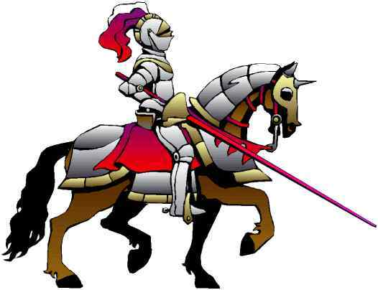
Knights: Warriors on Horseback
The Technology of Warfare Changes
Leather saddle and stirrups enable knights to handle heavy weapons
In 700s, mounted knights become most important part of an army

Slide 3
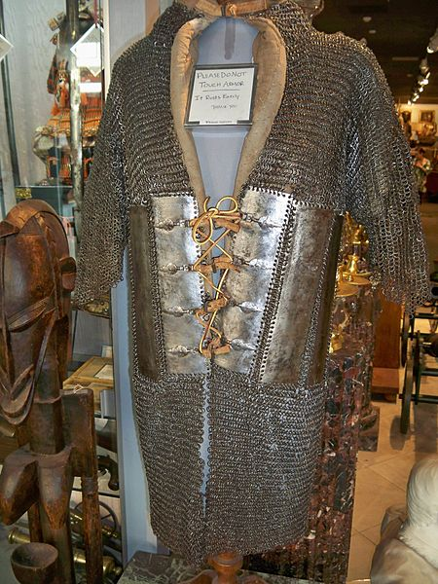
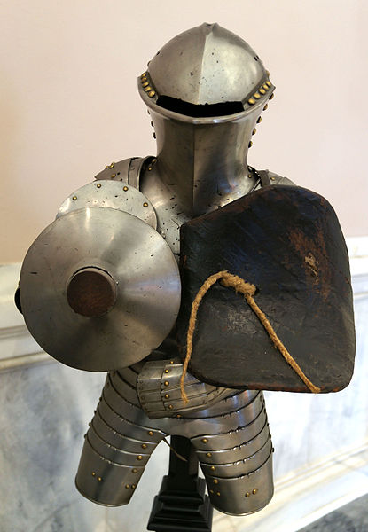
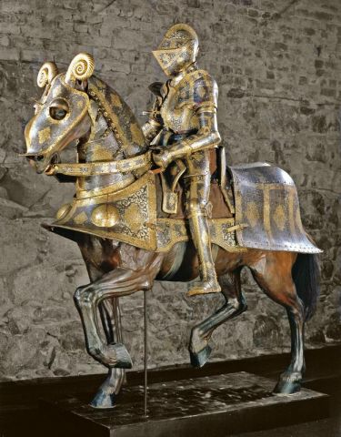
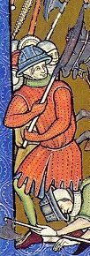
Armour
Plate Armour
Chainmail
Gambeson, a padded jacket worn alone or in combination with chainmail

Slide 4
Knights: Warriors on Horseback
The Warrior’s Role in Feudal Society
By 1000s, western Europe is a battleground of warring nobles
Feudal lords raise private armies of knights
Knights rewarded with land; provides income for needed weapons
Knights other activities help train them for combat
Ightham Mote, a 14th-century moated manor house in Kent, England

Slide 5
Knighthood and the Code of Chivalry
The Code of Chivalry
By 1100s knights obey a code of chivalry—a set of ideals on how to act
They are to protect weak and poor; serve feudal lord, God, chosen lady
"Stitching the Standard" by Edmund Blair Leighton: the lady prepares for a knight to go to war

Slide 6
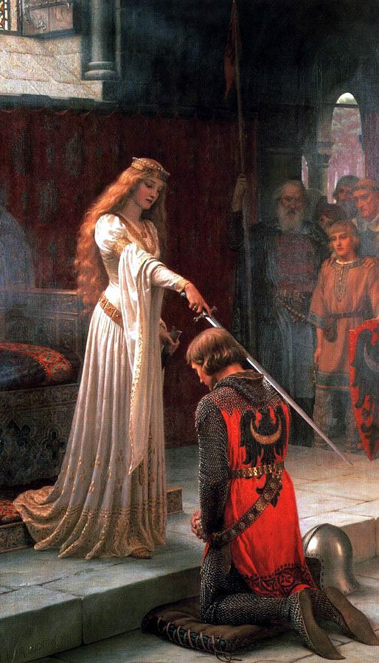
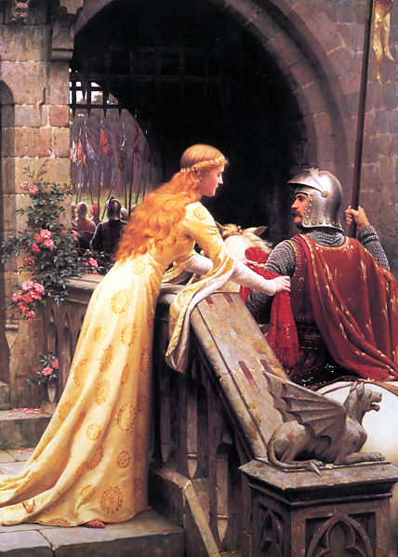
“The Accolade” (right, 1901) and “Godspeed” (1900, below) by Edmund Blair Leighton

Slide 7
Knighthood and the Code of Chivalry
A Knight’s Training
Boys begin to train for knighthood at age 7; usually knighted at 21
Knights gain experience in local wars and tournaments—mock battles

Slide 8
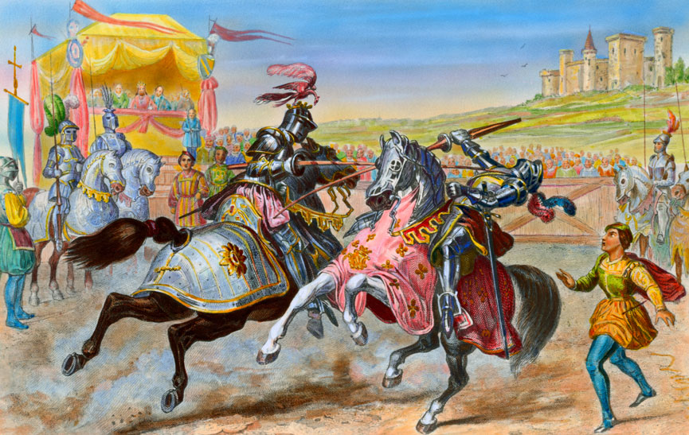

Slide 9
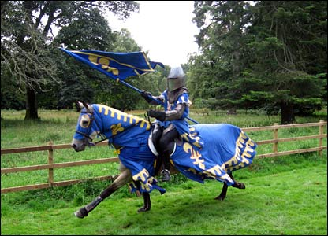

Slide 10
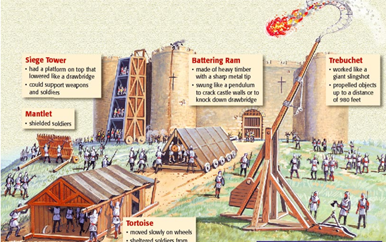
Knighthood and the Code of Chivalry
Brutal Reality of Warfare
Castles are huge fortresses where lords live
Attacking armies use wide range of strategies and weapons

Slide 11
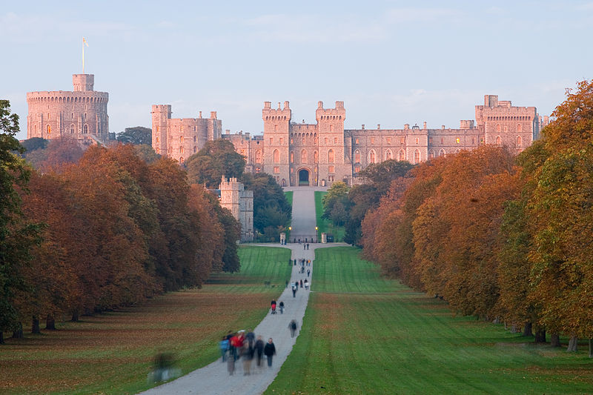
Windsor Castle in England

Slide 12
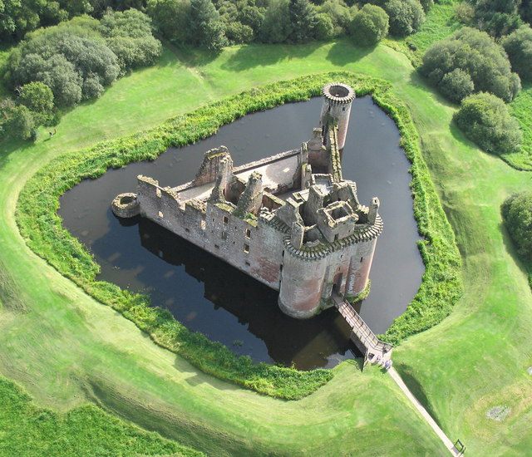
Caerlaverock Castle in Scotland is surrounded by a moat.

Slide 13
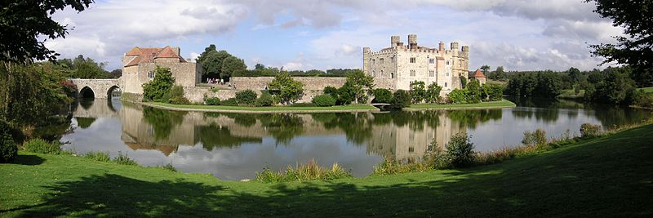
Leeds Castle, England

Slide 14
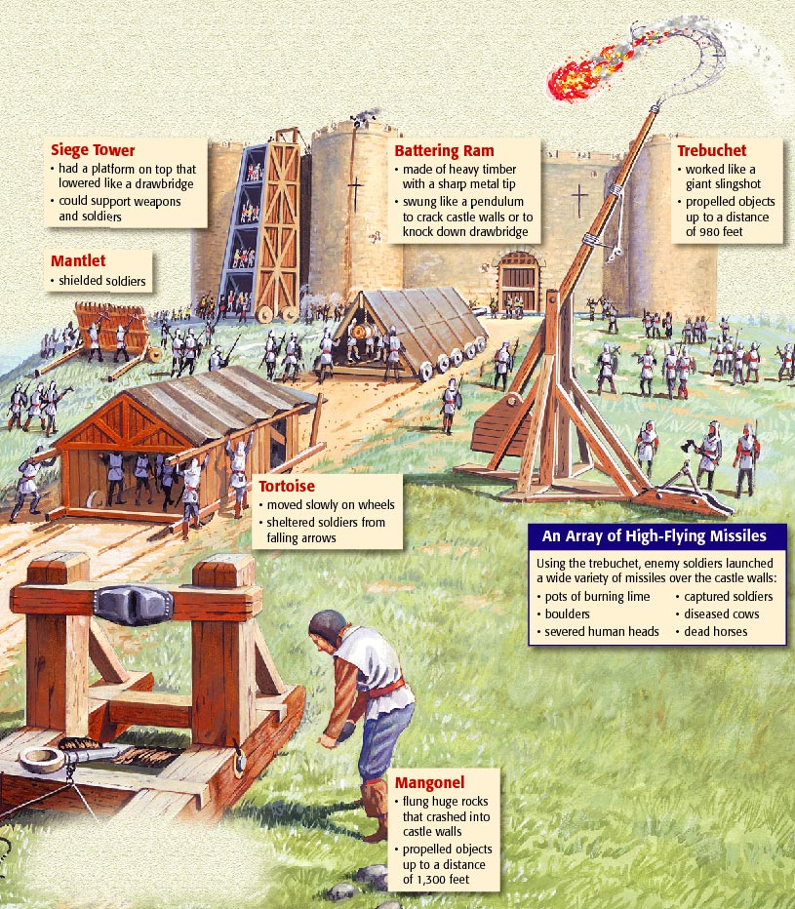
Siege Warfare

Slide 15
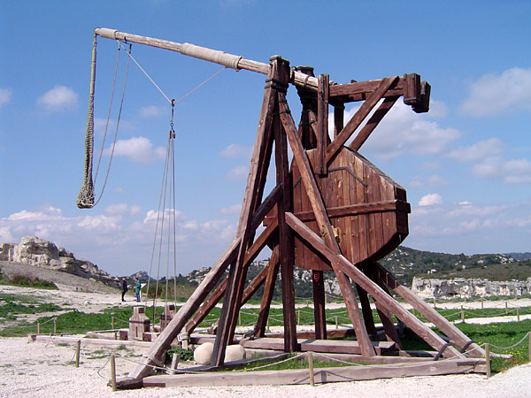
Counterweight trebuchet at Château des Baux, France

Slide 16
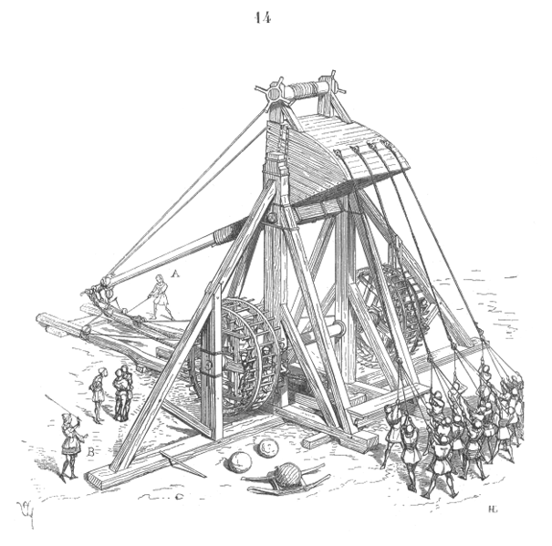
Medieval mangonel, a type of catapult

Slide 17
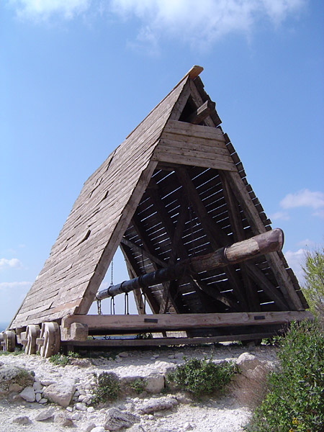
Replica battering ram at Château des Baux, France

Slide 18
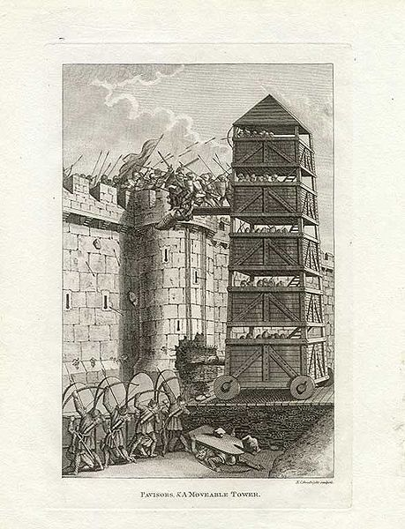
Medieval moveable siege tower

Slide 19
The Literature of Chivalry
Epic Poetry
Epic poems recount a hero’s deeds and adventures
The Song of Roland is about Charlemagne’s knights fighting Muslims

Slide 20
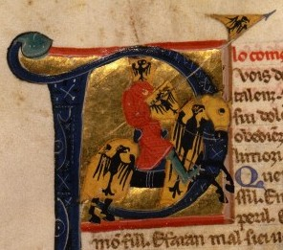
The Literature of Chivalry
Love Poems and Songs
Knights’ duties to ladies are as important as those to their lords
Troubadours—traveling poet-musicians—write and sing short verses
Above and right: troubadours portrayed in illumined texts.

Slide 21
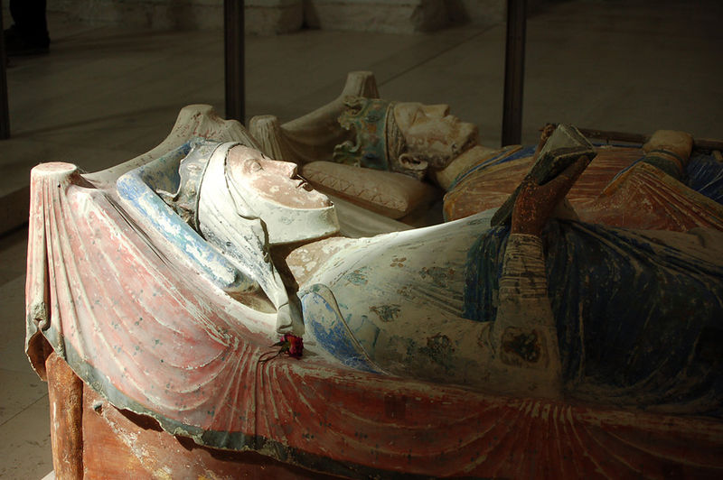
The Literature of Chivalry
Most celebrated woman of the age in Eleanor of Aquitaine (1122-1204)
Wife of two kings (Louis VII, King of the Franks, annulled) and Henry II of England
Mother of two kings of England (Richard and John)
Eleanor’s son, Richard the Lion-Hearted, also wrote songs and poems
Above right: Eleanor of Aquitaine depicted on a mural in the Chapel of St. Radegund, Chinon, France
Right: tomb effigy of Eleanor and Henry II

Slide 22
Women’s Role in Feudal Society
Status of Women
According to the Church and feudal society, women were inferior to men
Noblewomen
Can inherit land, defend castle, send knights to war on lord’s request
Usually confined to activities of the home or convent
Peasants Women
Most labor in home and field, bear children, provide for family
Poor, powerless, do household tasks at young age

Slide 23
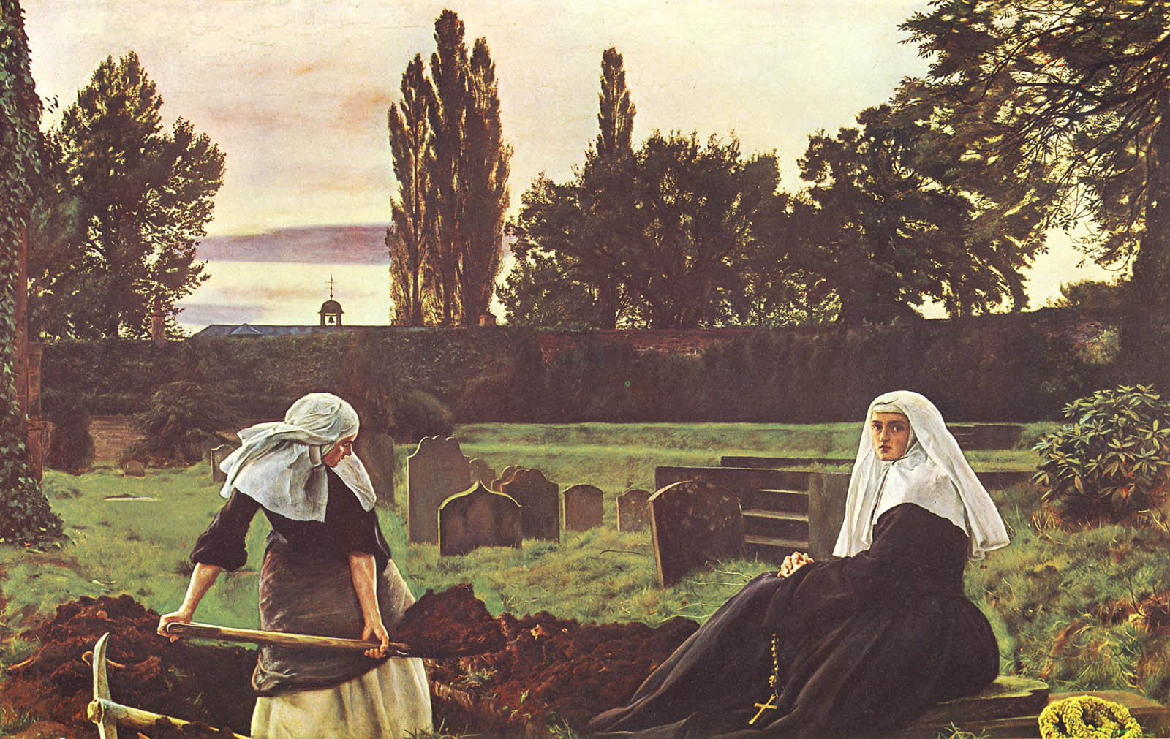
Convents provided women in the middle ages an alternative to married life. Childbirth was often deadly for women, so becoming a nun was a respectable and perhaps attractive alternative.

