Slide 1
11.1 The Byzantine Empire
After Rome split, the Eastern Empire, known as Byzantium, flourishes for a thousand years.

Slide 2
A New Rome in a New Setting
The Eastern Roman Empire
Roman Empire officially divides into East and West in 395.
Eastern Empire flourishes; becomes known as Byzantium
Justinian becomes emperor of Byzantium in 527.
His armies reconquer much of the former Roman territory.
Byzantine emperors head state and church, use brutal politics

Slide 3
Life in the New Rome
New Laws for the Empire
Justinian seeks to revise and update laws for governing the empire
Justinian Code—new set of laws consisting of four main parts
Code regulates much of Byzantine life; lasts for 900 years.

Slide 4
Creating the Imperial Capital
Justinian launches a program to beautify the capital, Constantinople.
Constructs new buildings; builds magnificent church, Hagia Sophia.
Byzantines preserve Greco-Roman culture and learning.

Slide 5
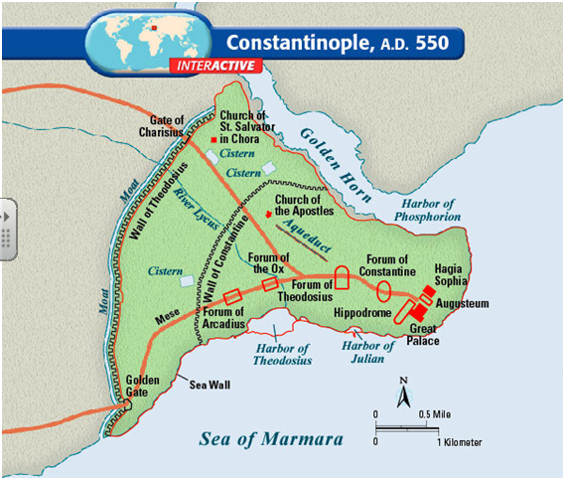

Slide 6
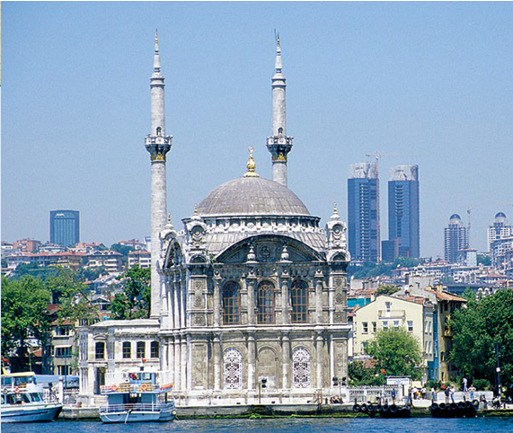

Slide 7
Constantine’s Hectic Pace
City becomes trading hub with major marketplace.
Giant Hippodrome offers chariot races and other entertainment.
Racing fans start riots in 532; the government restores order violently.
Empress Theodora is the powerful wife and adviser to Justinian.

Slide 8
The Empire Falls
Years of Turmoil
Justinian dies in 565; the empire faces many crises after his death.
Attacks from East and West
Byzantium faces attacks from many different groups.
Empire survives through bribery, diplomacy, and military power.
Constantinople falls in 1453; brings an end to the Byzantine Empire.

Slide 9
The Church Divides
A Religious Split
Christianity develops differently in Eastern and Western Roman Empires.
Two churches disagree over many issues, including the use of icons.
Icons are two-dimensional religious images used to aid in prayer.
Leading bishop of Eastern Christianity is known as a Patriarch.
In the West, the pope excommunicates the emperor, banishing him from the church over the iconoclast controversy.

Slide 10
The Primary Causes of the East-West Schism of 1054*
Cause | Eastern Church | Western Church
POLITICAL RIVALRY | Byzantine Empire | Holy Roman Empire
CLAIMS OF PAPACY | Patriarch of Constantinople was considered second in primacy to the bishop of Rome. | Bishop of Rome claimed supremacy over entire church.
THEOLOGICAL DEVELOPMENT | Stagnated after Council of Chalcedon. | Continued to change and grow through controversies and expansion.
FILIOQUE CONTROVERSEY | Declared that the Holy Spirit proceeds from the Father. | Declared that the Holy Spirit proceeds from the Father and the Son.
ICONOCLASTIC CONTROVERSY | Engaged in 120-year dispute over the use of icons in worship; finally concluded they could be used (statues prohibited). | Made constant attempts to interfere in what was purely an Eastern dispute (statues permitted).
*from Robert C. Walton. Chronological and Background Charts of Church History. Grand Rapids: Zondervan, 1986.

Slide 11
The Primary Causes of the East-West Schism of 1054*
Cause | Eastern Church | Western Church
DIFFERENCES IN LANGUAGE AND CULTURE | Greek/Oriental | Latin/Occidental
CLERICAL CELIBACY | Lower clergy were permitted to marry. | All clergy were required to be celibate.
OUTSIDE PRESSURES | Muslims constricted and put continual pressure on Eastern Church. | Western Barbarians were Christianized and assimilated by Western church.
MUTUAL EXCOMMUNICATION OF 1054 | Michael Cerularius anathematized Pope Leo IX after having been excommunicated by him. | Leo IX excommunicated Patriarch Michael Cerularius of Constantinople.
*from Robert C. Walton. Chronological and Background Charts of Church History. Grand Rapids: Zondervan, 1986.

Slide 12
Eastern Orthodox View of the Equality of Patriarchs
Patriarch of Rome
“primacy”
First Among Equals
Patriarch
of
Constantinople
Patriarch of Alexandria
Patriarch of Antioch
Patriarch of Jerusalem
“First among equals” merely meant that the Pope’s opinion was the one that was asked first. As noted above, the distance of Rome from the east could imply impartiality. But the Eastern Orthodox did not hold that the Pope’s opinion was law for the entire Church. In the ancient “pentarchy” (the five “sees” listed below) he would preside as the “chair” in an ecumenical council. This did not give him any authority over other jurisdictions however.

Slide 13
Roman Catholic View of “Papal Supremacy”
Pope of Rome
Supreme above other provinces
Patriarch of
Constant-inople
Patriarch of Alexandria
Patriarch of Antioch
Patriarch of Jerusalem

Slide 14
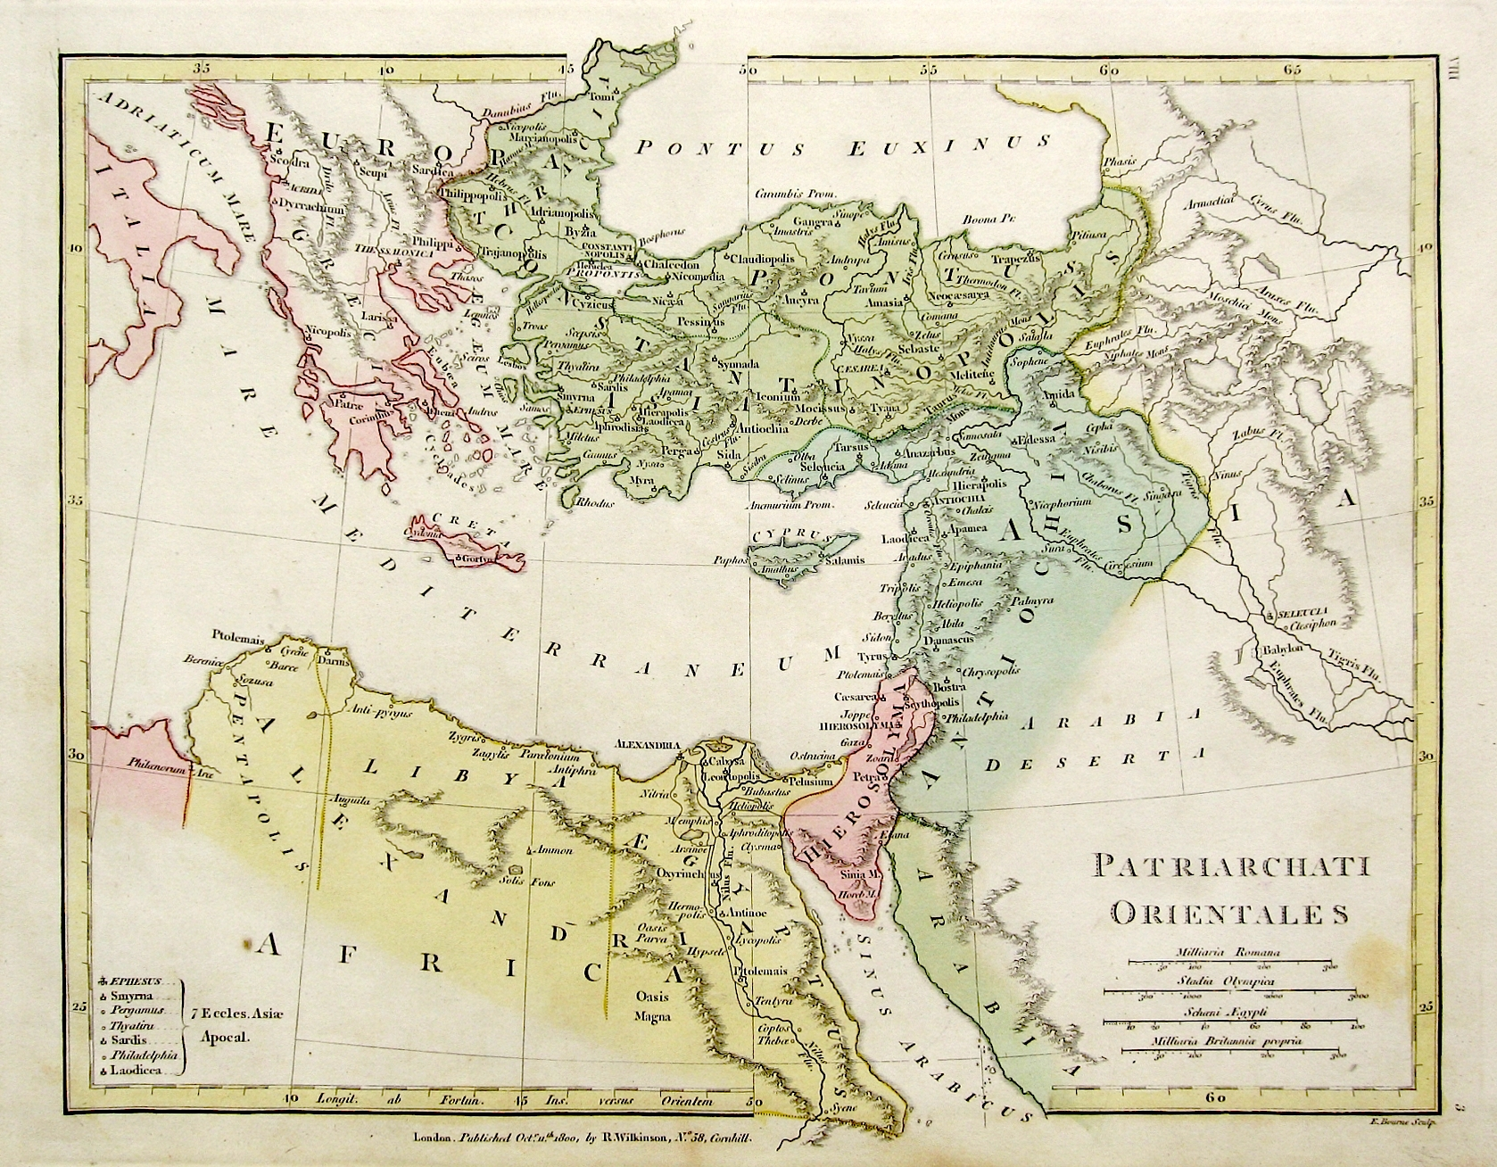
Effect of Islamic Conquests
Constantinople
Rome
Antioch
Alexandria
Jerusalem
The Islamic conquests of the 7th and 8th Centuries effectively eliminate any influence of the patriarchates of Jerusalem, Antioch, and Alexandria in the Christian world. Constantinople had already been given second place in “primacy” to Rome, therefore the two main “rival” patriarchates are Rome and Constantinople. This sets up the political conflict that was to come and be exacerbated by the linguistic, liturgical, and theological differences between Rome and Constantinople.

Slide 15
Linguistic Disunity
West—dominant language Latin
East—dominant language Greek
Decline in bilingualism after the fall of the western empire
Linguistic disunity develops into cultural disunity
Different religious rites and liturgy develop
Different approaches to Christian doctrine emerge

Slide 16
Iconoclast Controversy
The Byzantine Emperor Leo III outlawed the veneration of icons in the 8th century. Some believe this to be a result of the pressures of Islam. Those who were against the use of icons in the church were called “iconoclasts.” The first period of iconoclasm occurred from 730-787 C.E. A second period of iconoclasm occurred from 814-842 C.E.
Arguments usually surrounded the understanding of how to depict the two natures of Jesus Christ in Christian theological teaching. “Iconodules” (supporters of the use of icons) believed that to disallow depicting Jesus artistically denied the incarnation.
The western church rejected iconoclasm. However, icons, which are generally two dimensional works of art were generally not used. Instead, statues were allowed in the western church .

Slide 17
Different Church/State Relations
Caesaropapism in the east subordinated the church to the religious claims of the dominant political state. In the Byzantine Empire, the emperor had supreme authority over the church.
In the west the church was relatively independent of the state due to the fall of the western empire and a lack of imperial authority. Later, when strong kingdoms emerge in Western Europe, the investiture controversy surfaces creating church/state conflicts.

Slide 18
Pope and patriarch excommunicate each other over religious doctrines and disputes over jurisdiction.
Eastern and Western churches officially split in 1054.
West—Roman Catholic Church
East—Orthodox Church

Slide 19
Byzantine Missionaries Convert the Slavs
Eastern Orthodox missionaries seek to convert the northern peoples known as the Slavs.
Missionaries create the Cyrillic alphabet—the basis for many Slavic languages.
Alphabet enables many groups to read the Bible.

